Slide 1
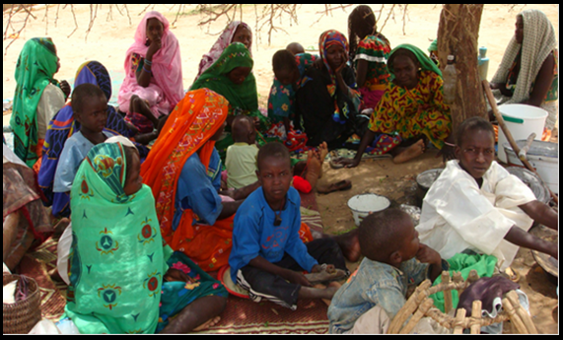
Make Your Collections Active NOW!
Audrey Powers, Associate Librarian, University of South Florida

Slide 2
Objectives
Generate interest in your collections.
Develop faculty/student collaborative relationships.
Infuse library resources and services into academic programs.
Showcase your activity beyond the walls of the academy.

Slide 3
Prompt Books

Slide 4
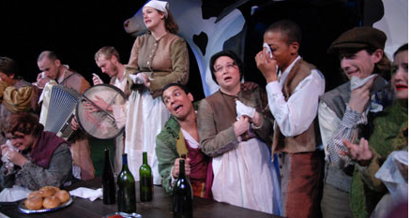
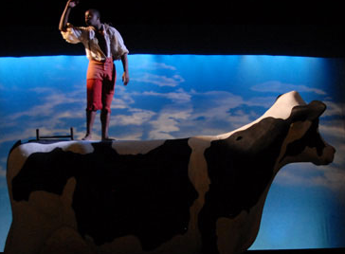
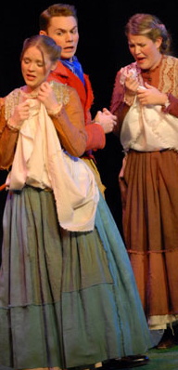
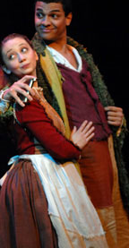
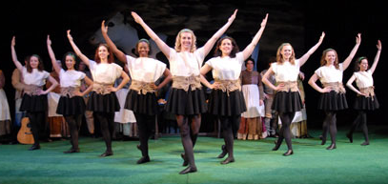
The Shaughraun
USF School of Theatre & Dance

Slide 5
USF iSTEAM
History of Visual Arts
Select objects on campus: Architecture, Public Art and Special Collections
Connect = Librarians, Faculty and Project Coordinator
Create records for a database
Teach = Fields / Databases / RESEARCH

Slide 6
Picasso’s Bust of a Woman

Slide 7
Picasso’s Bust of a Woman

Slide 8
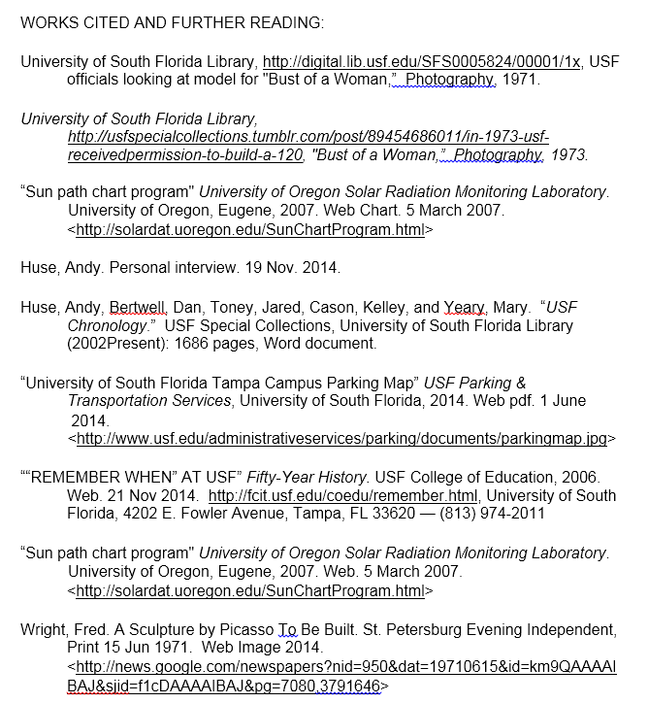

Slide 9
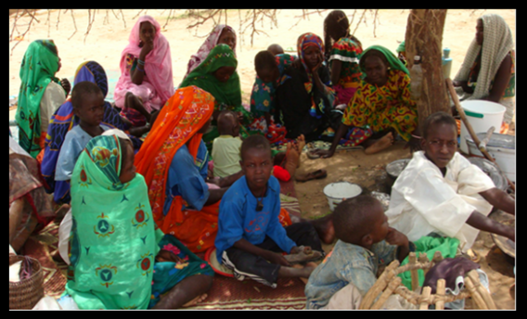
What the Heart Remembers

Slide 10
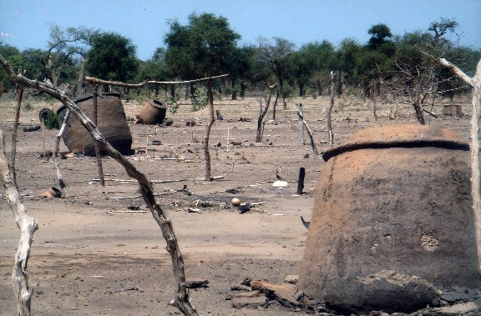
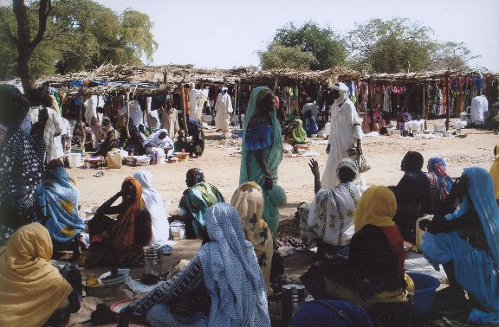
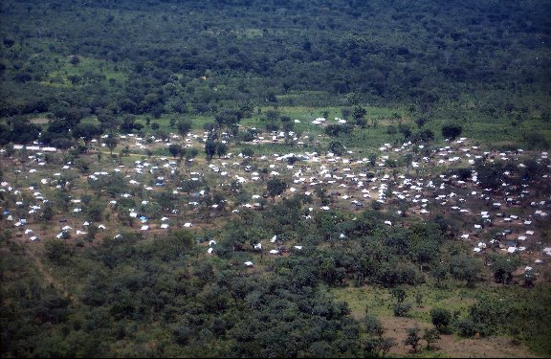
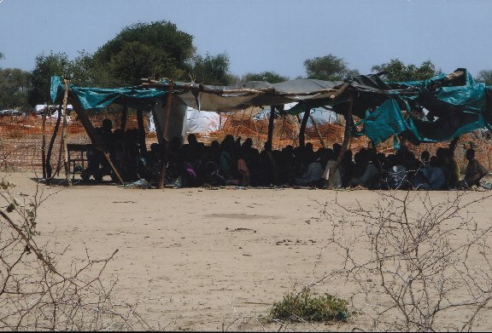

Slide 11
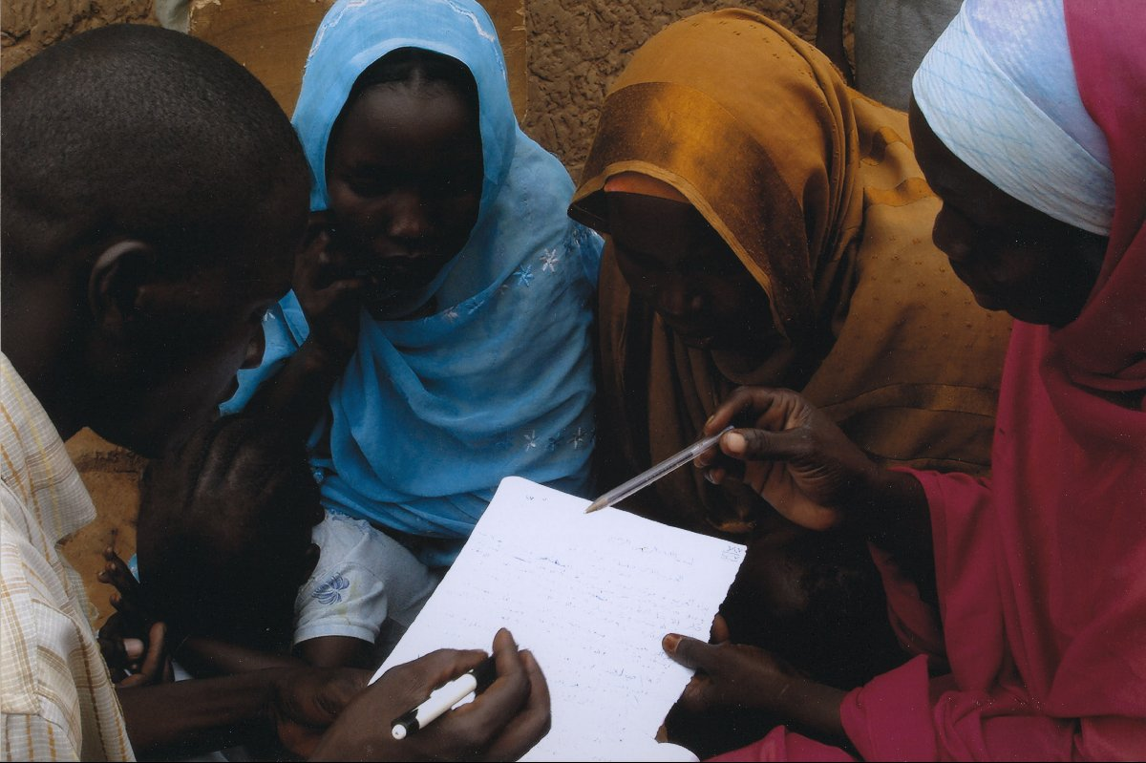

Slide 12
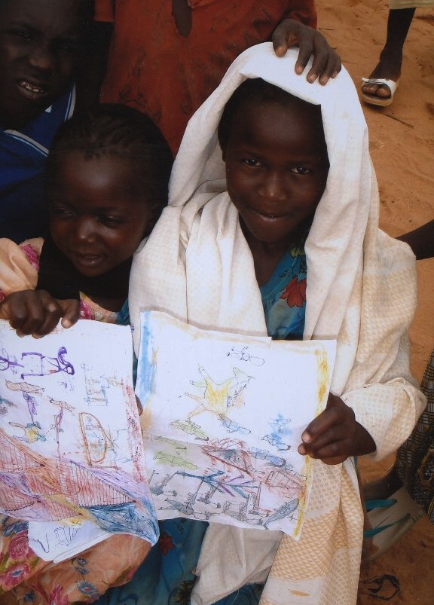

Slide 13
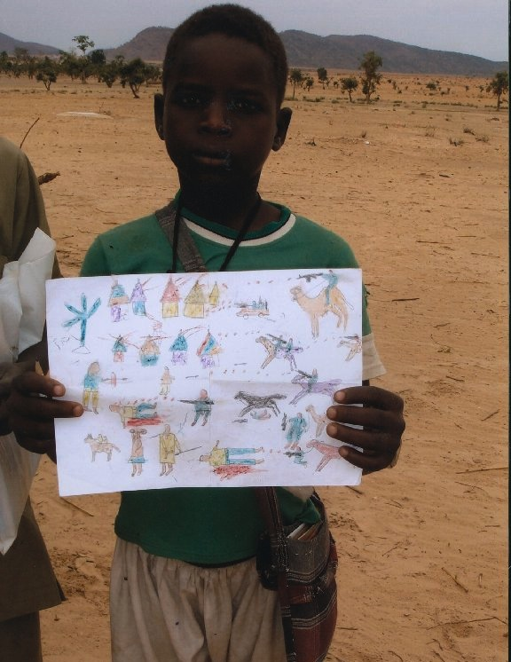

Slide 14
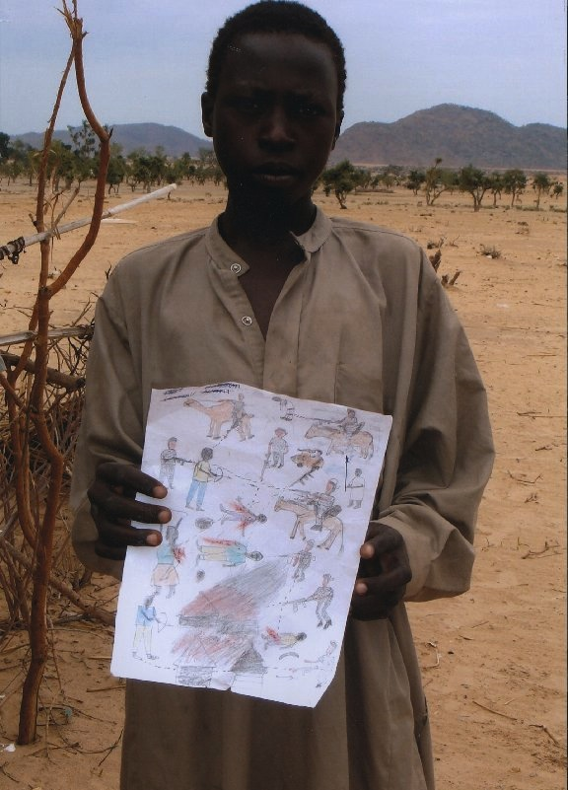

Slide 15
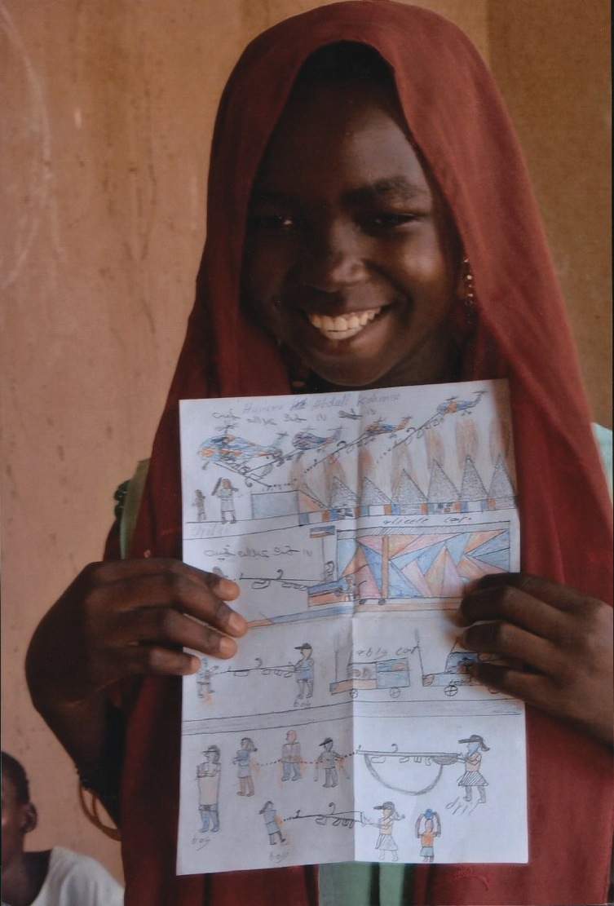

Slide 16
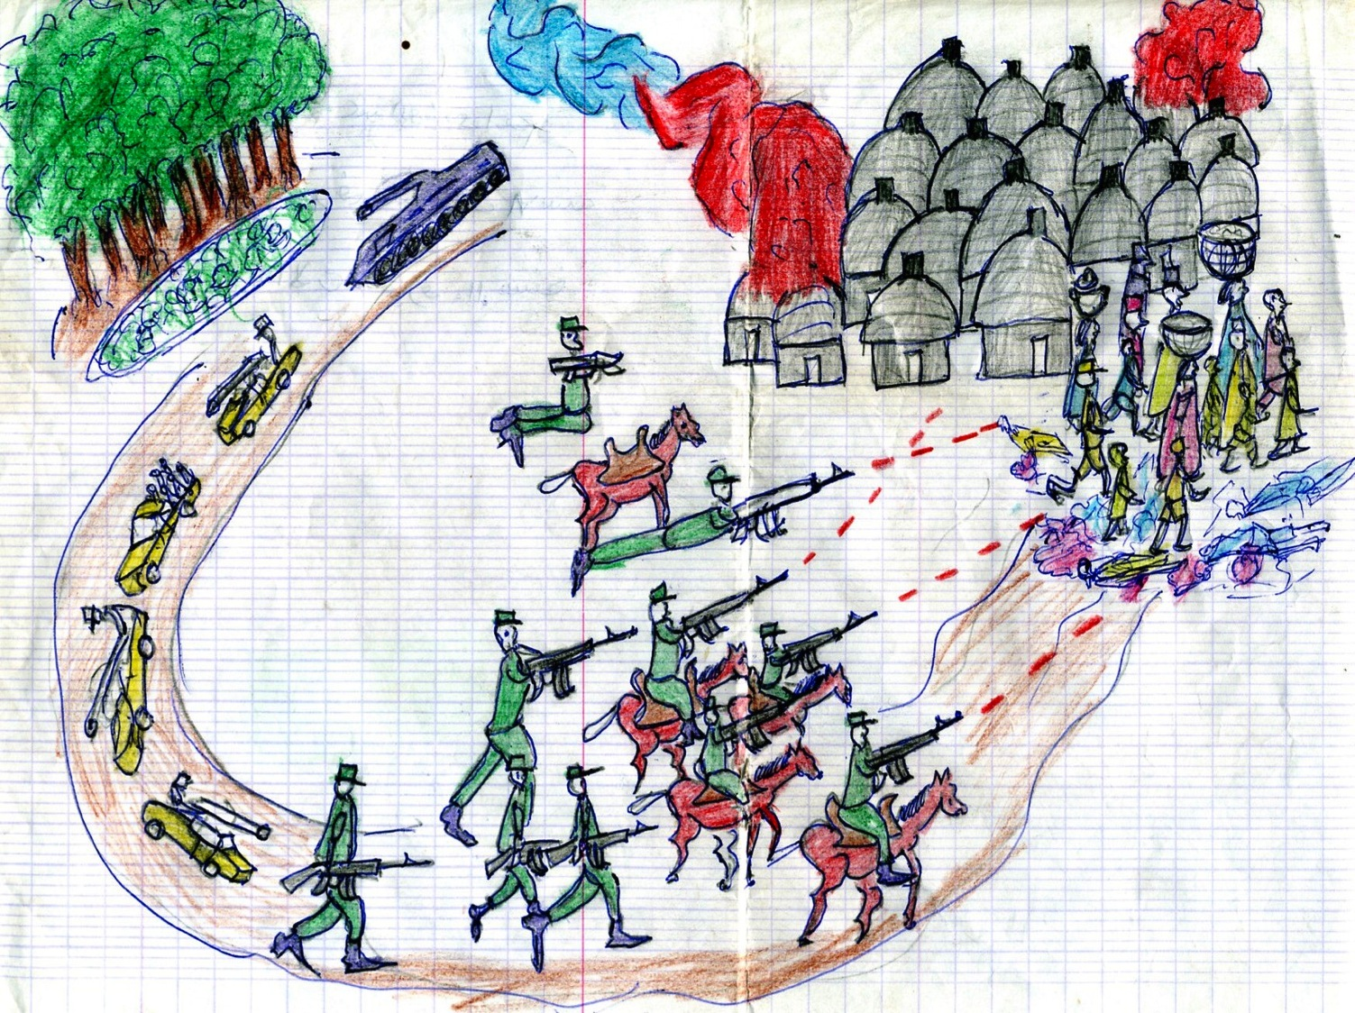

Slide 17
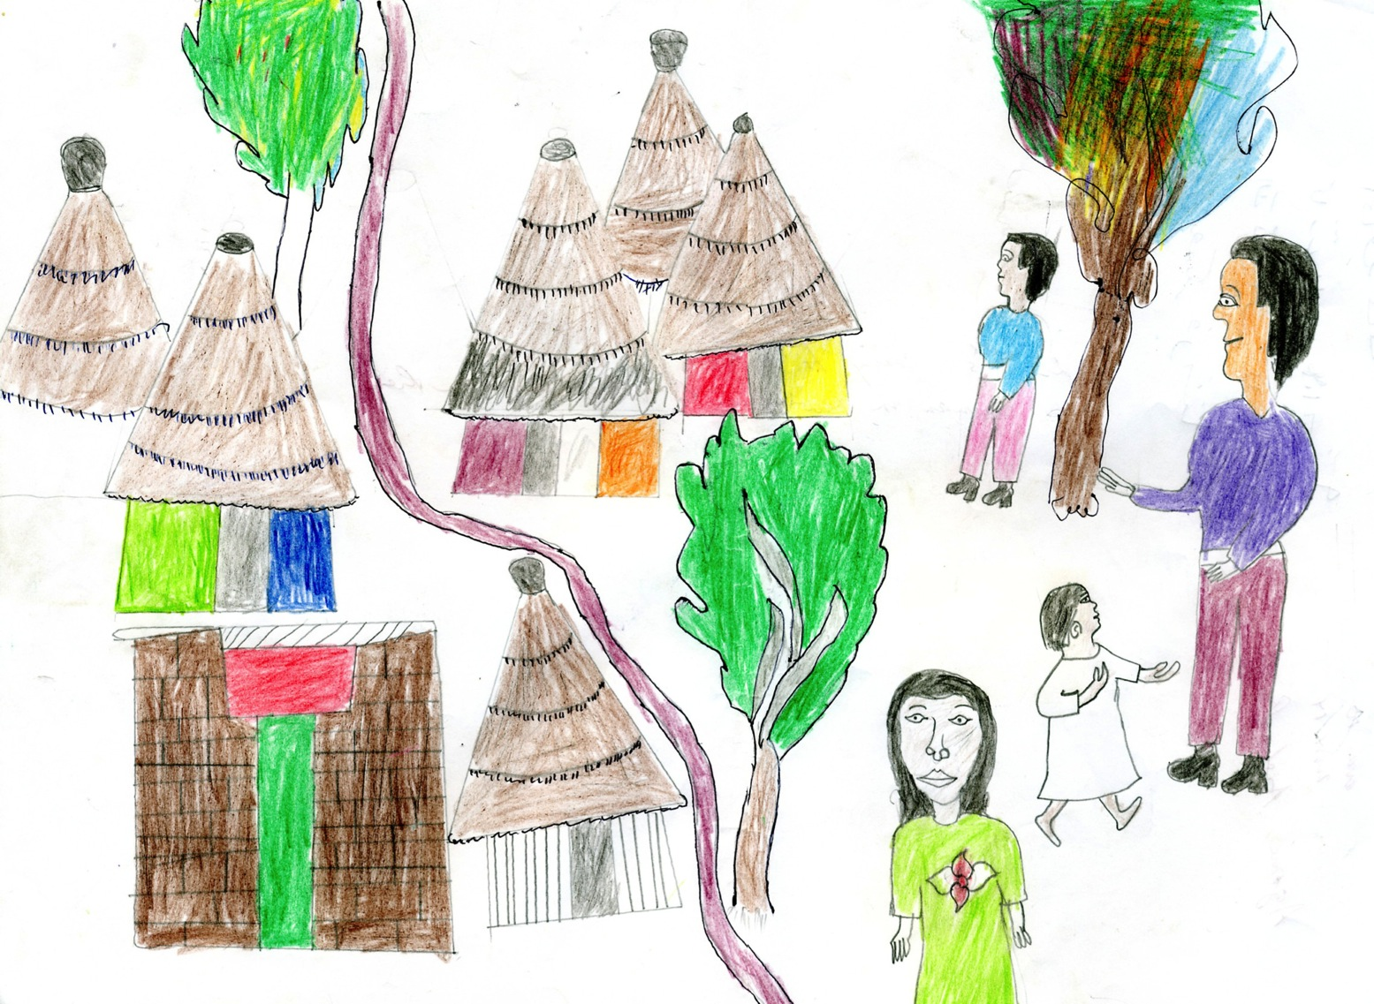

Slide 18
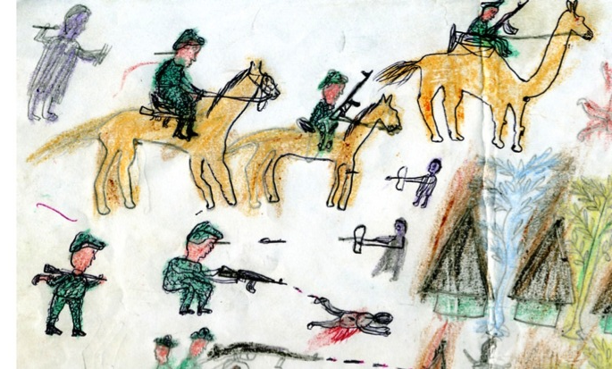
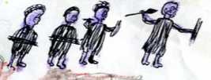
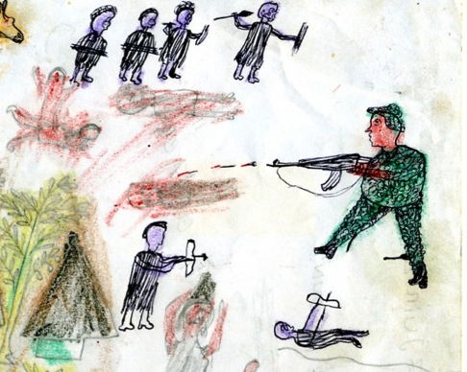
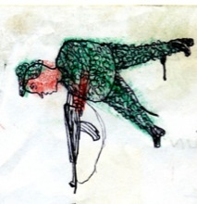
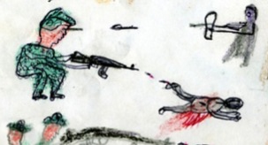
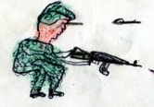
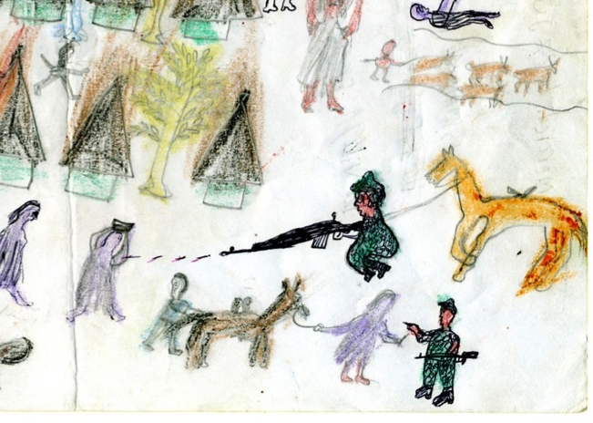
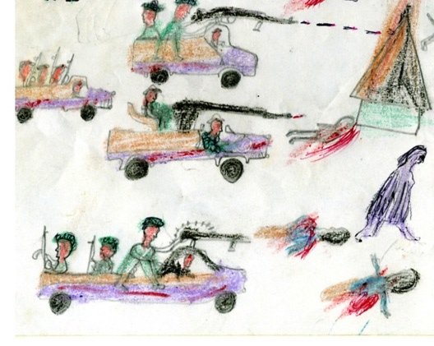
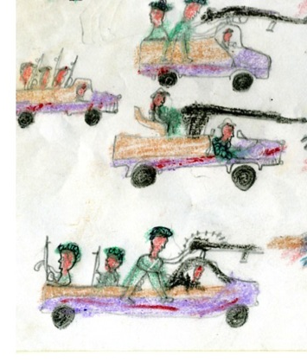

Slide 19
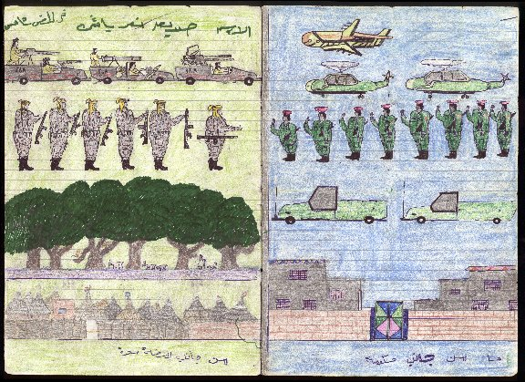

Slide 20
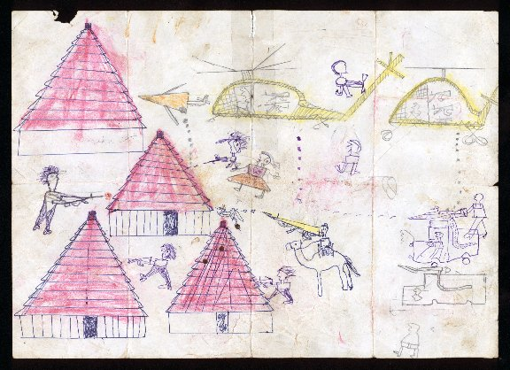

Slide 21
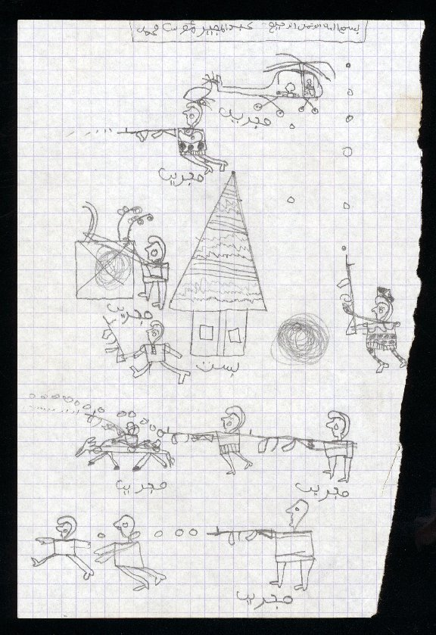

Slide 22
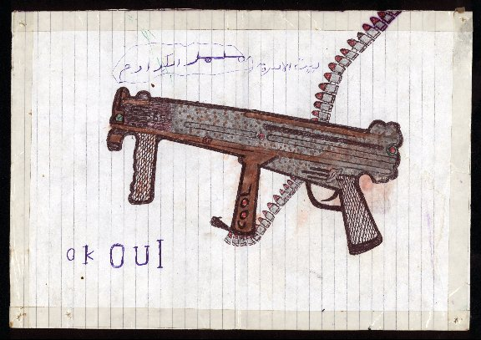

Slide 23
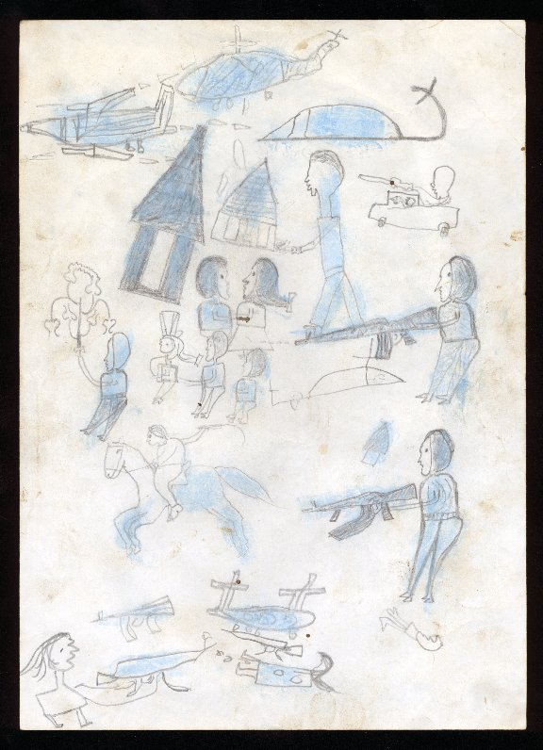

Slide 24
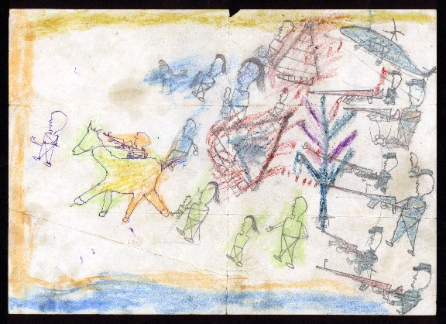

Slide 25
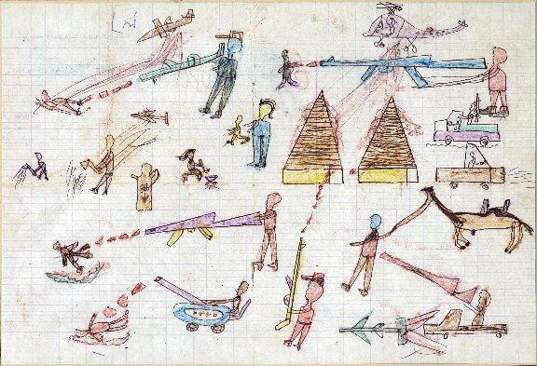

Slide 26
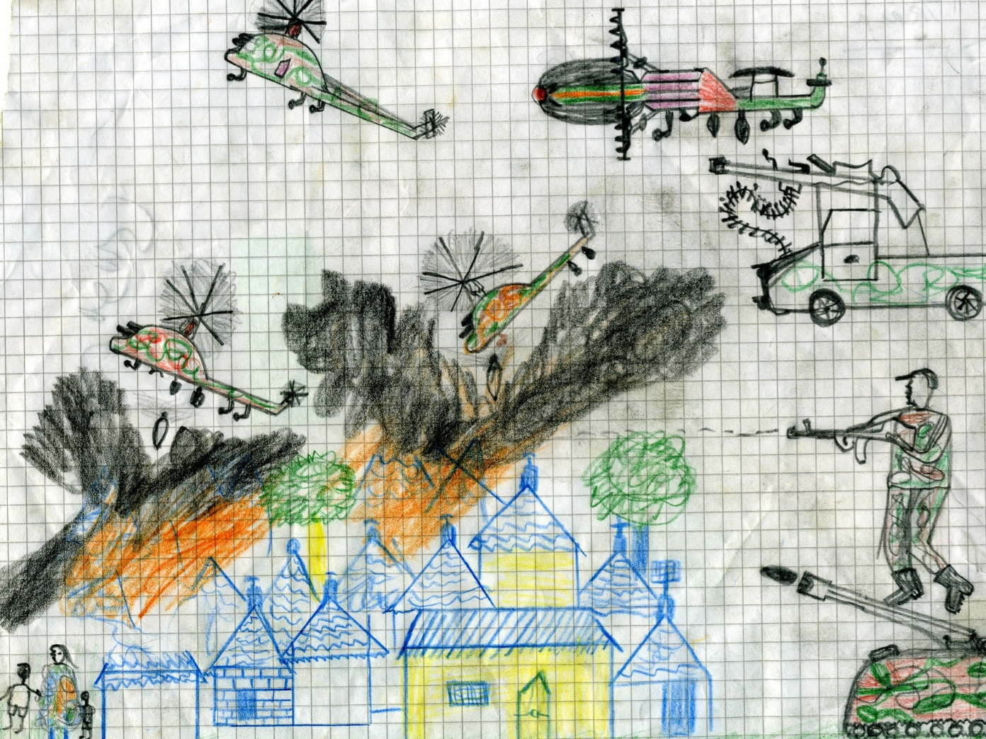

Slide 27
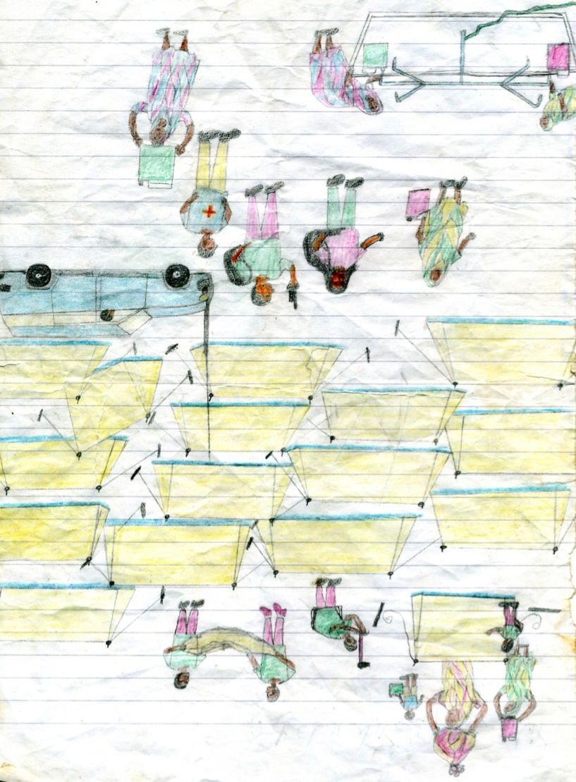

Slide 28
It was as if we had been summoned

Slide 30
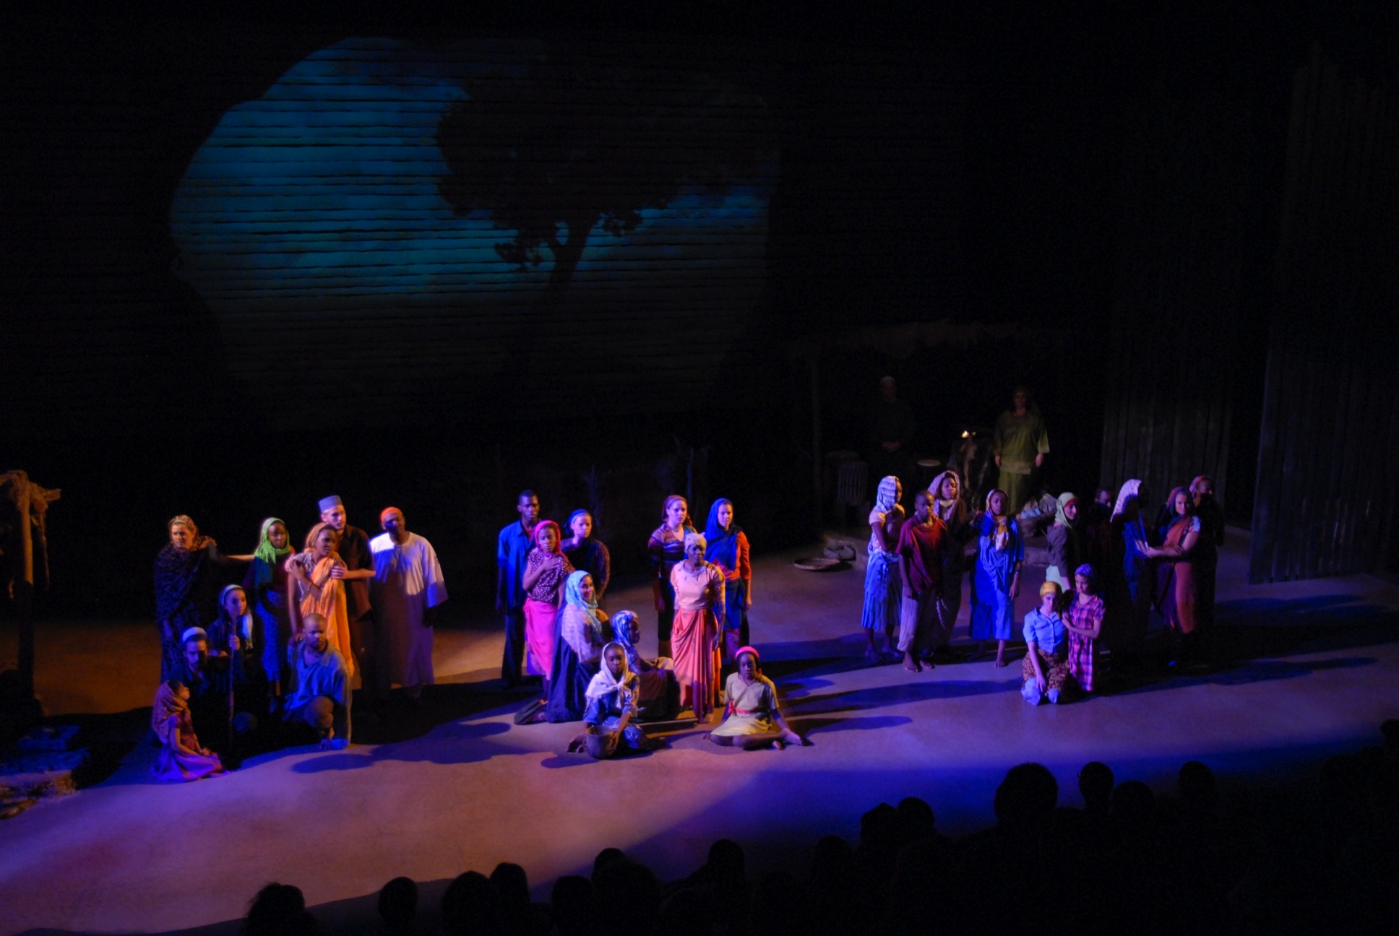

Slide 31
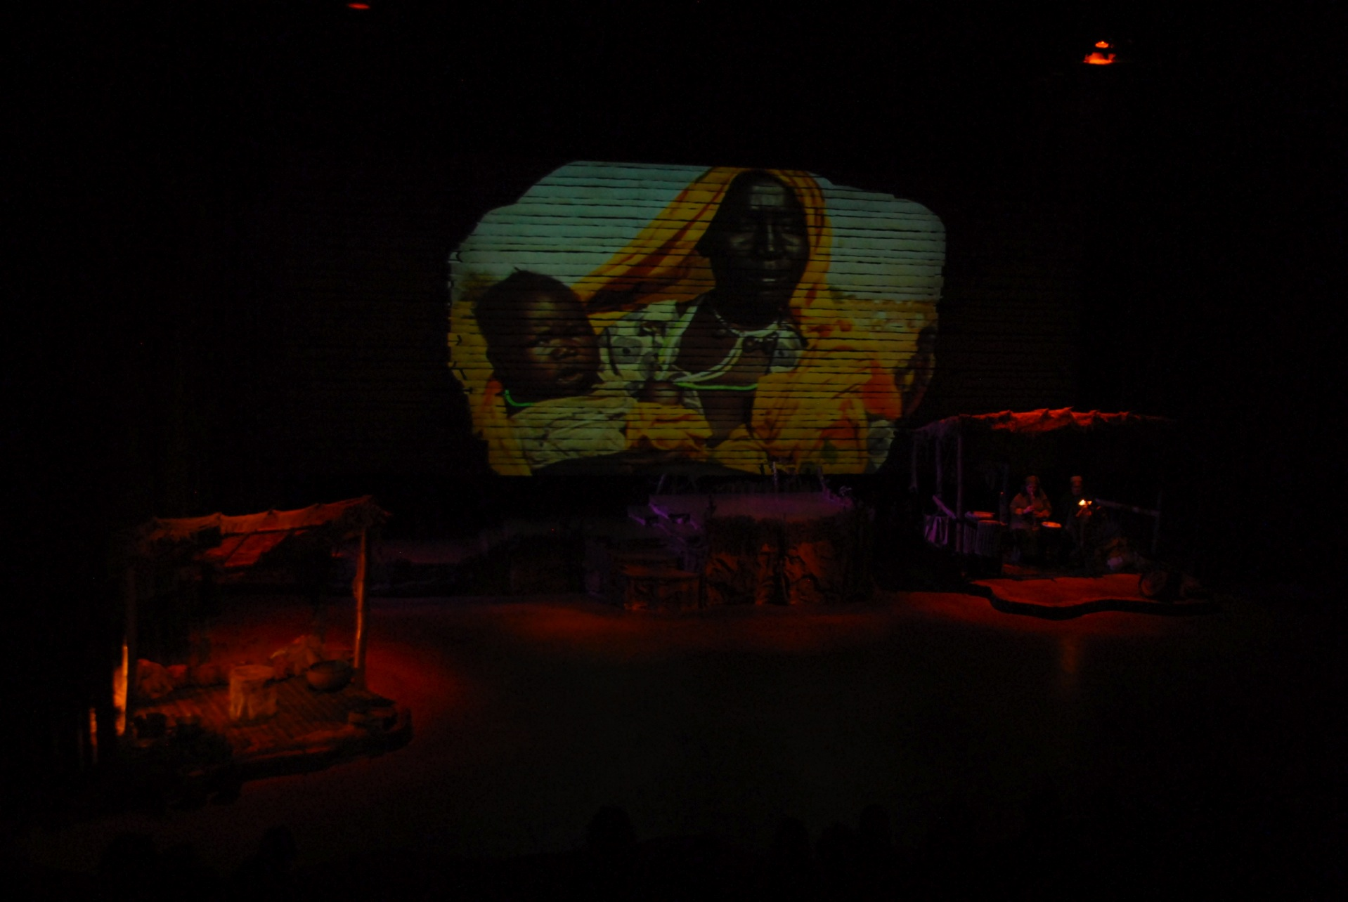

Slide 33
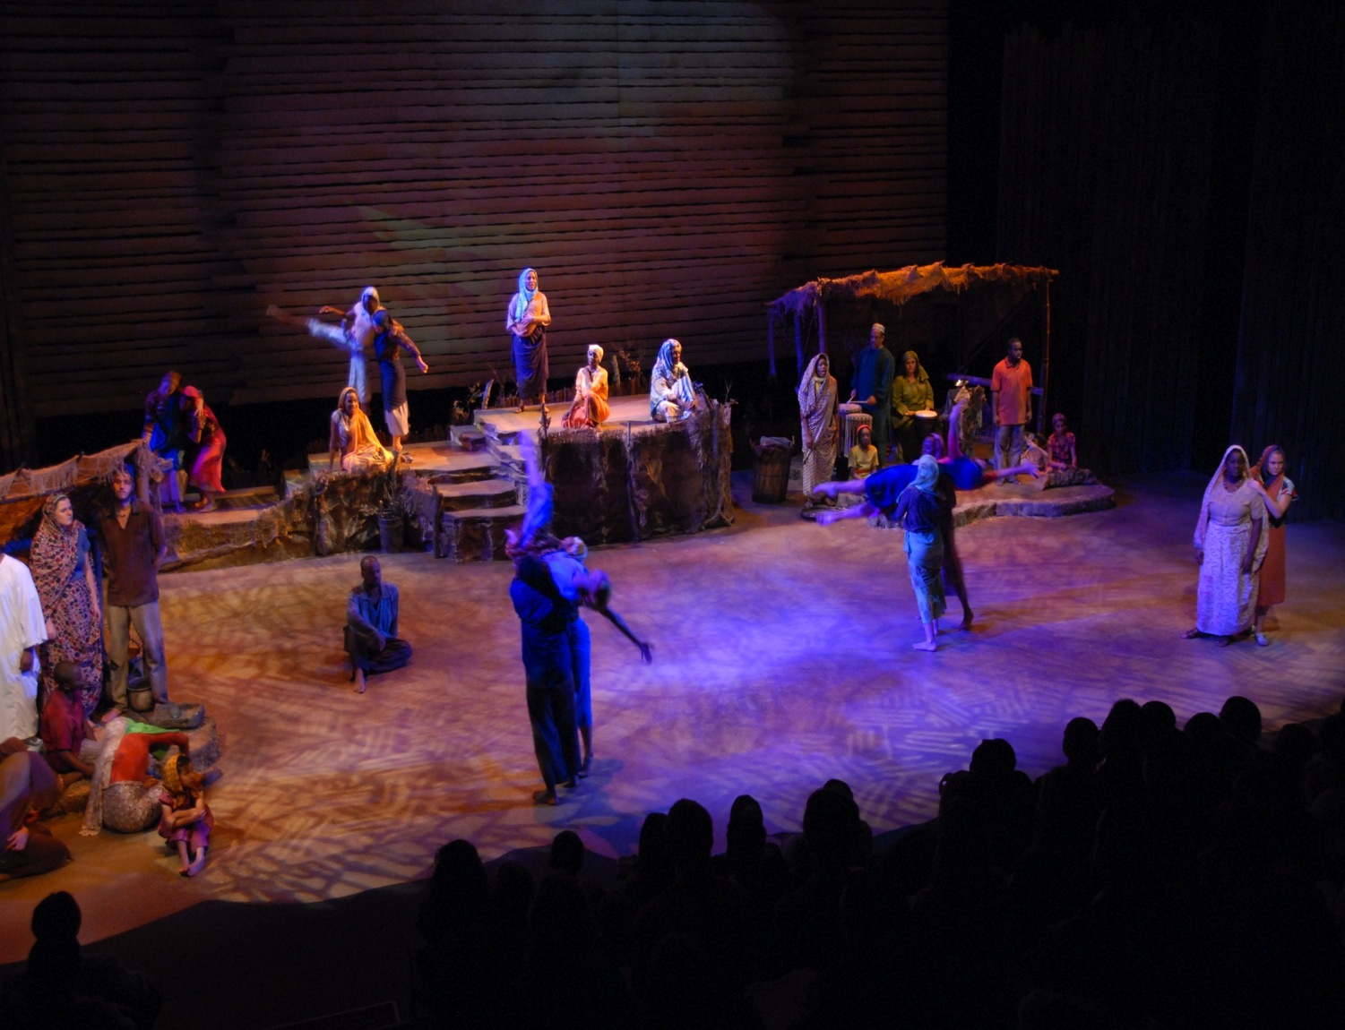

Slide 34
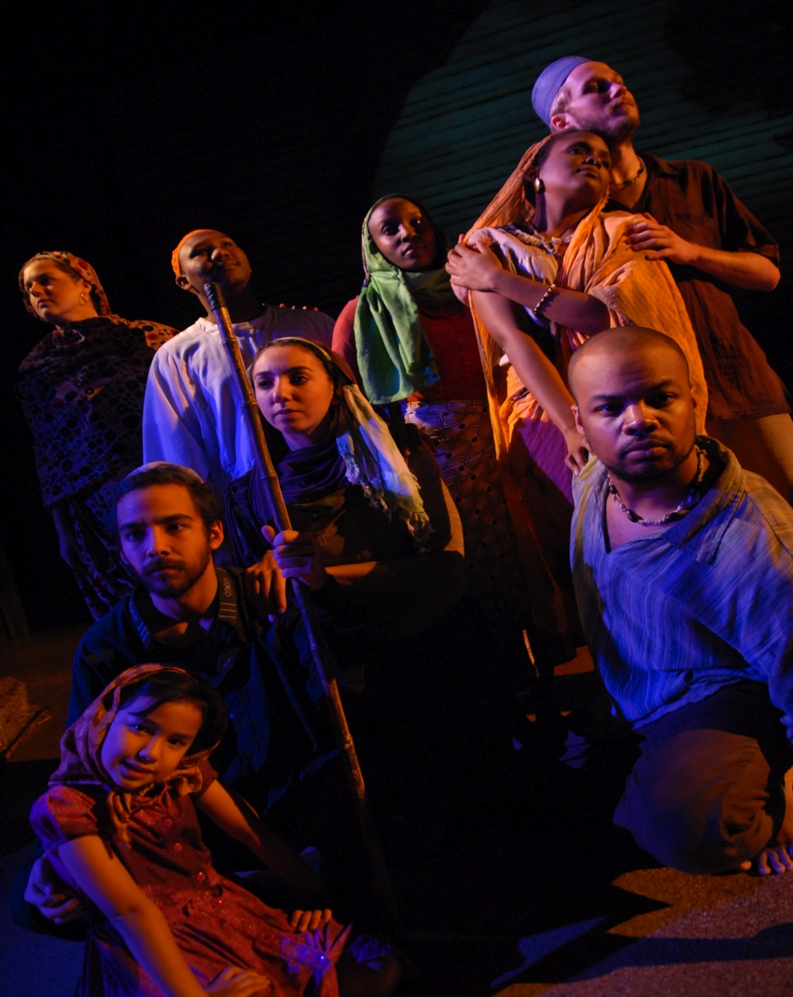

Slide 35
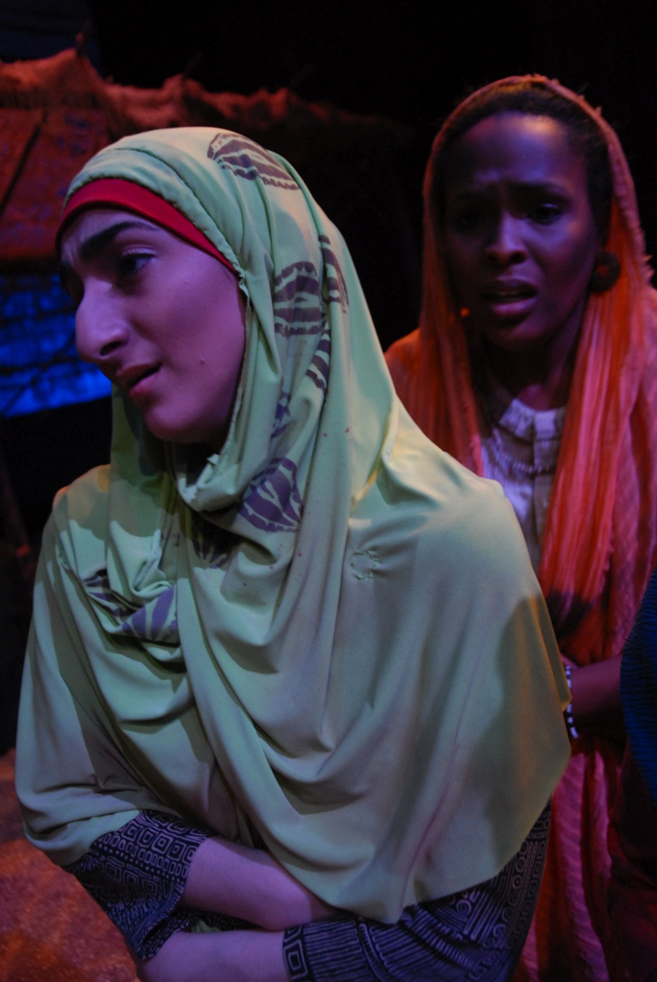

Slide 36
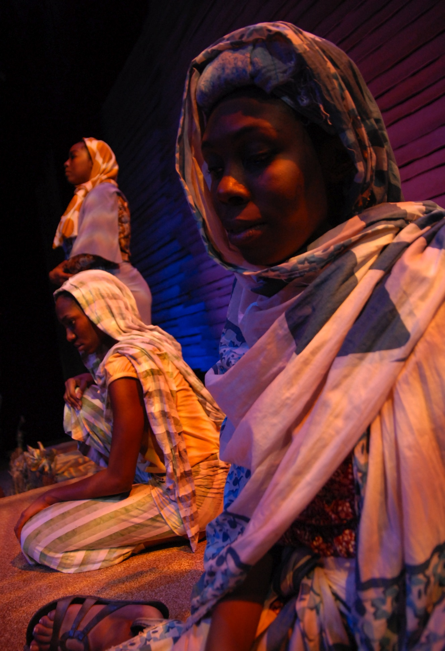

Slide 37
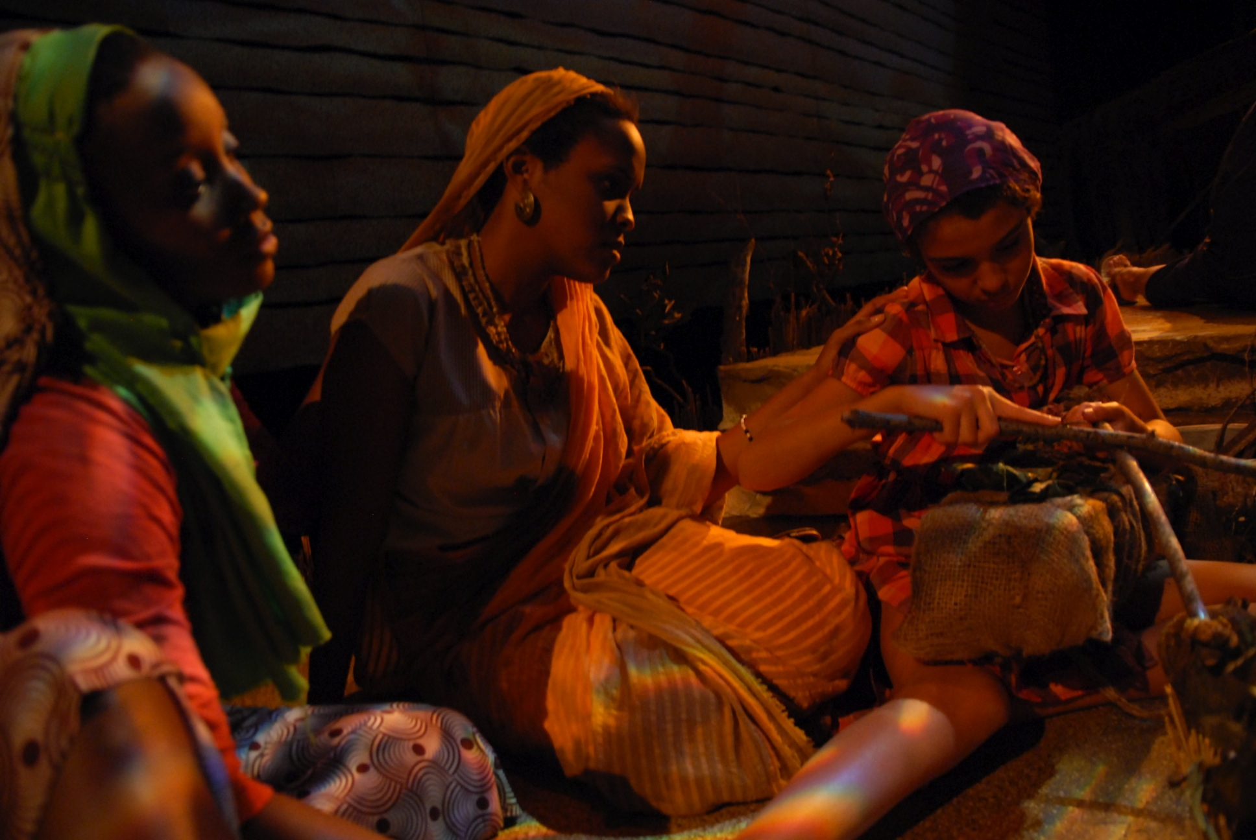

Slide 38
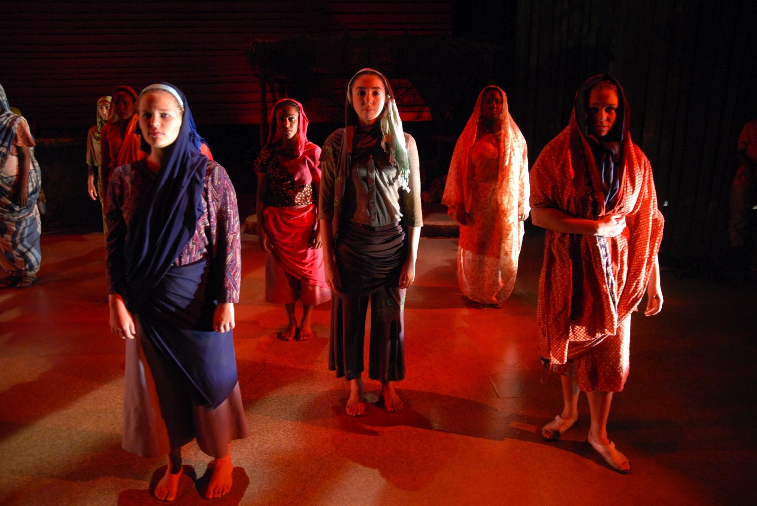

Slide 39
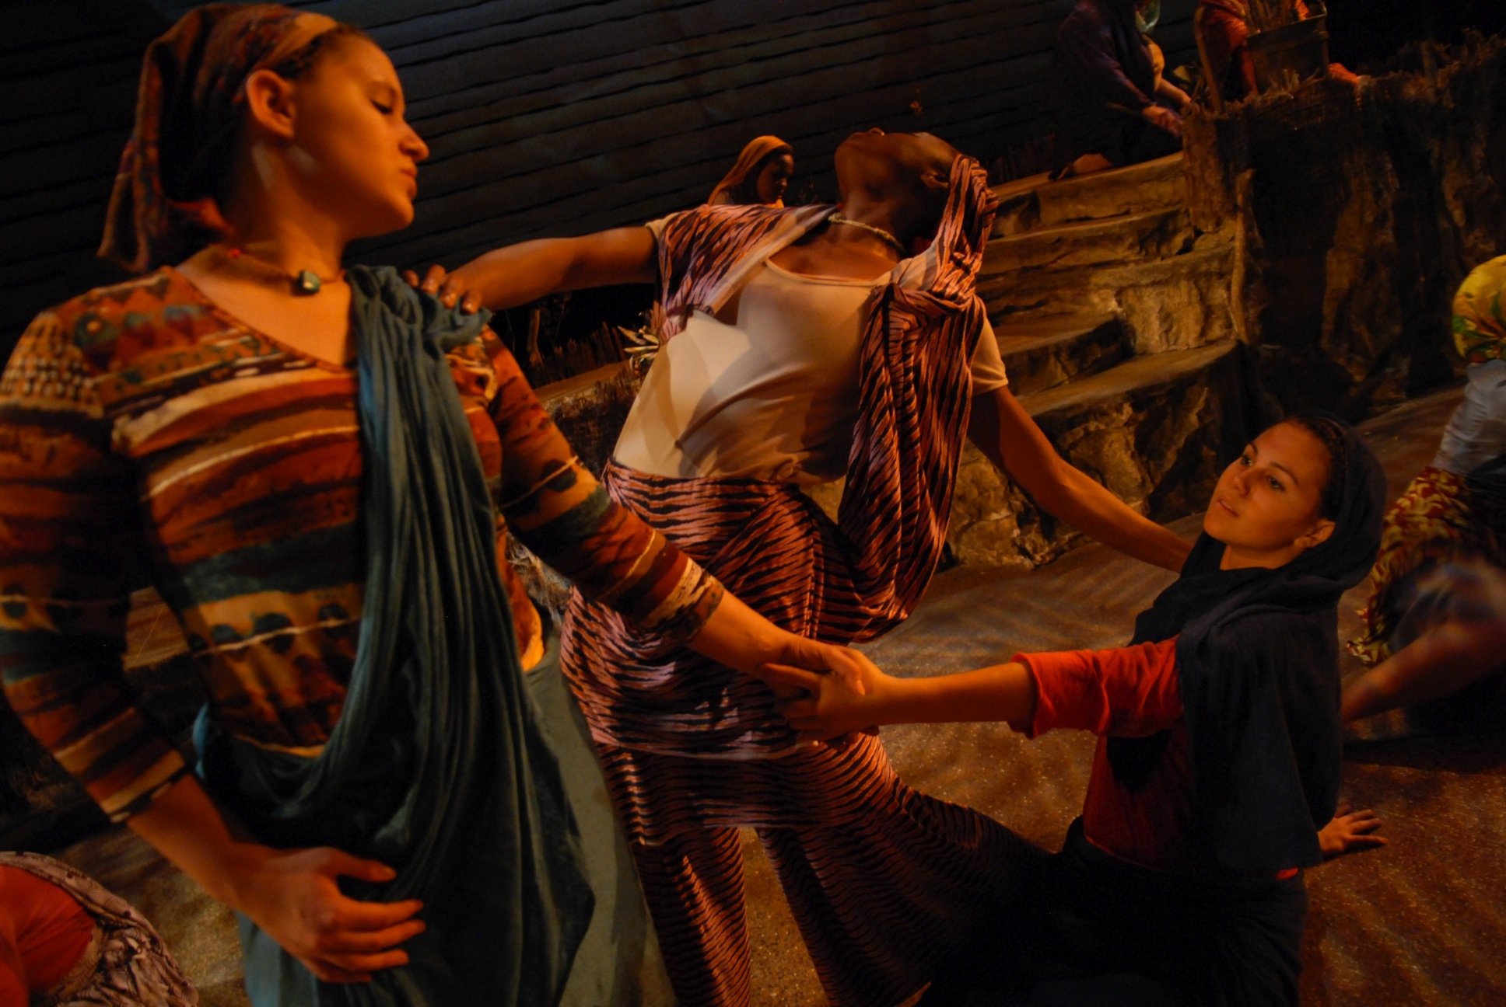

Slide 40
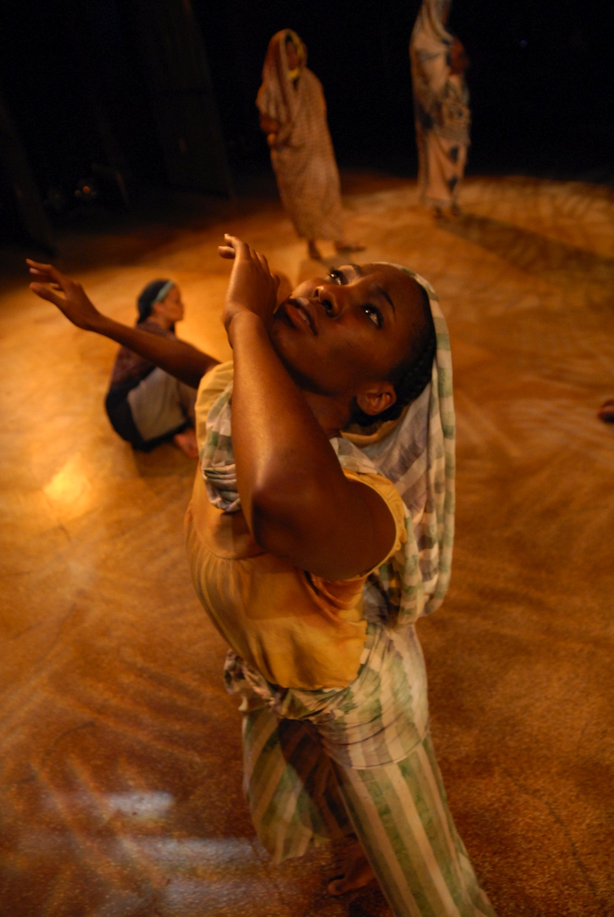

Slide 41
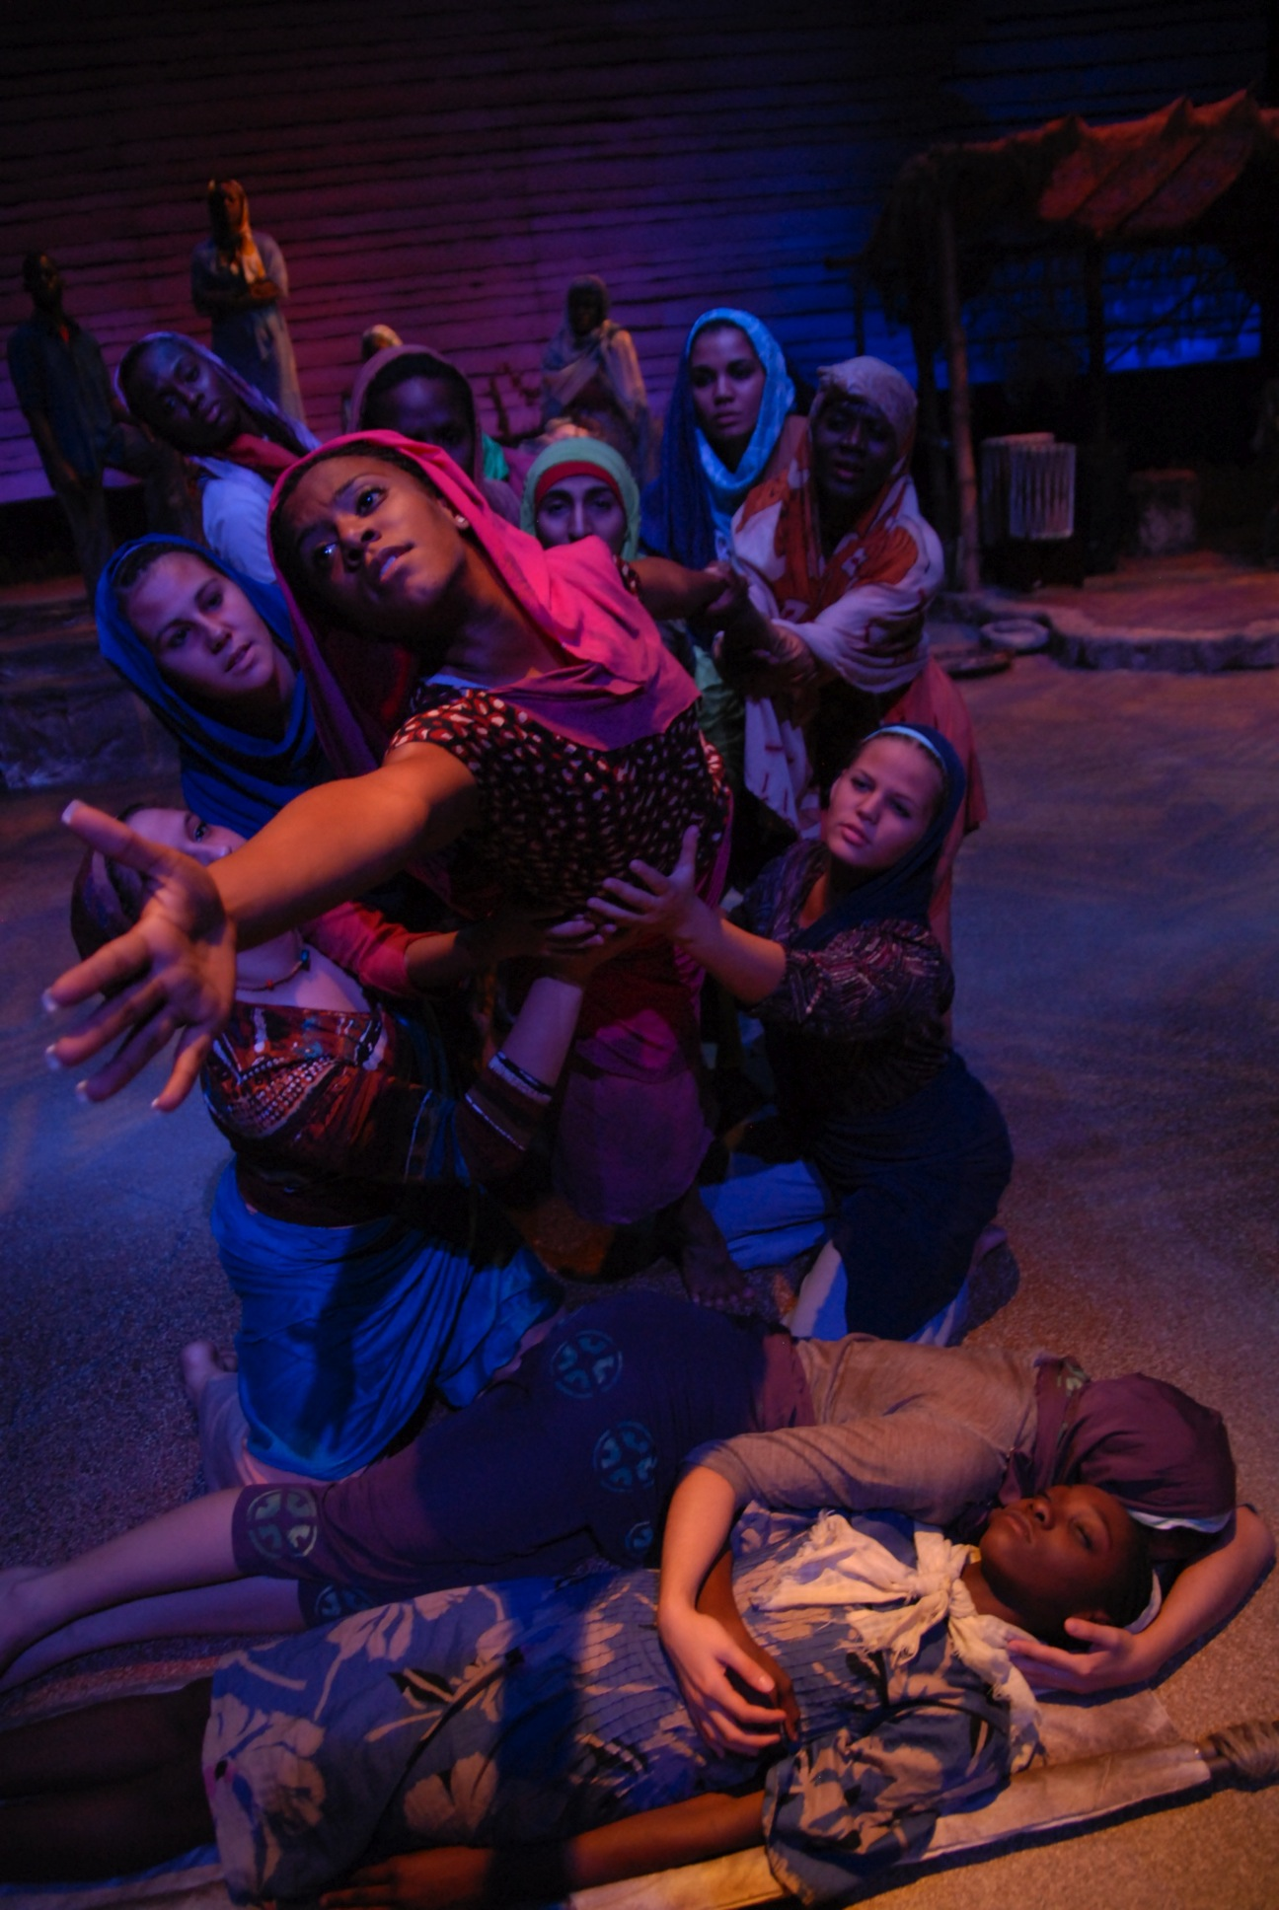

Slide 42
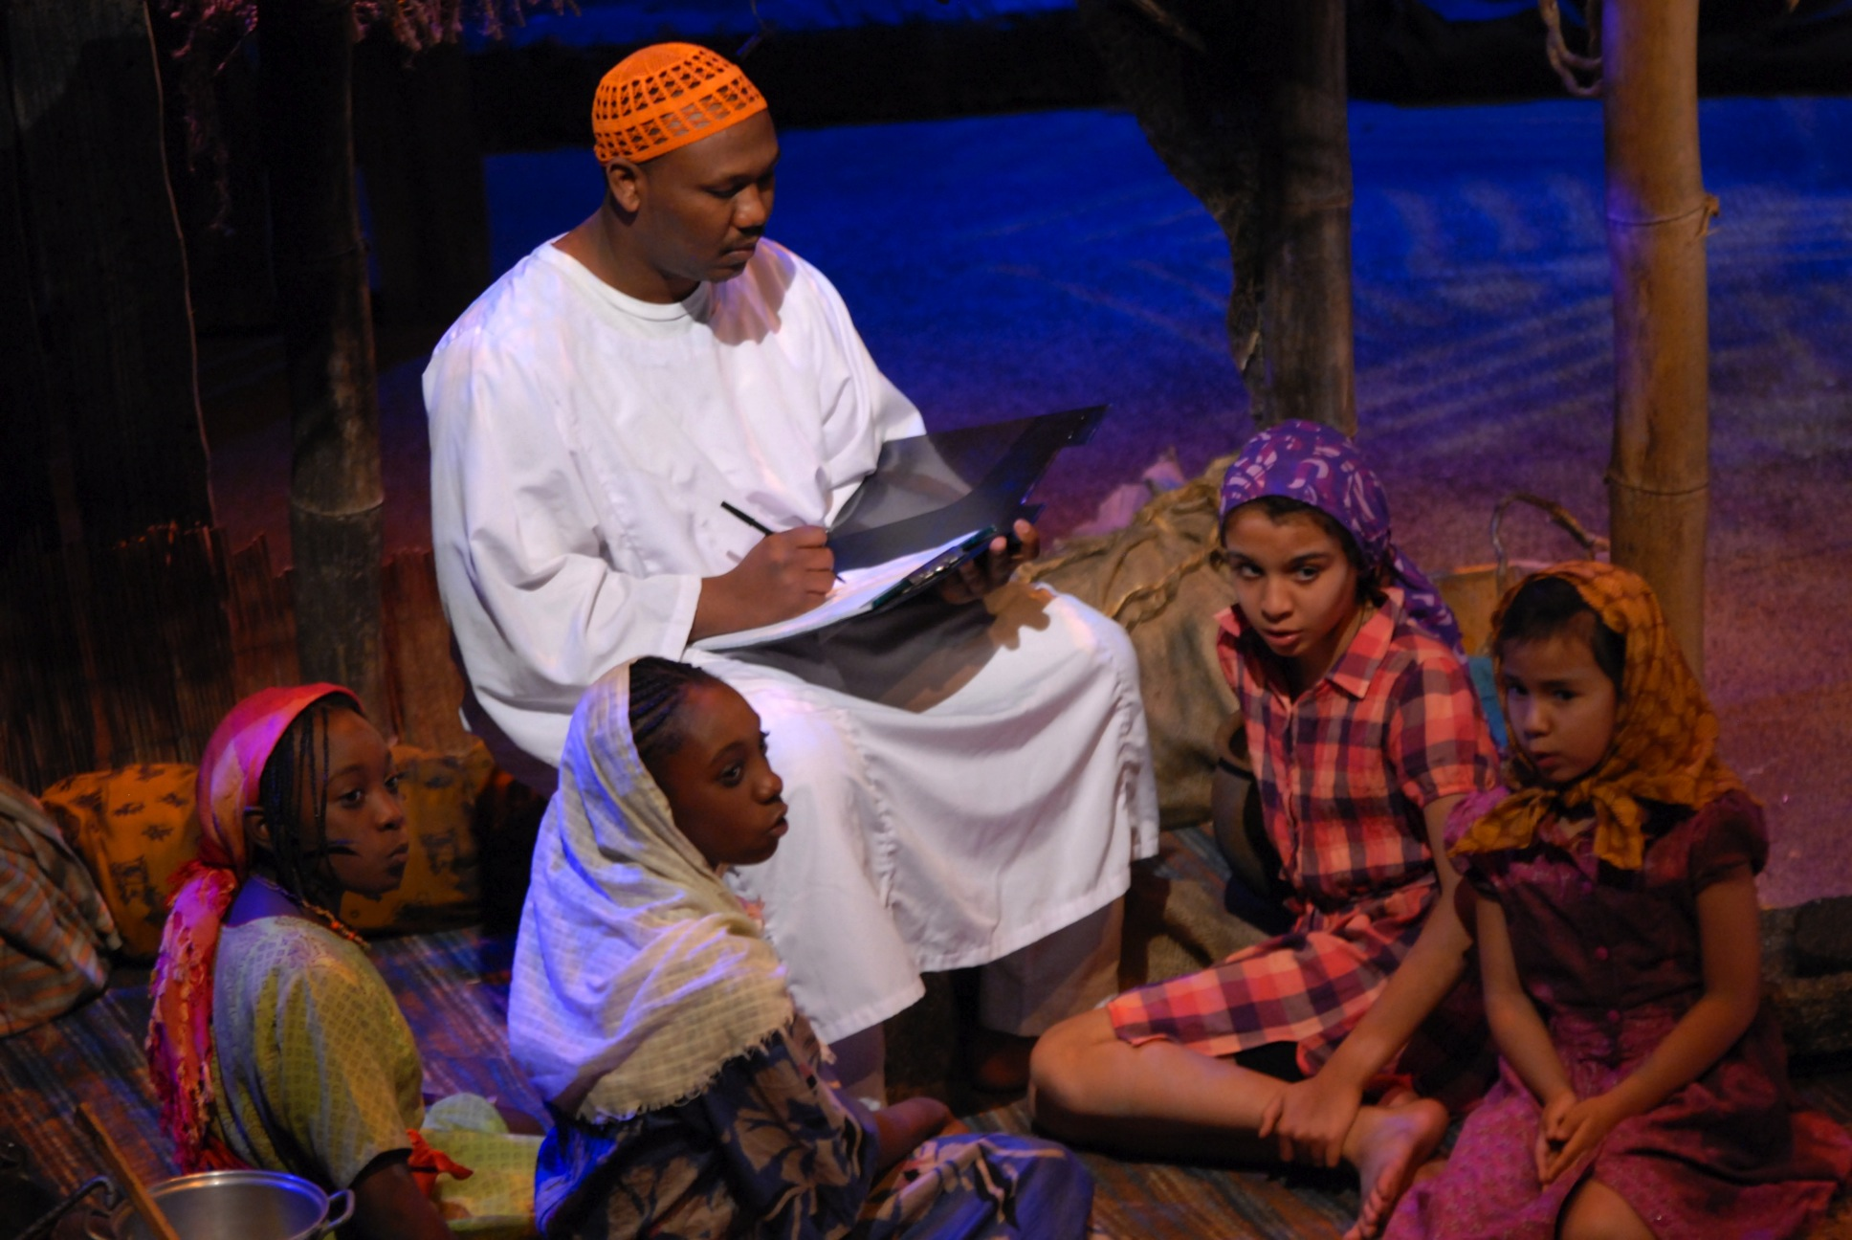

Slide 43
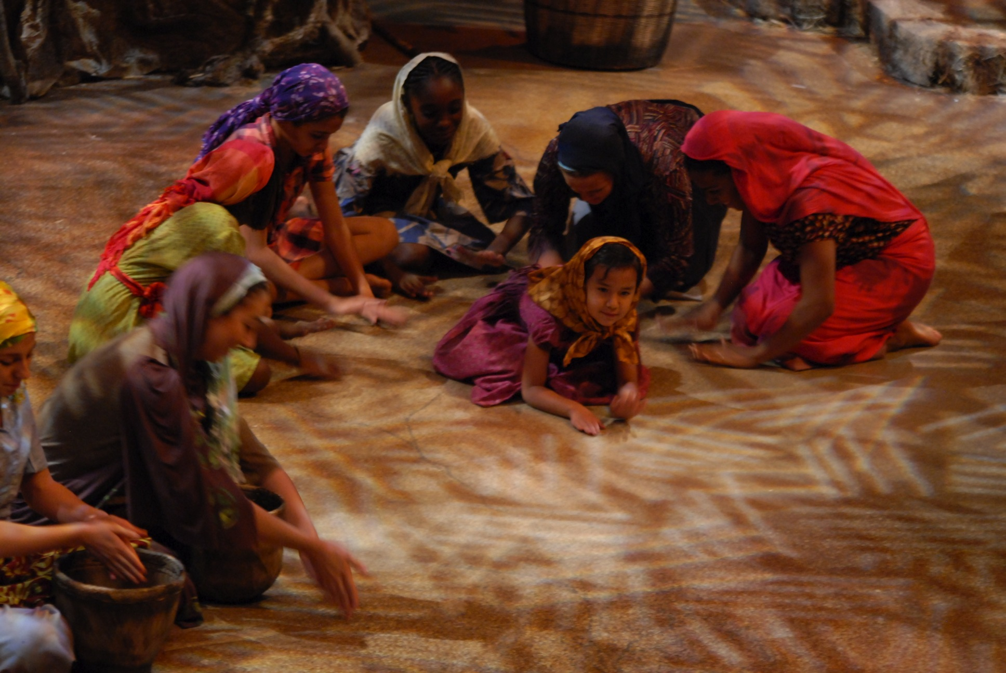

Slide 57
Shall I Tell You My Darfur? Village Portraits Place of Man Women and Children: Walking…Walking…Walking Adam’s Song Teresa Children at Play The Road to Water The Camp Love Duets Death, Burial and Sorrow: Let the Dad Bury the Dead Resilience and Hope: This is Not the Time

Slide 58
Edinburgh Fringe Festival

Slide 60
Objectives
Generate interest in your collections.
What collections do you have that could be showcased?
How can you generate interest in those collections?
What active learning strategies would you employ to create excitement and enhance learning?

Slide 61
Objectives
Develop faculty/student collaborative relationships.
How can you enhance your collaborations with students?
How can you enhance your collaborations with faculty?
Can you develop relationships with faculty and students in which they look to you as a source of inspiration?

Slide 62
Objectives
Infuse library resources and services into academic programs.
What types of resources could be used to enhance the learning experience?
What services do you offer that would benefit researchers working on creative projects?

Slide 63
Objectives
Showcase your activity beyond the walls of the academy.
Where could you showcase your projects?
Is there funding available?
How can you acquire funding?
What about marketing and public relations?

Slide 64
Thank You Audrey Powers Associate Librarian, University of South Florida apowers@usf.edu

