Slide 1
Killing It with Kindness: Incorporating Sustainable Assessment through Kindness Audits
Virtual Conference Webcast
March 26, 2015
Association of College and Research Libraries Conference, Portland, Oregon
Jessica Olin and Joe Hardenbrook
Twitter: @olinj and @mrlibrarydude #acrlkindness
Email: librarykindnessaudit@gmail.com

Slide 2
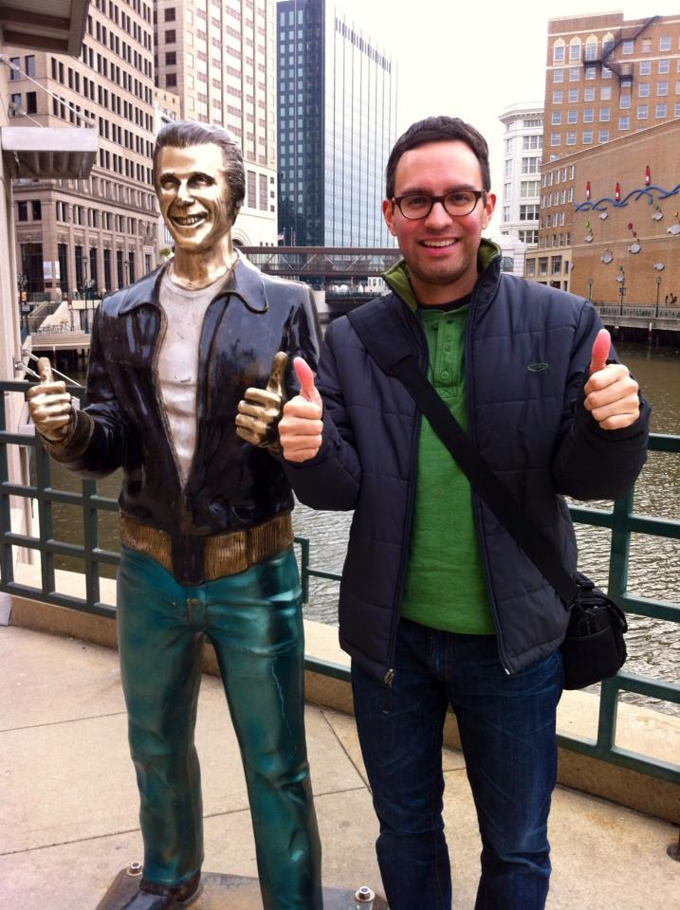
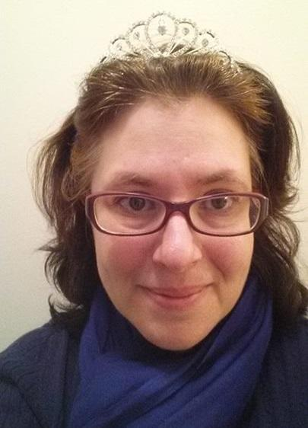
Speakers
Joe Hardenbrook
Jessica Olin

Slide 3
Joe’s Statements:
My favorite movie is Legally Blonde.
I am a certified storm chaser.
Winner of an airport code trivia contest.

Slide 4
Jessica’s Statements:
I was in a made for tv mini series when I was a kid.
I have lived in 10 different states.
I am a descendent of someone who signed the Declaration of Independence.

Slide 5
Kindness Audit
What is it, anyway?
Notes:
Kindness Audit:
It’s taking a concerted effort to look at your library with fresh eyes and experience it as a new user.
It’s taking a look at things like wayfinding, signage, library spaces, furniture, are the service desks welcoming, what obstacles do your users encounter?
First introduced to the concept from a MOOC experience: Hyperlinked Library MOOC - San Jose State University - Fall 2013.
Taught by Michael Stephens of the Tame the Web blog and Kyle Jones.
Completed a kindness audit as a MOOC project at the library I was working at at the time.
Easily replicated at any library. Decided to do it at Carroll.
We did things a little differently from each other and want to walk you through how each of us approached it prior to discussing how you can recreate this at your own institutions.

Slide 6
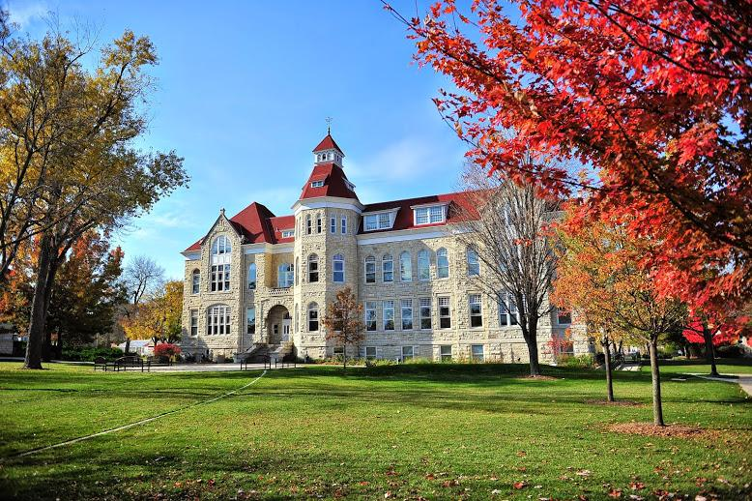
Carroll University
Notes:
Carroll University:
Waukesha, Wisconsin: 20 minutes from downtown Milwaukee.
3,000+ students
Starting in mid-1990s: transitioned from a small liberal arts college to a university with a strong health sciences focus.
Most popular undergrad majors: 1) Exercise Science 2) Nursing 3) Psychology 4) Business Admin 5) Biology.
Grad programs include: MBA, Master of Education, Doctor of Physical Therapy.

Slide 7
Todd Wehr Memorial Library
Notes:
Todd Wehr Memorial Library:
Current building opened in 1942.
Expanded in the 1960s, remodeled in 1998-1999, and a new Library Classroom 2013.
Staff: 6 librarians, 2.5 staff members, 4 PT evening/weekend staff.

Slide 8
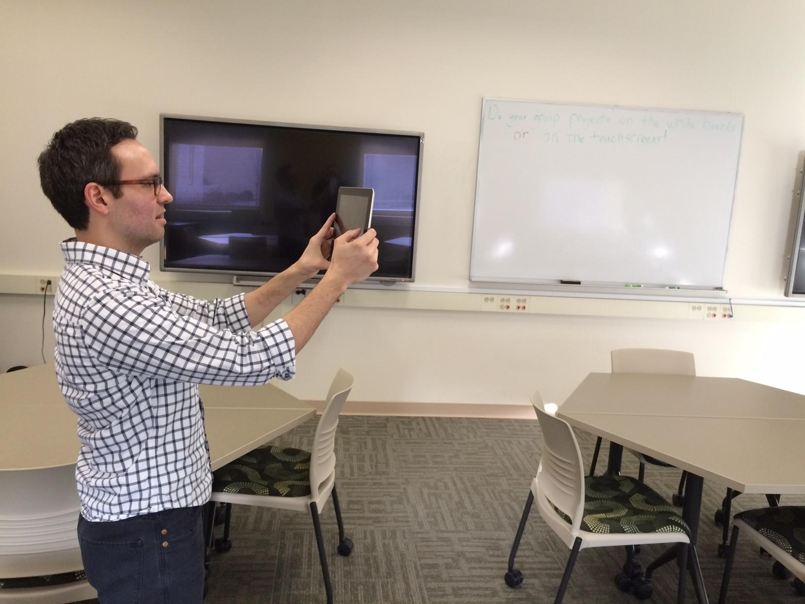
Librarian Audit
Notes:
Librarian Kindness Audit:
Conducted May 2014.
Really wanted to experience it as a “new user” - so started at front entrance on main floor and just wound my way through the library.
Used my library iPad to take photos.
When finished: divided photos into two categories:
Commendable, or
Needs Improvement

Slide 9
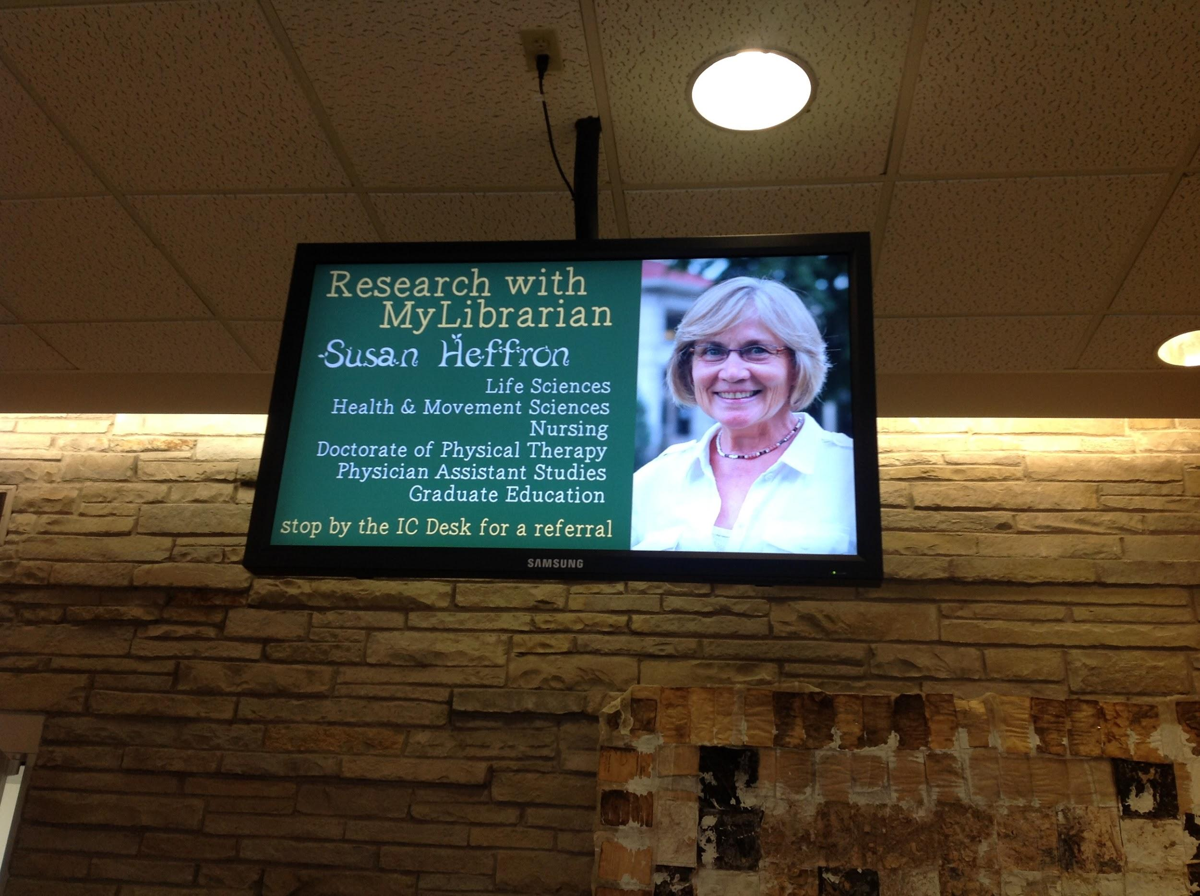
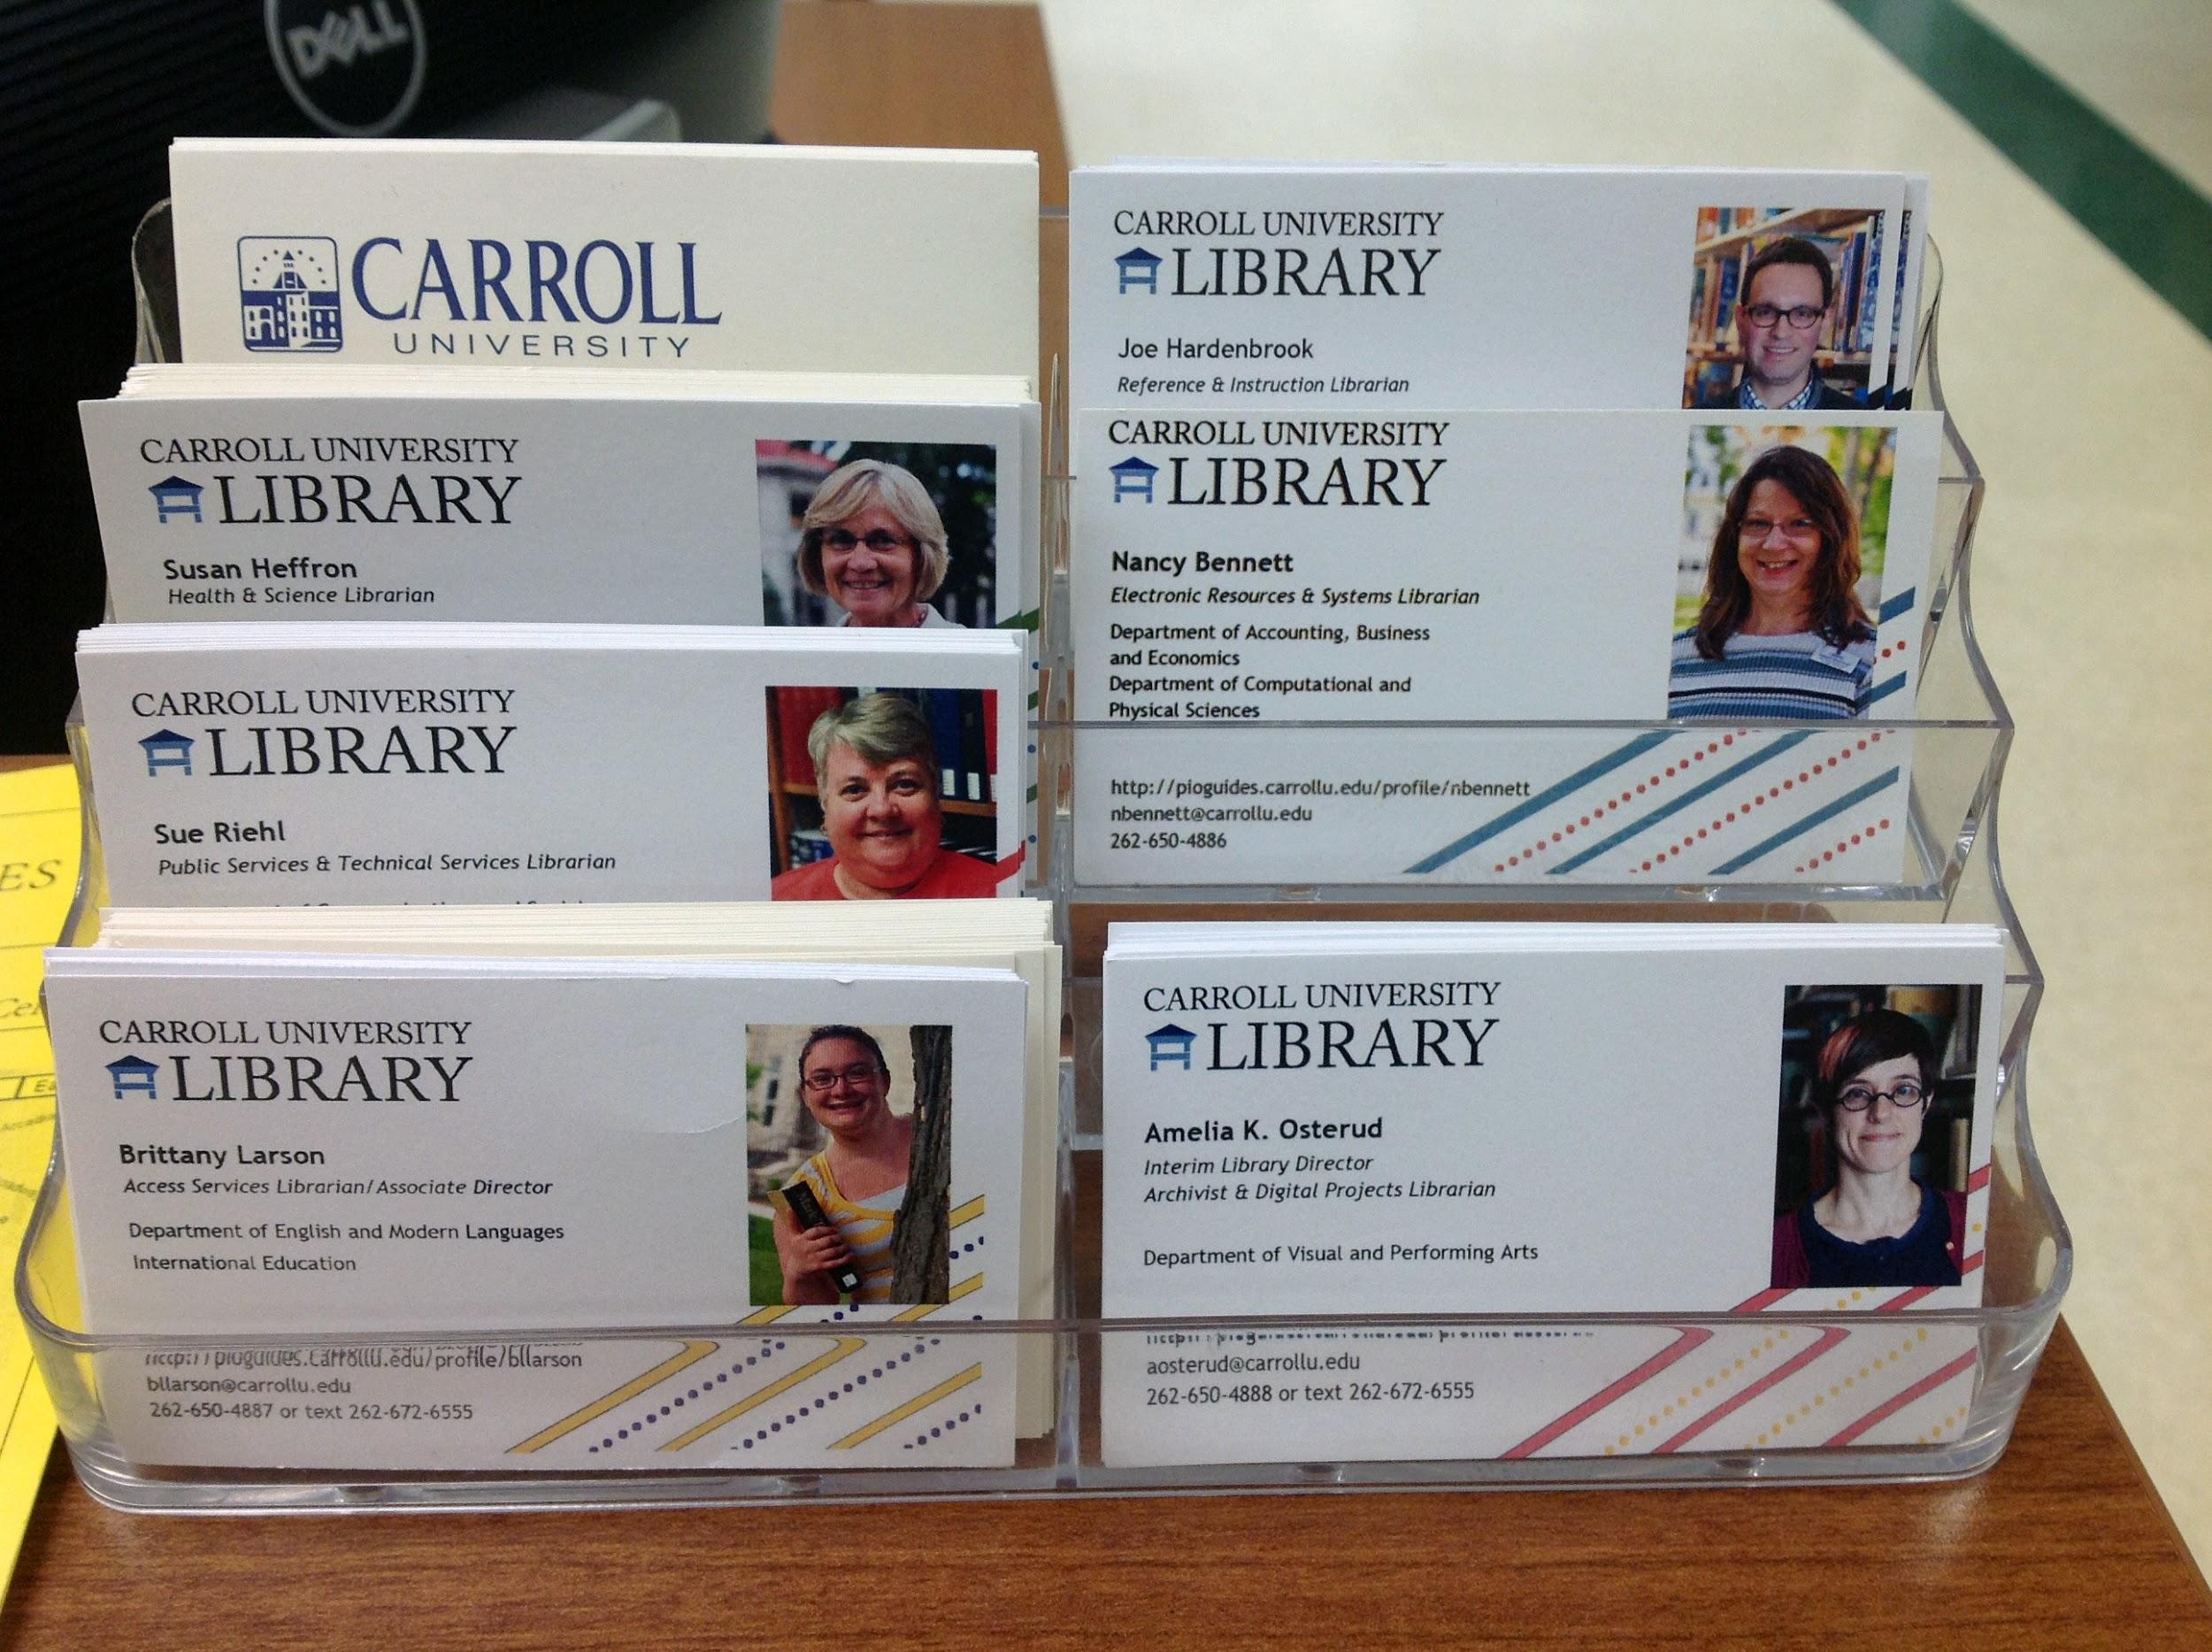
Library Lobby
Commendable: Library Info
Notes:
Commendable - Library Information:
Plasma screen rotates w/ library news, announcements.
Librarians’ business cards at service desk - liked that it put names & faces together.

Slide 10
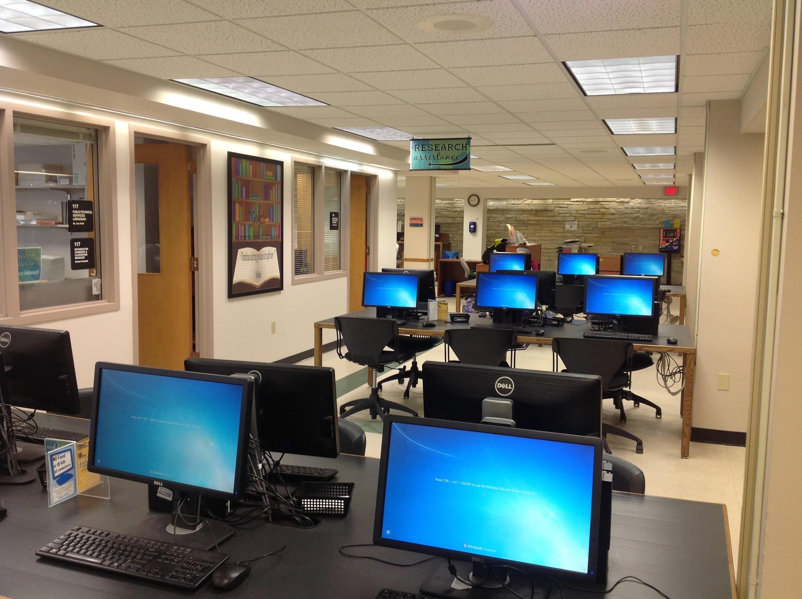
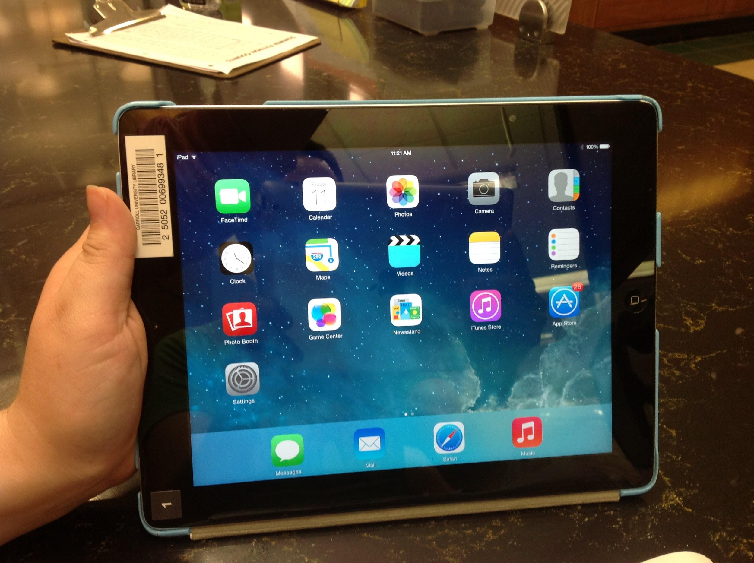
Library Lobby
Commendable: Technology
Notes:
Commendable - Technology:
Plenty of computers in the Information Commons (not the largest lab on campus, but the busiest).
60+ iPads for checkout at the Circulation Desk.

Slide 11
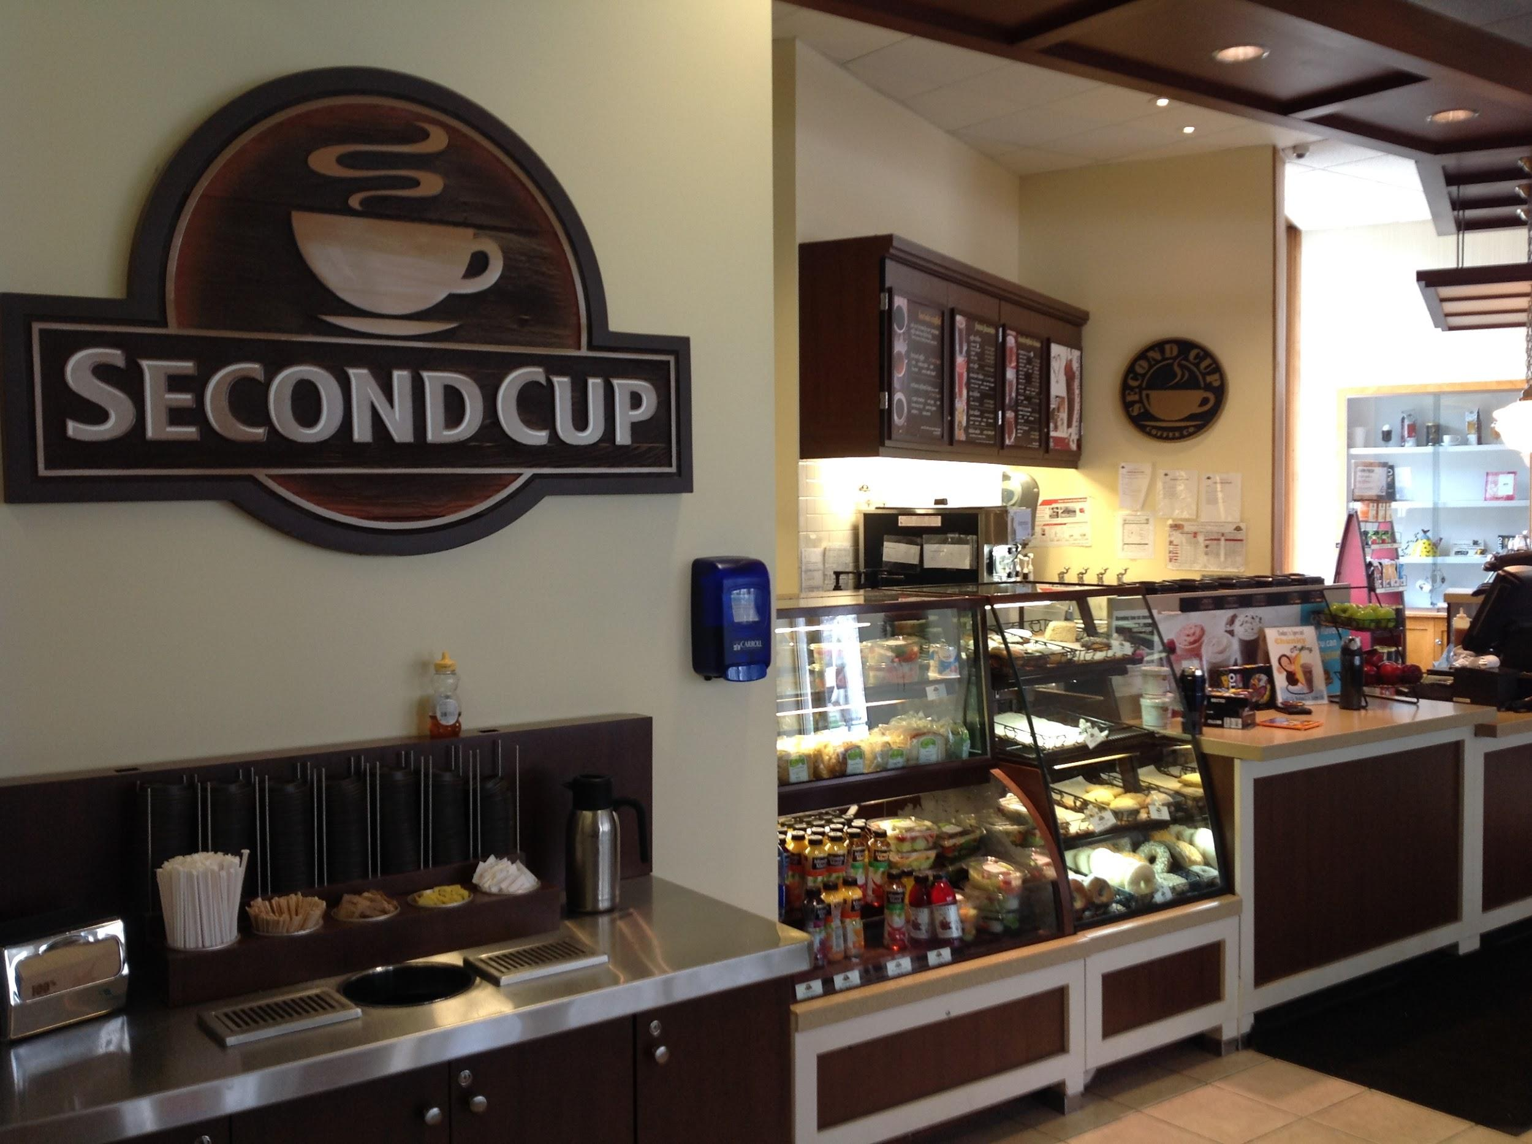
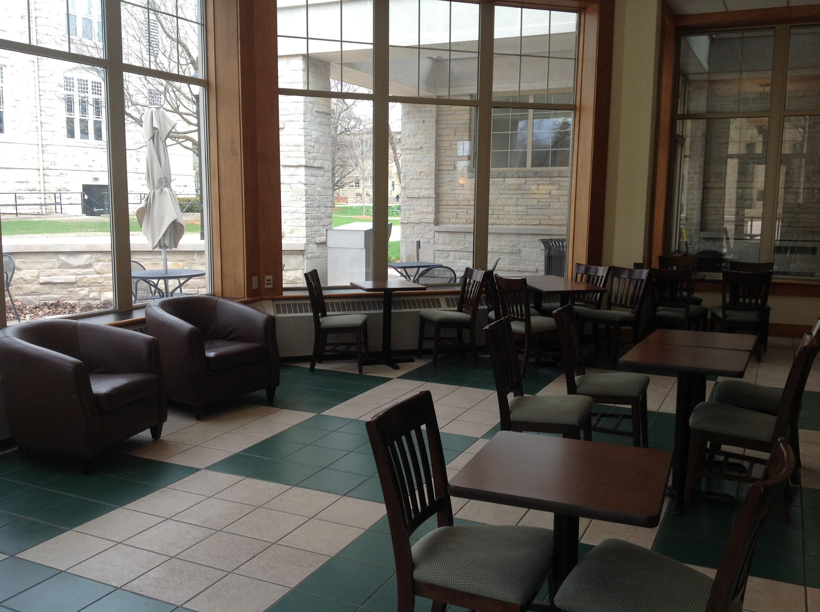
Commendable: Library Coffee Shop
Notes:
Commendable - Library Coffee Shop:
Inviting space.
Has doors that close so noise is not a disruption.
Large windows w/ views of the campus.
Has lots of soft seating: something that the rest of the library lacks.

Slide 12
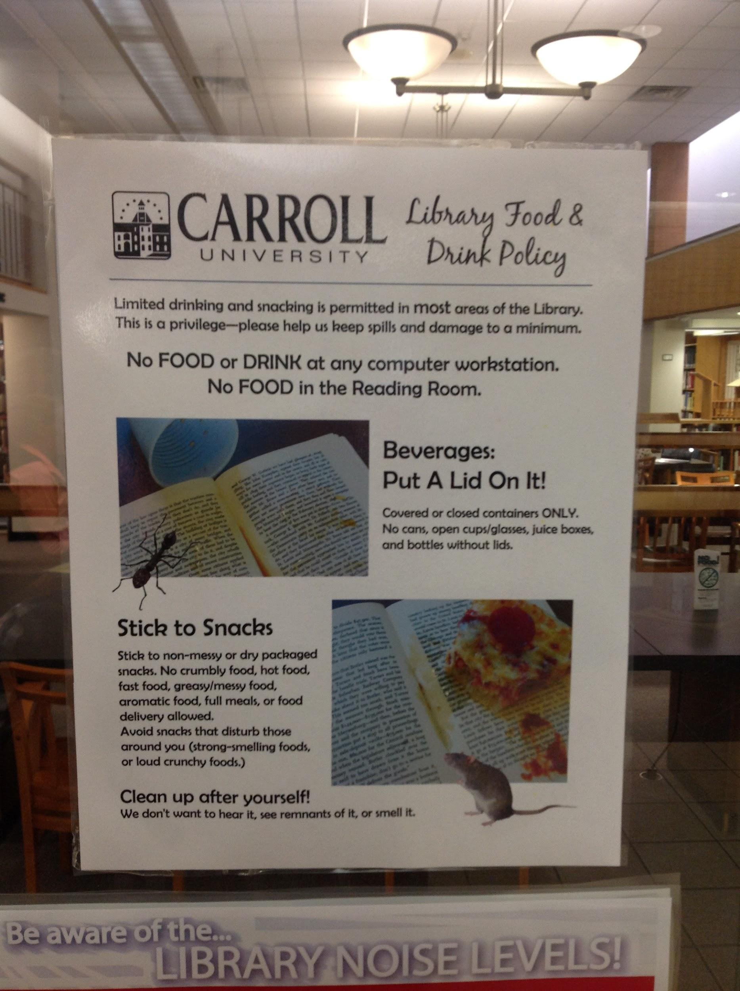
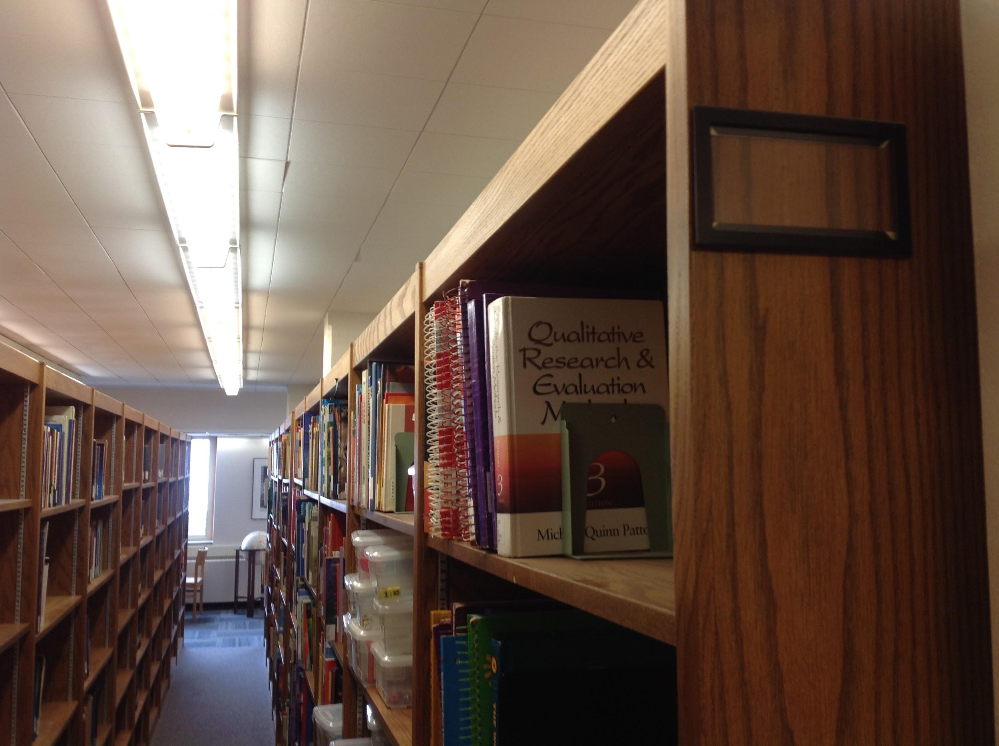
Needs Improvement: Signage
Notes:
Needs Improvement - Signage:
Food/drink signage
Negative, overly wordy in some cases, looks cheap
There’s a coffee shop in the library...what do you expect?
Stacks signage
In my walkthrough I noticed some end caps didn’t even have call number signage and some were handwritten.
Noticed some end caps list subject area too (like “U.S. history” or “Psychology”) - why wasn’t this applied to the entire collection?

Slide 13
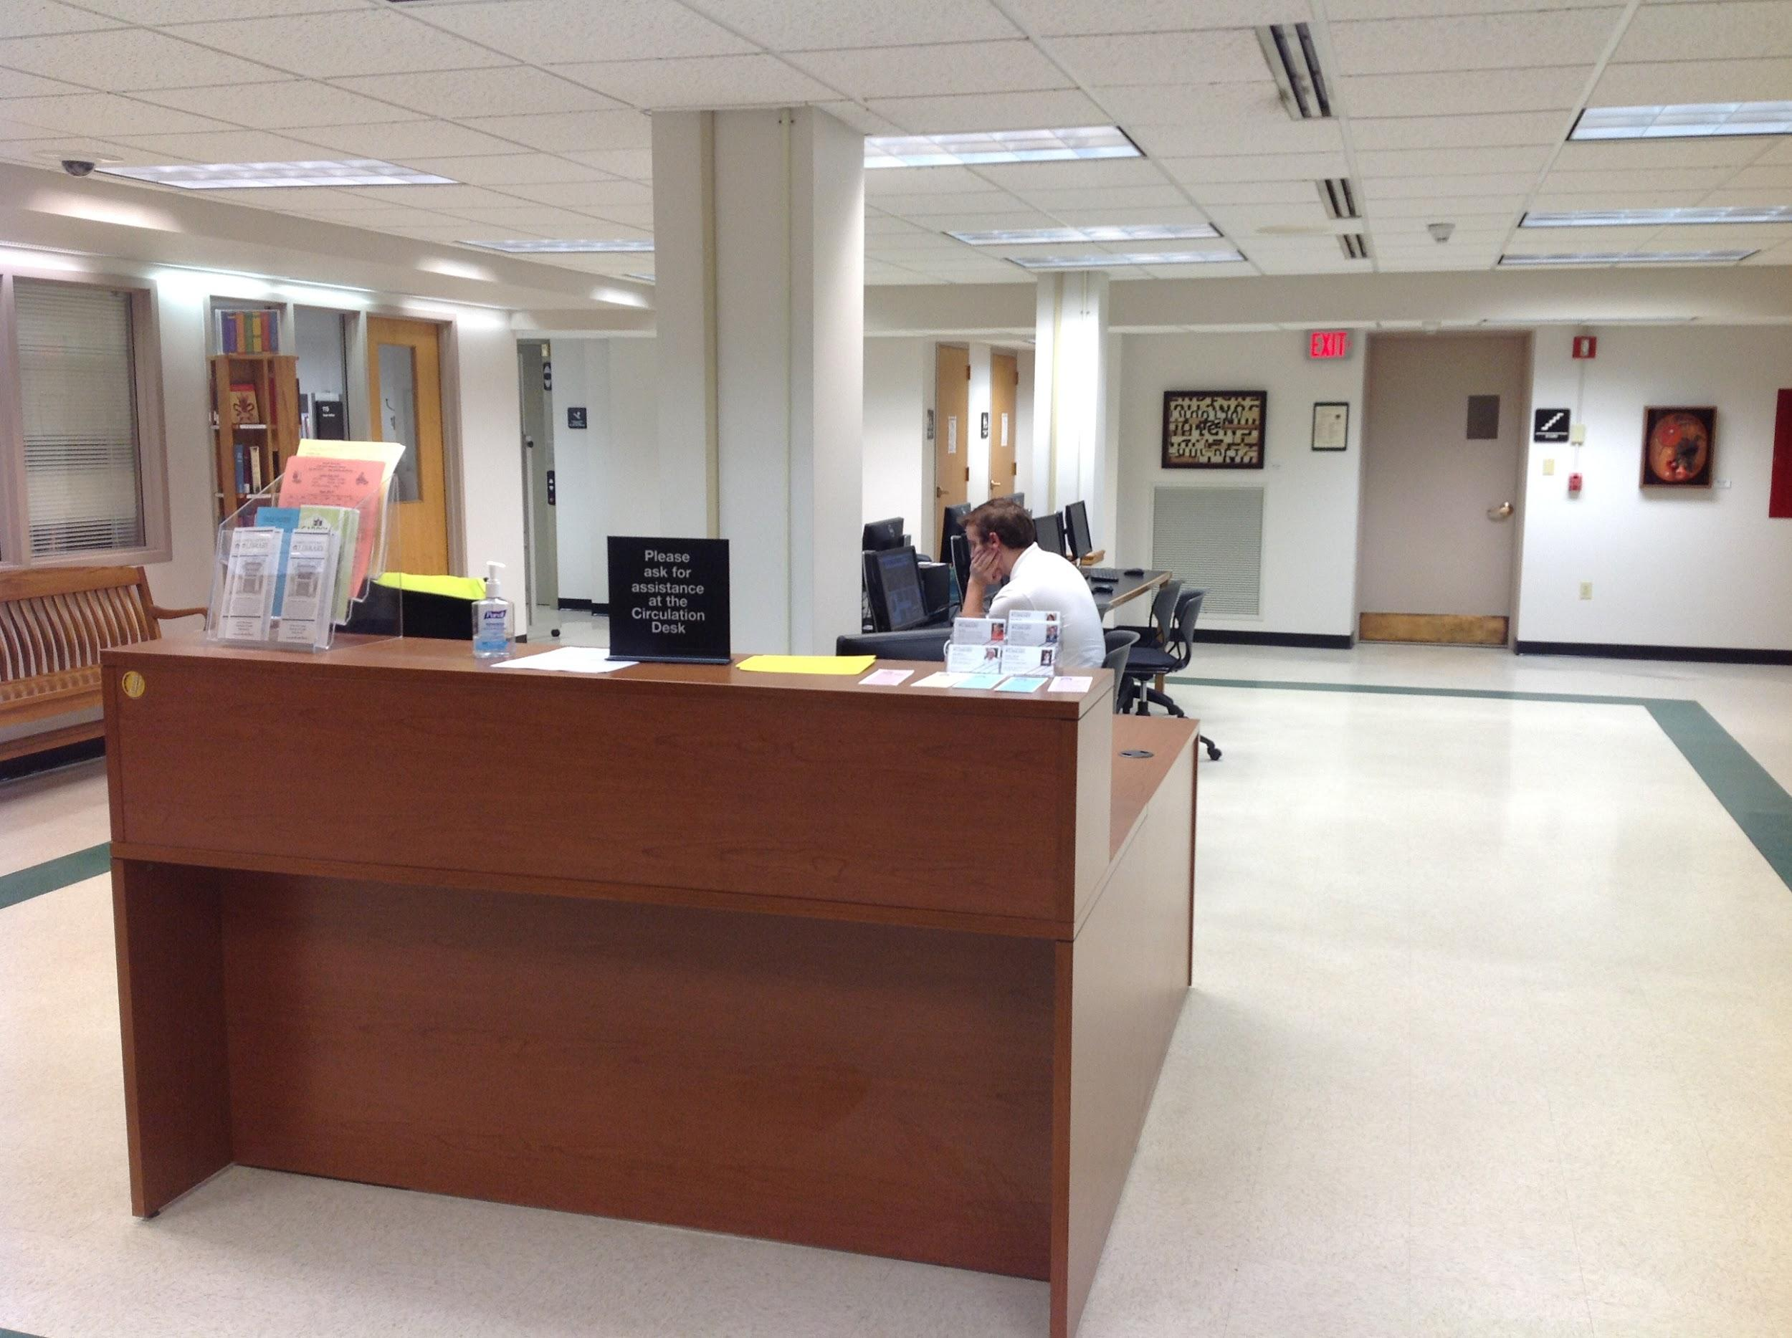
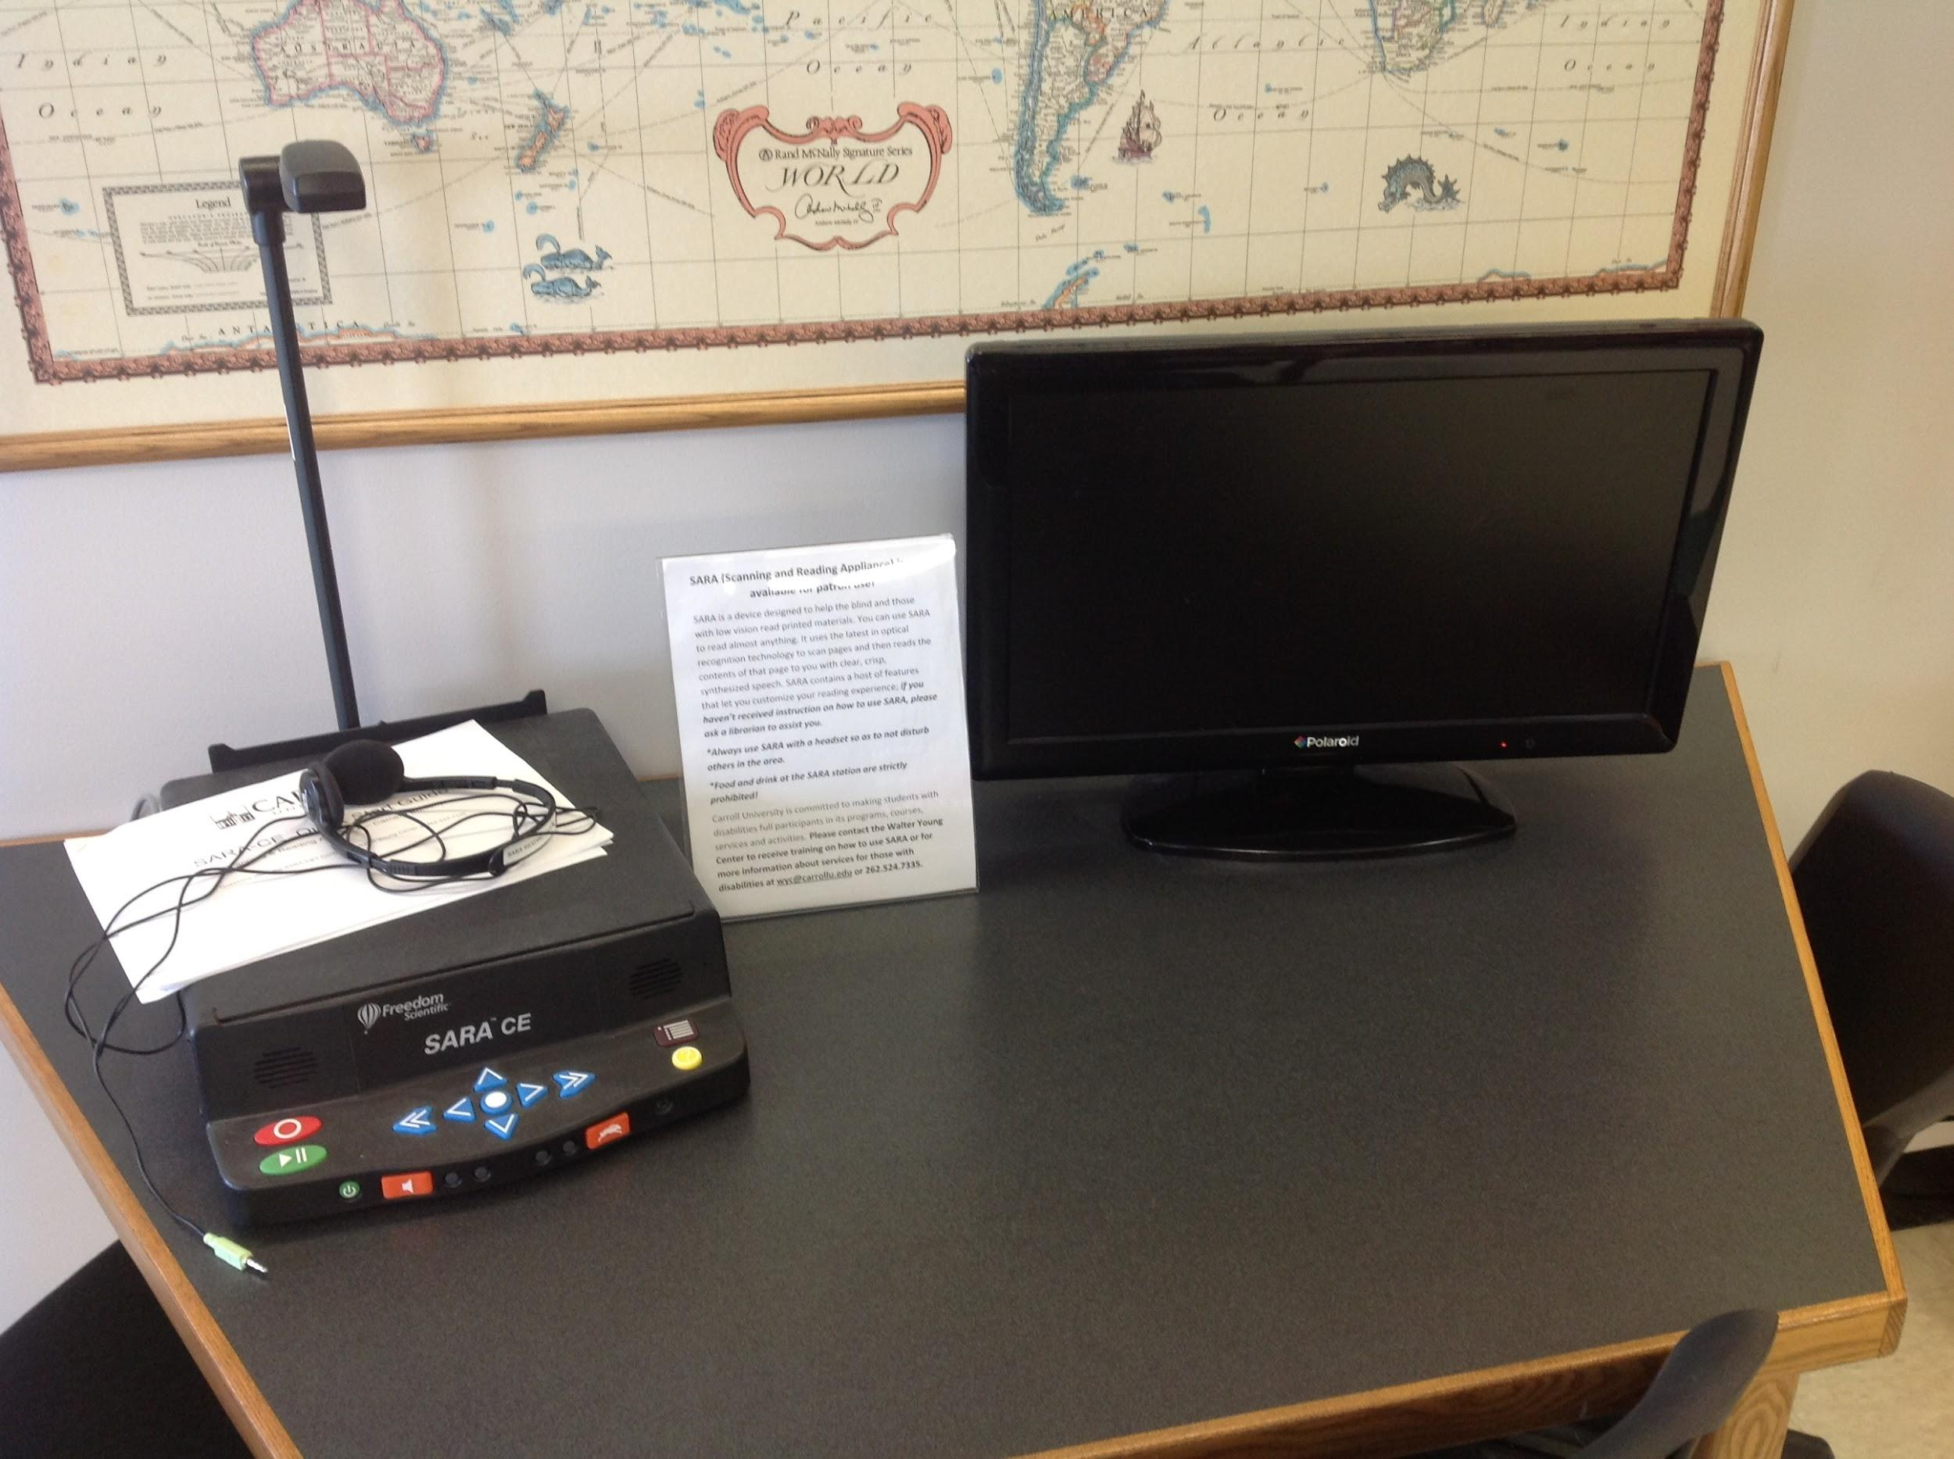
Needs Improvement: Services
Notes:
Needs Improvement - Services:
Information Desk
Photo on left.
What is it? What questions can ask here? Why is no one here? How is it different from the other desk nearby (Research Assistance Desk)?
Note: there is usually a student worker situated here to answer questions about printing, technology, copying, and scanning, etc.
Disability Workstation
Photo on right.
No signage. Not labeled. It looks like a scanning station.

Slide 14
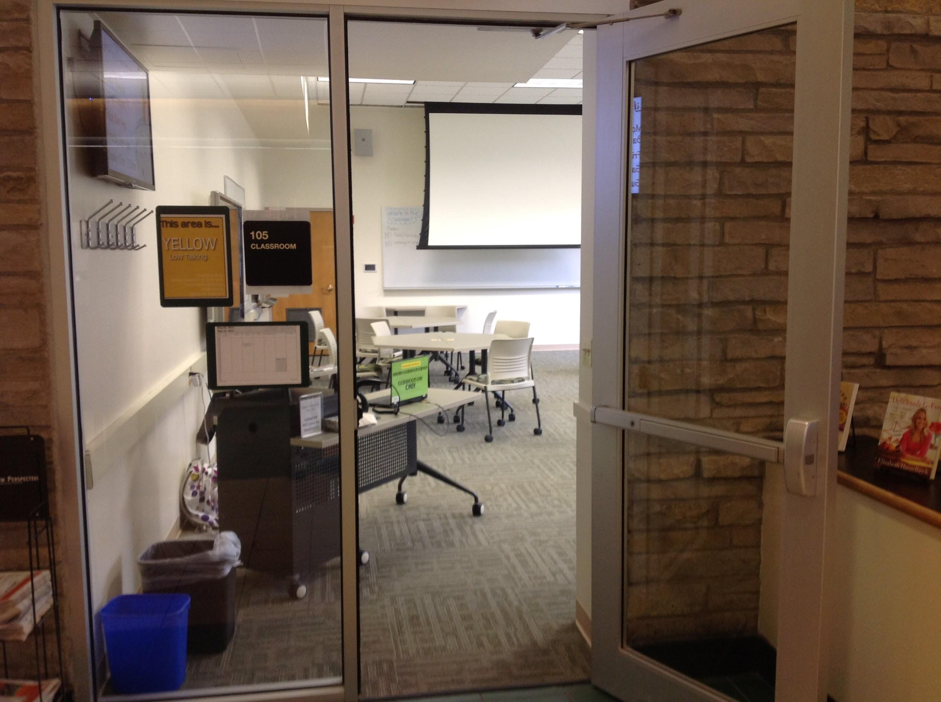
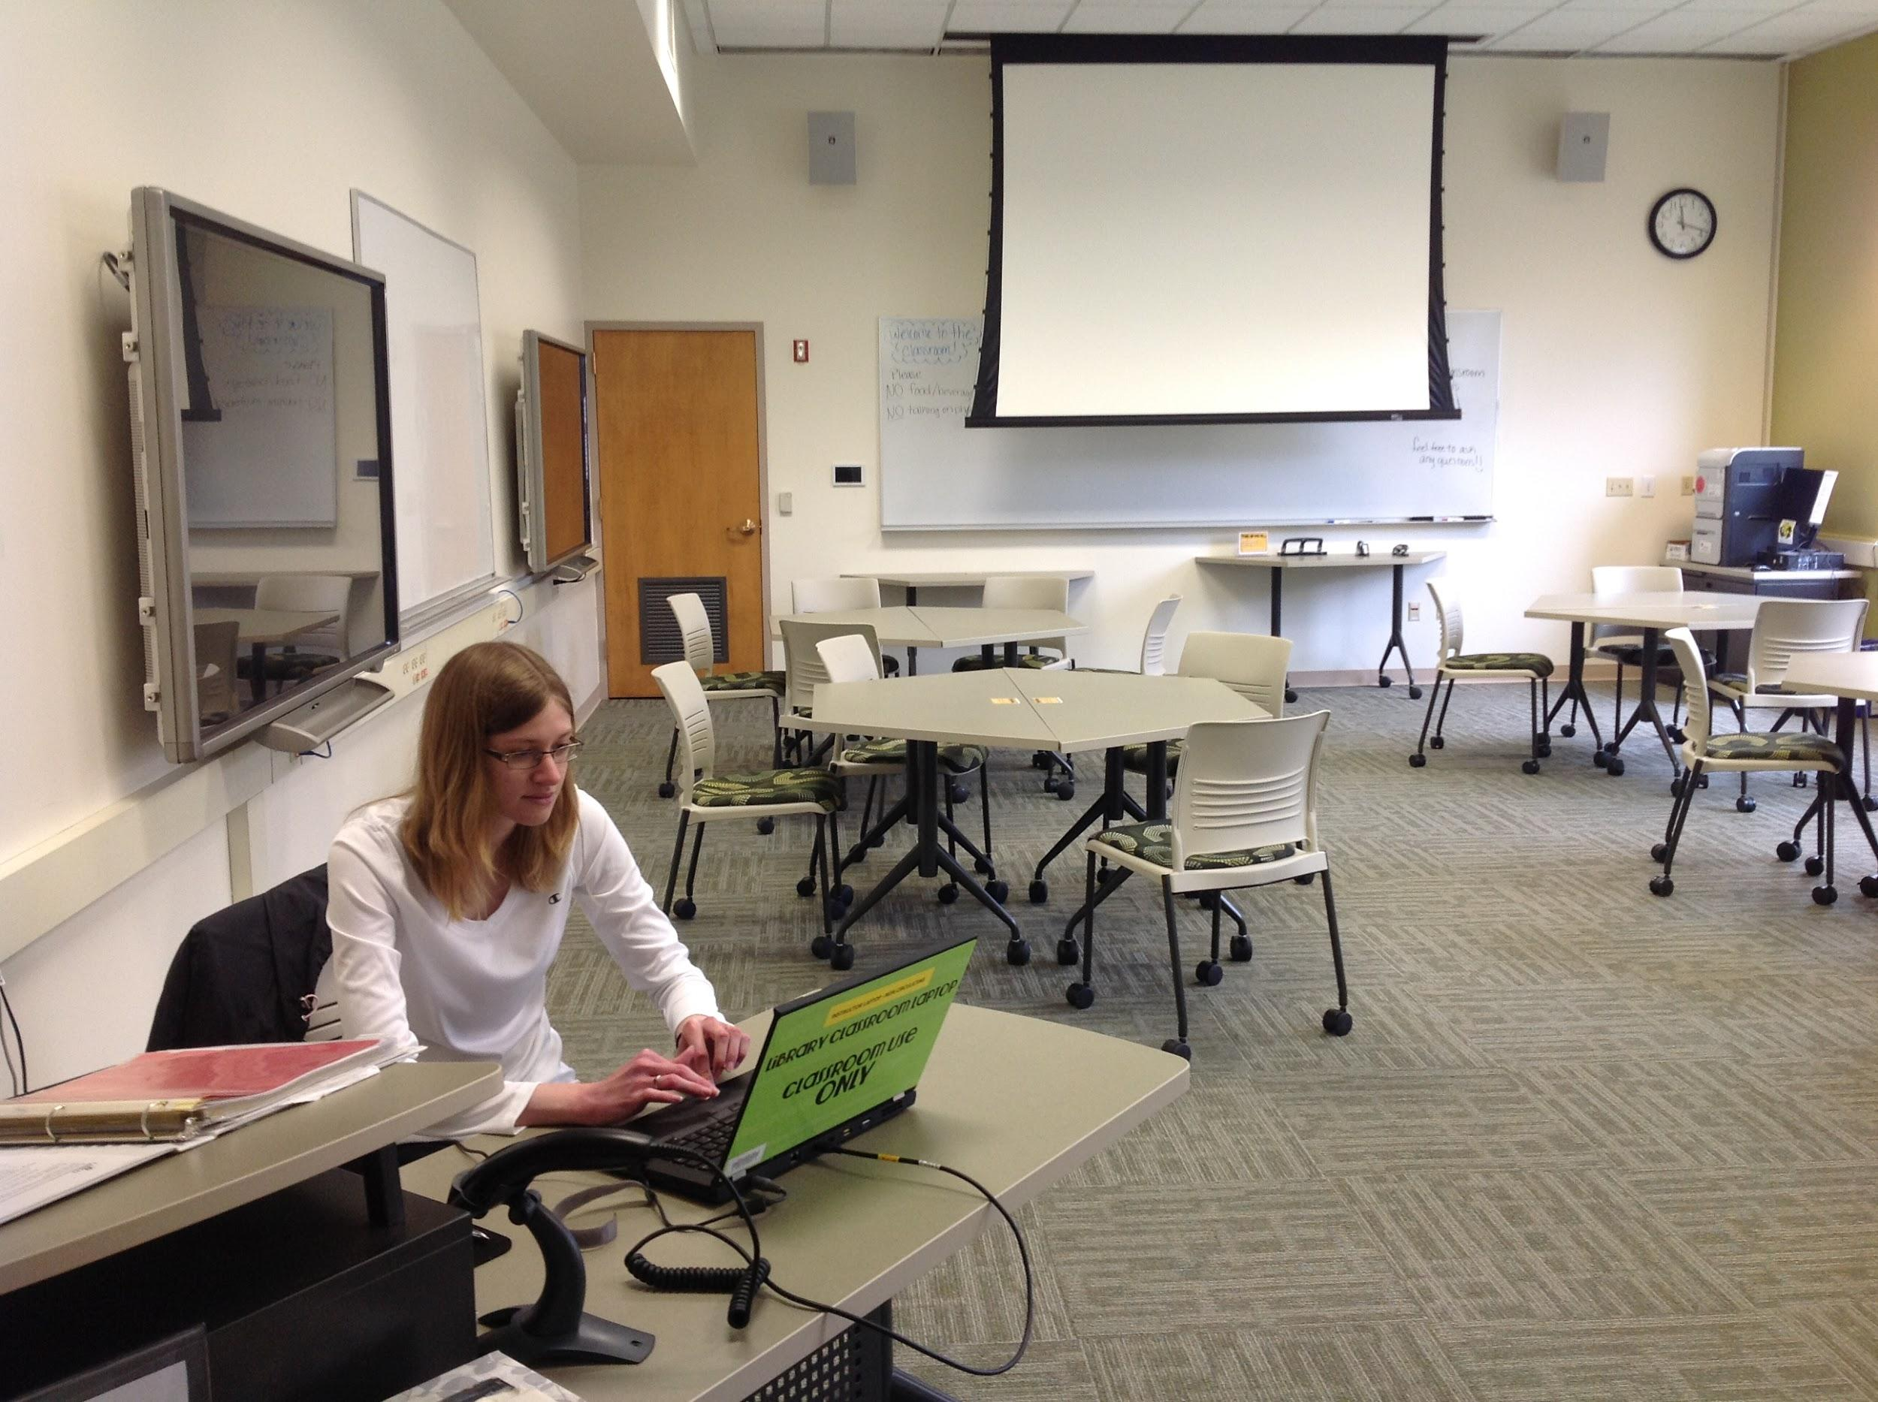
Changes Implemented
Changes Implemented: Library Classroom
Notes:
Changes Implemented - Library Classroom:
How easy can a kindness audit be? These changes in the classroom were made the same day!
To be more welcoming:
Door kept open when a class is not being taught.
Student worker moved from front of classroom to entryway. Important because when we switched from a desktop PC lab to a laptop lab, students don’t “see” the computers anymore. They can check one out from the student worker.

Slide 15
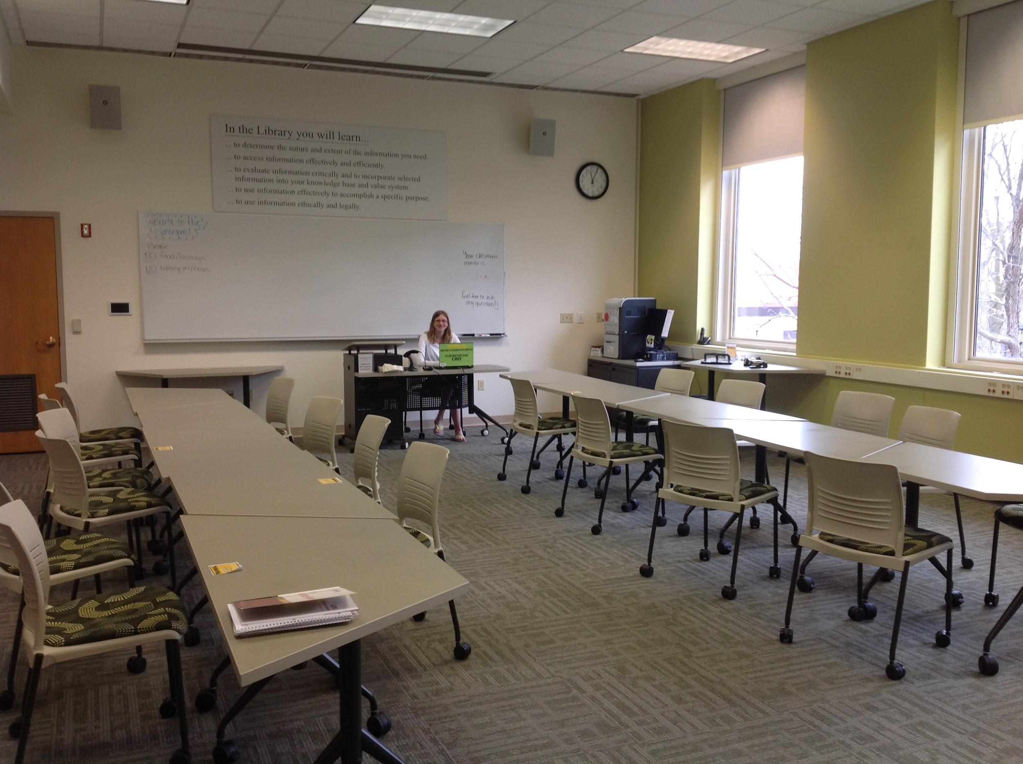
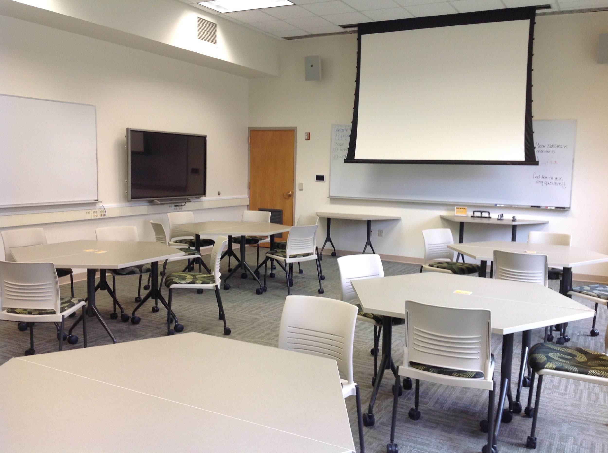
Changes Implemented
Changes Implemented: Library Classroom
Notes:
Changes Implemented - Library Classroom:
Default furniture setup changed to a style more conducive for group work.
Photo on the left is before, photo on the right is after.
Students permitted to use touchscreen technology and whiteboards.
Students permitted to move furniture around.

Slide 16
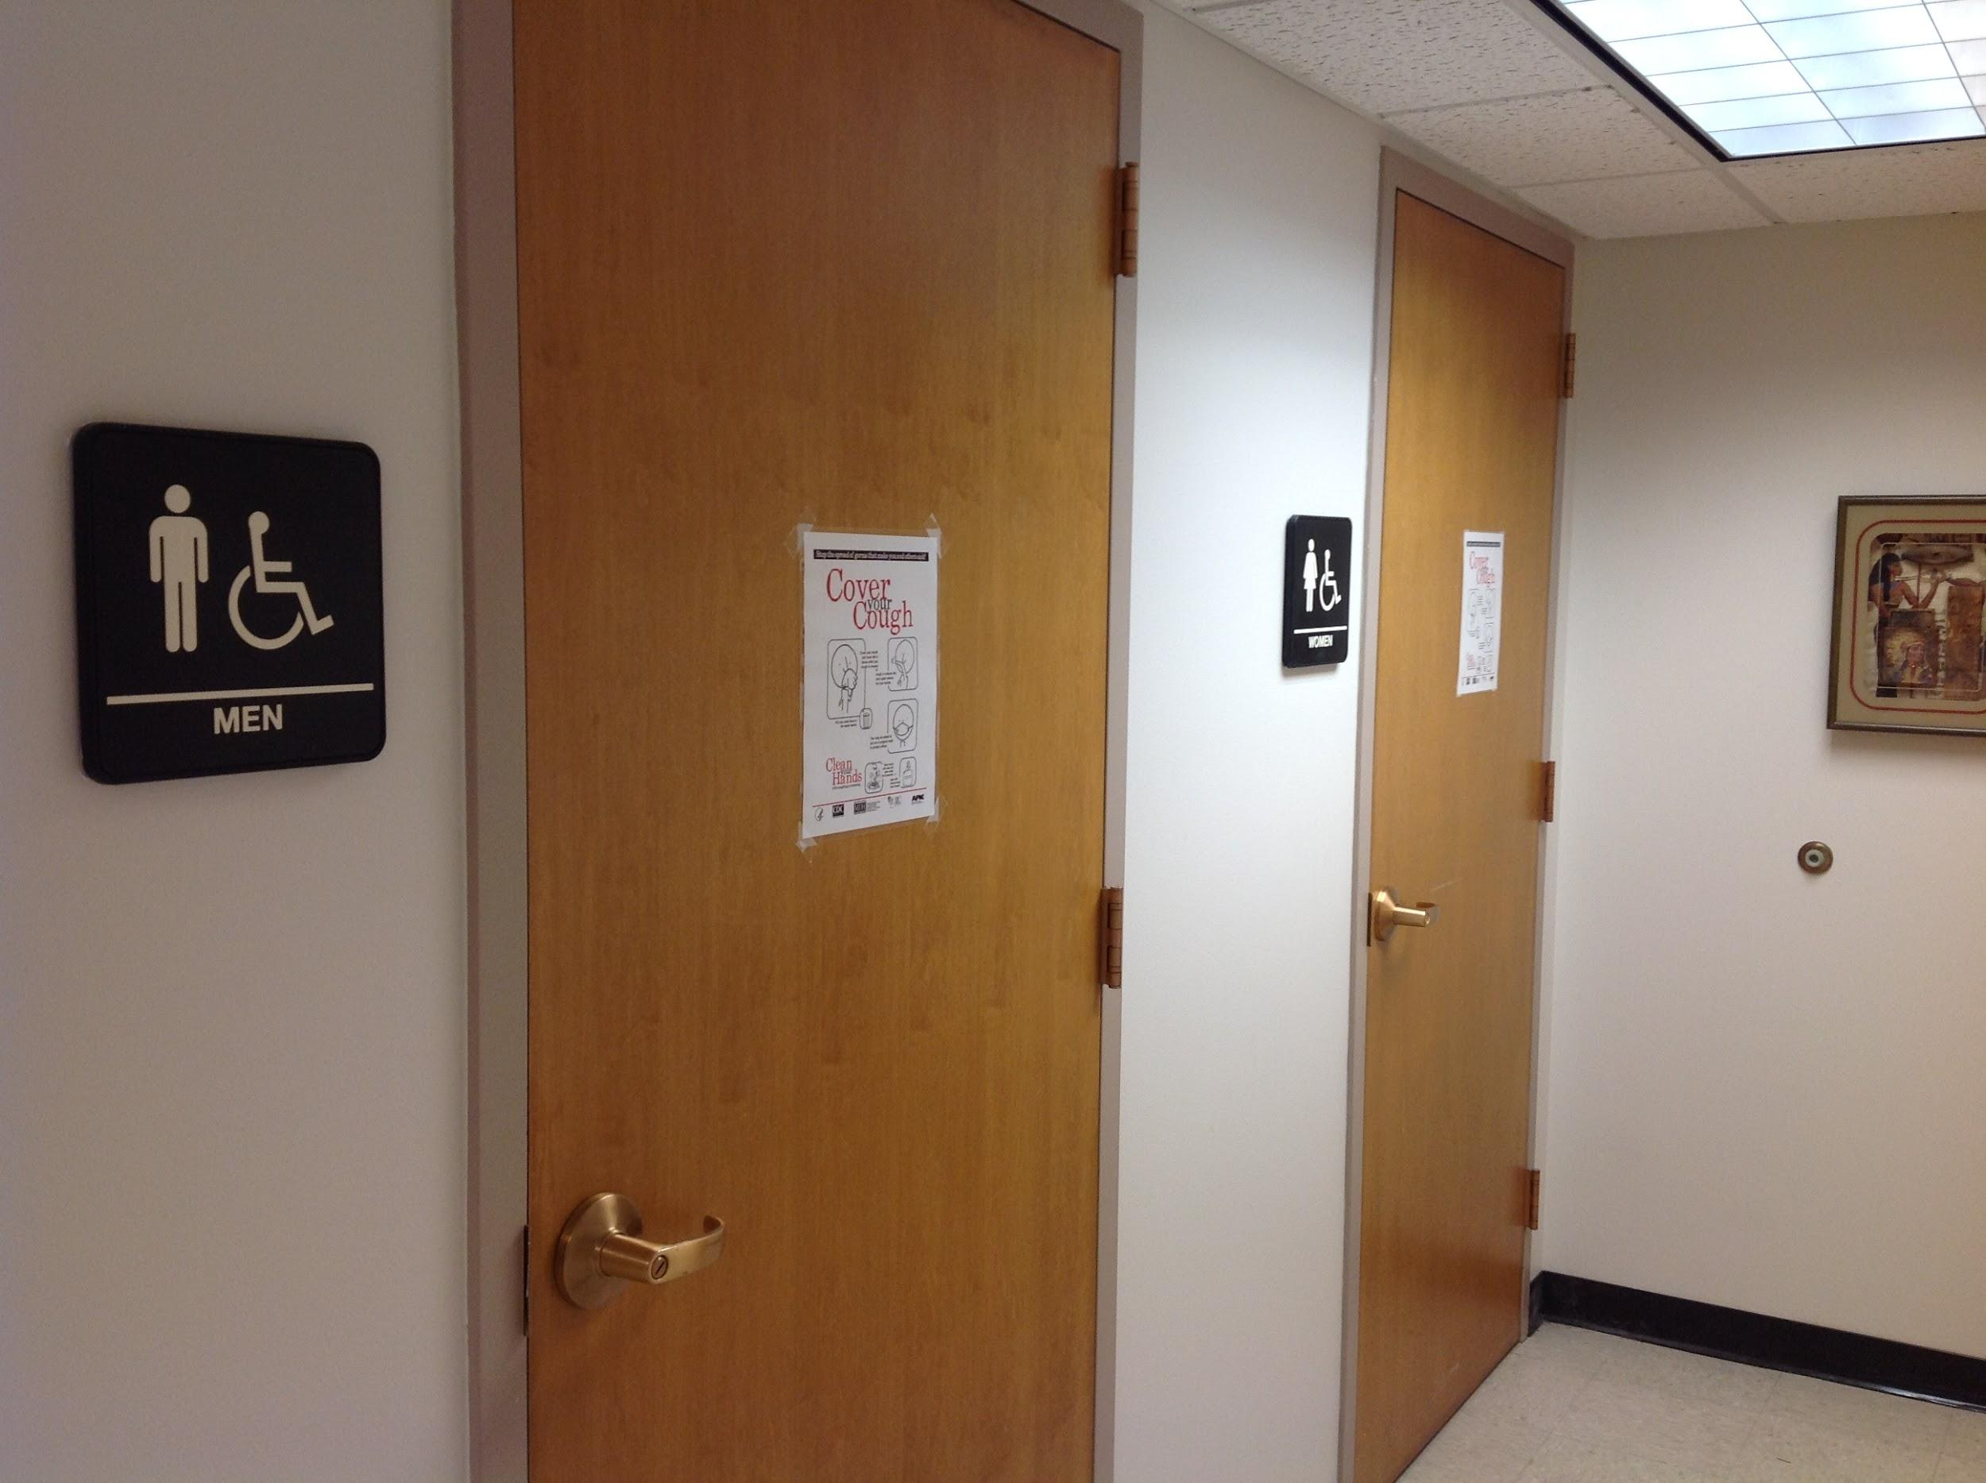
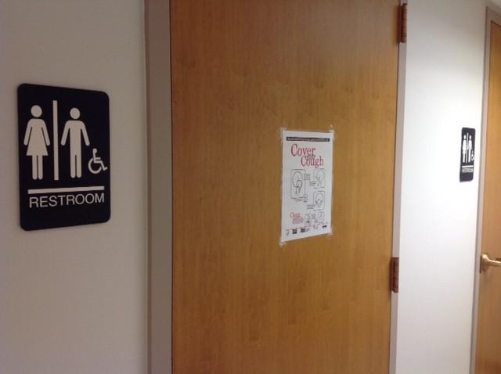
Changes Implemented: Single Occupancy Restrooms
Notes:
Changes Implemented - Single Occupancy Restrooms:
Didn’t make any sense for the single occupancy restrooms to be gendered.
Photo on the left is before, photo on the right is after.
Good timing: Campus is switching all single occupancy restrooms to gender neutral.
More inclusive.
Also reduces waiting time (66% female, 34% male split at Carroll).

Slide 17
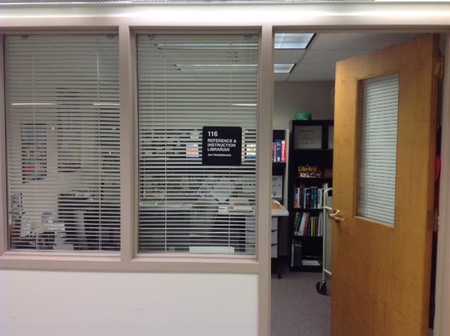
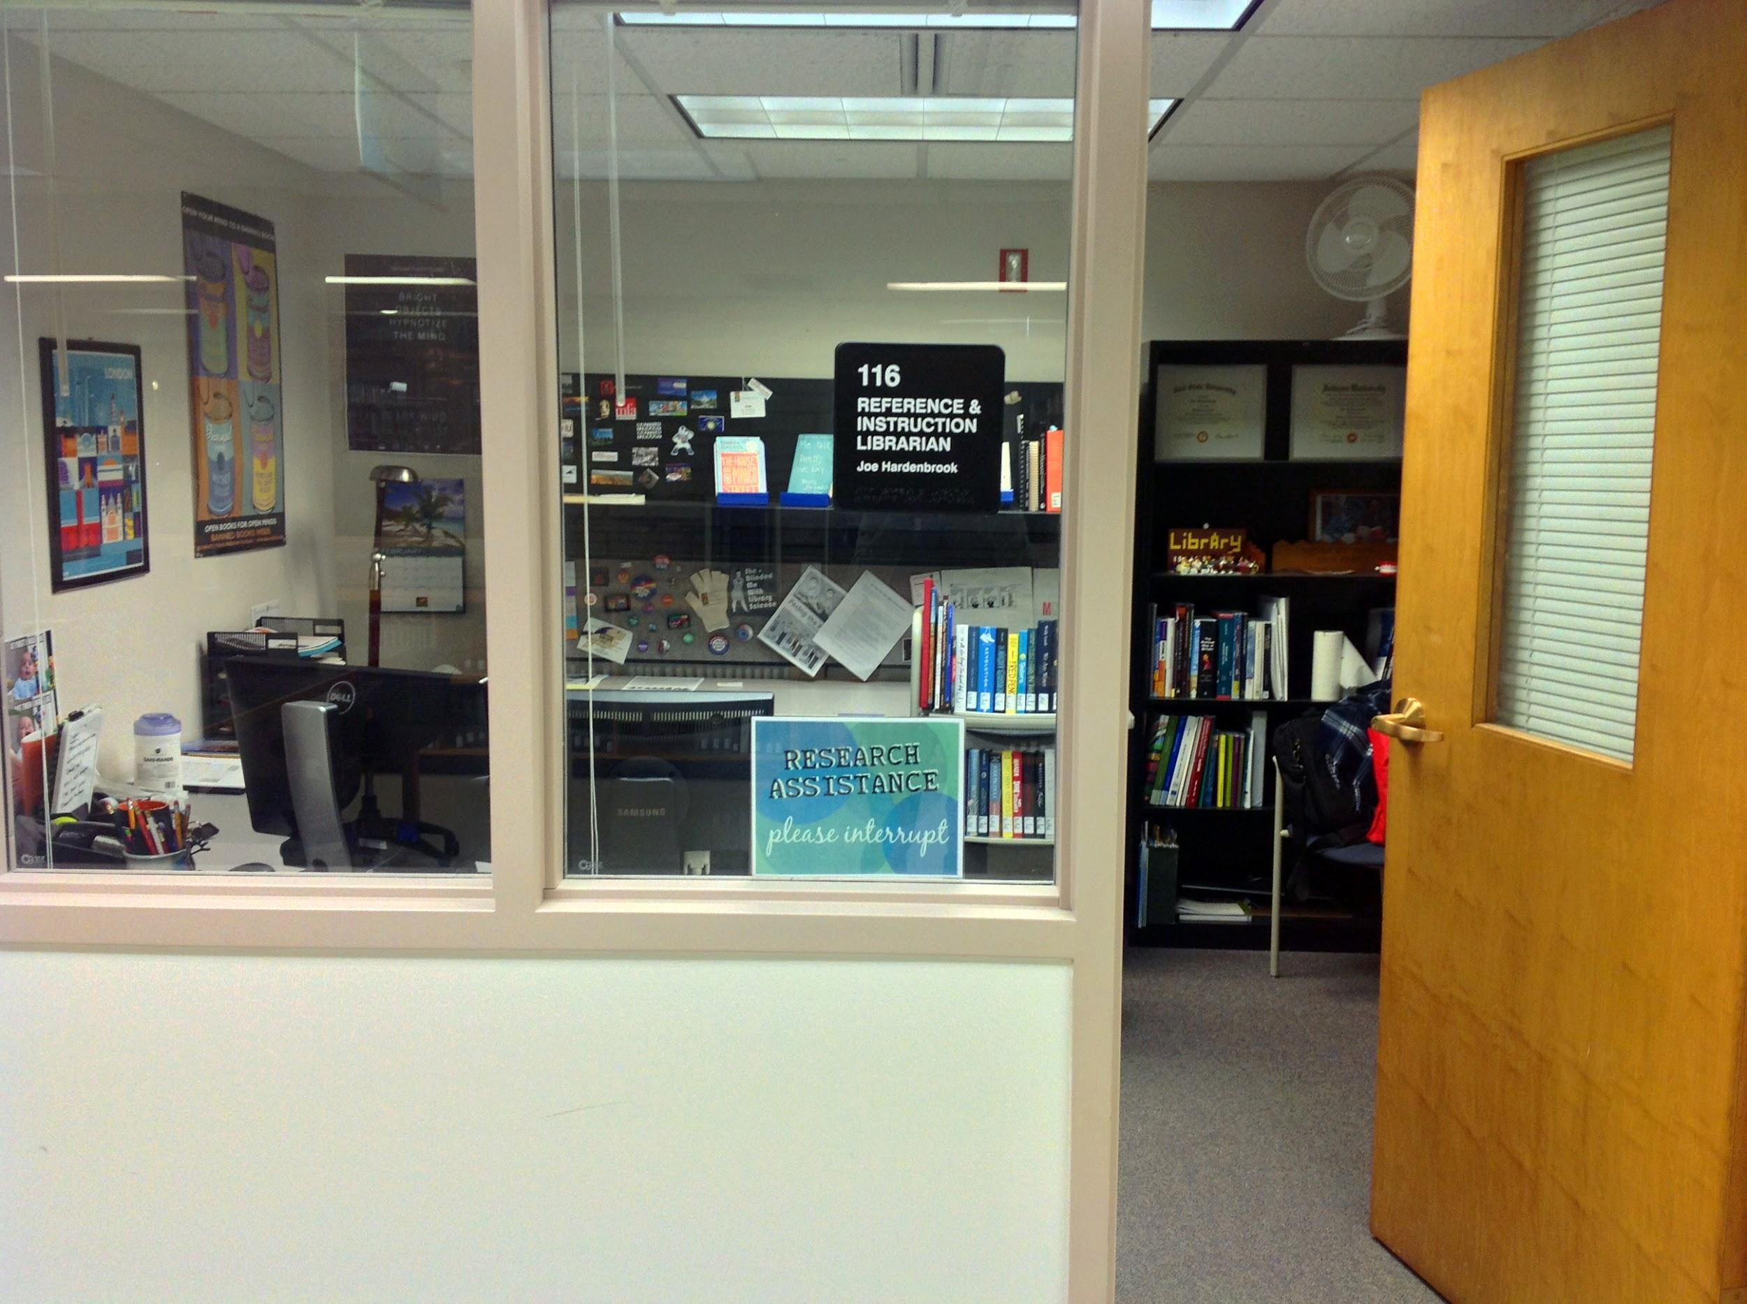
Changes Implemented: Librarians’ Offices
Notes:
Changes Implemented - Librarians’ Offices:
Photo on the left is before, photo on the right is after.
Blinds kept up to make more inviting.
Research assistance sign placed in office windows.
I get more questions now.

Slide 18
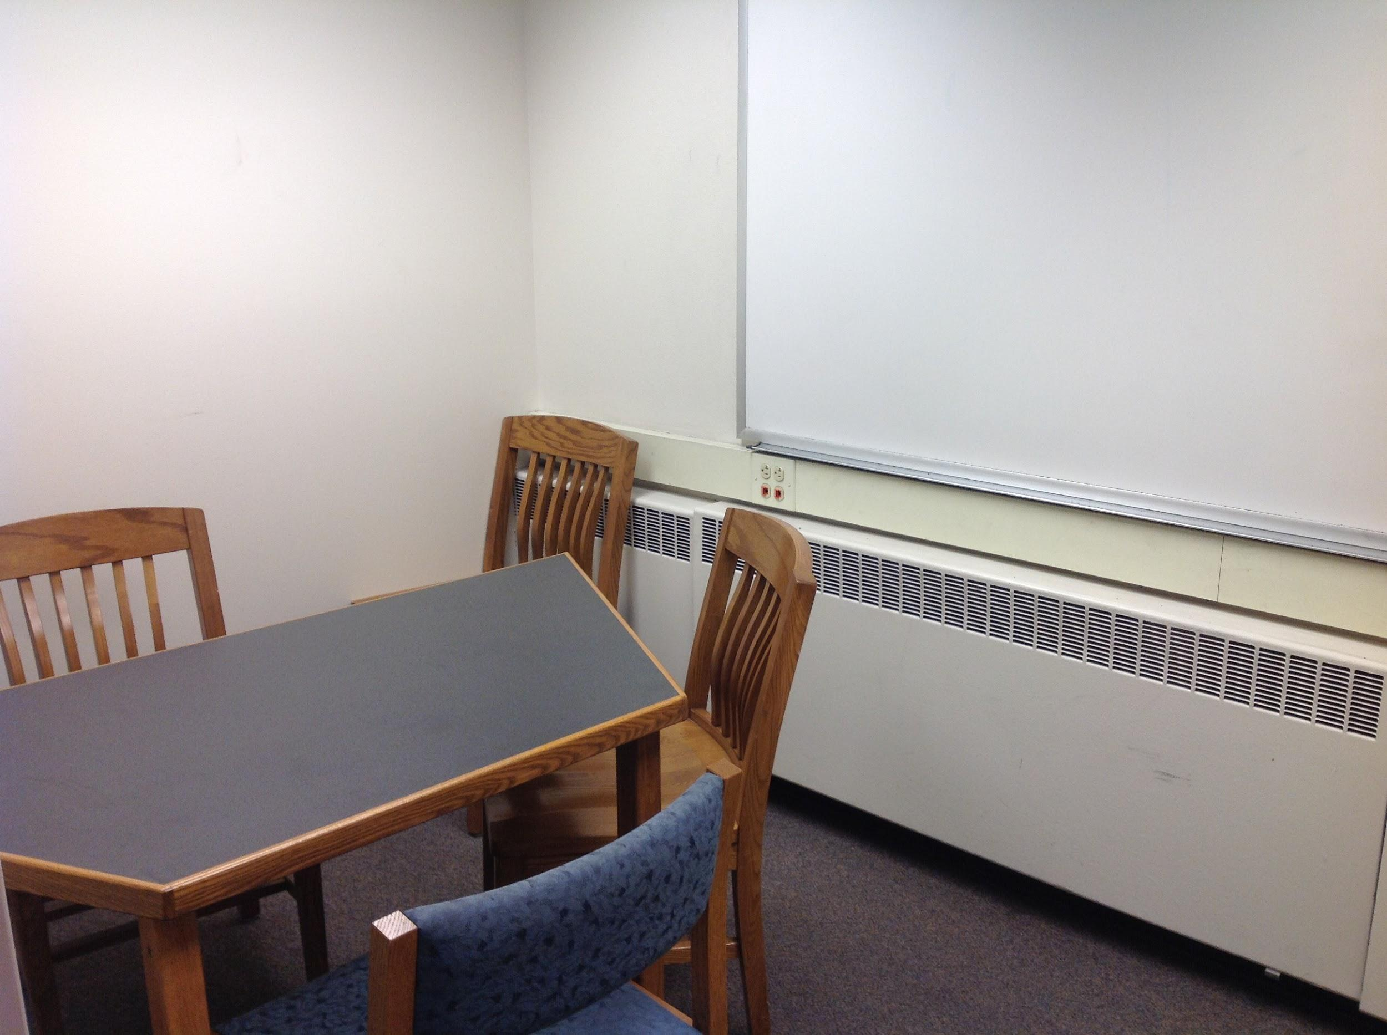
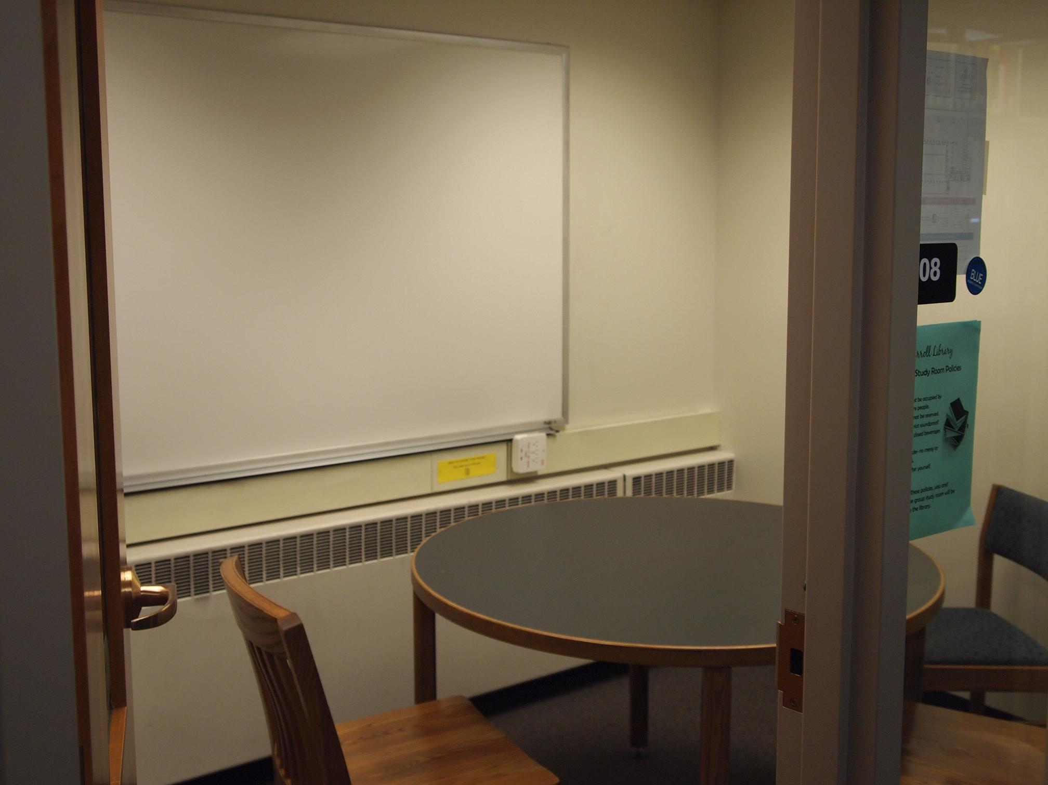
Changes Implemented: Group Study Rooms
Notes:
Changes Implemented - Group Study Rooms:
Photo on the left is before, photo on the right is after.
Trapezoid shaped tables make maneuvering in room difficult.
Switched to round tables for easier access.
Photo on the left is before, photo on the right is after.

Slide 19
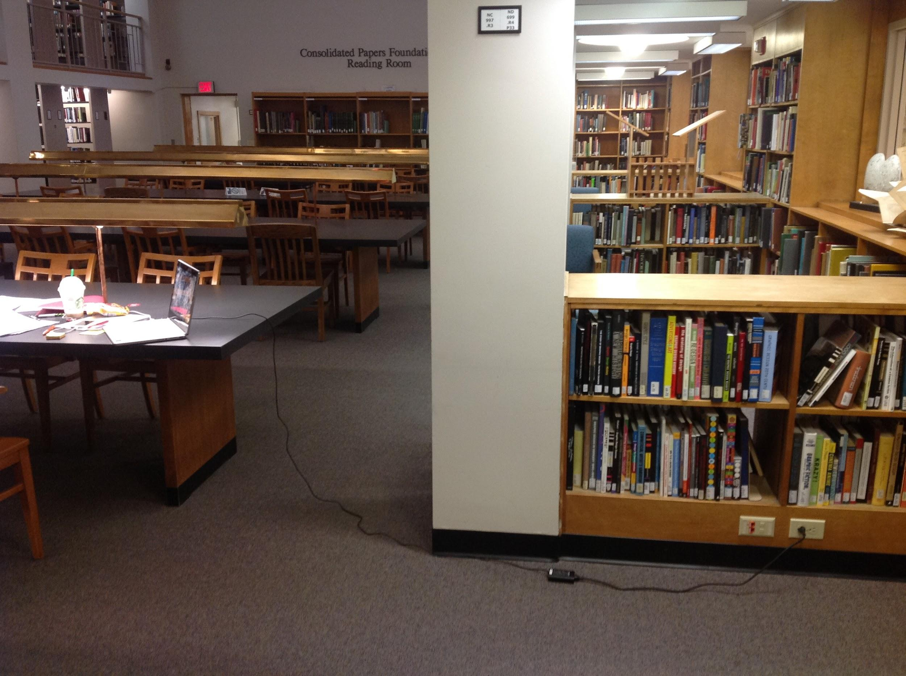
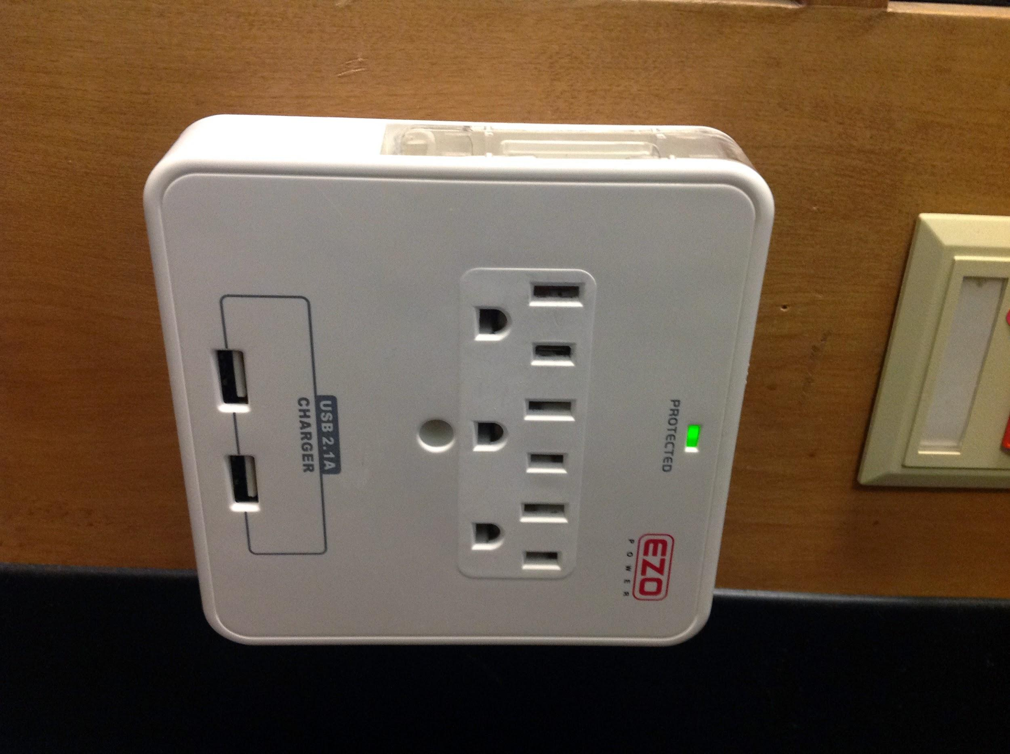
Changes Implemented: Outlets
Notes:
Changes Implemented - Outlets:
Before (left): Needs more outlets. Trip hazard w/ laptop plugged in.
After (right): More plugs added, including USB ports.
New plugs costs $15 each.

Slide 20
What surprised us
Easy fixes
More to like than not to like
Marketing/Branding and Info Lit
Notes:
What surprised us:
Most suggestions were easy fixes, quick changes, low cost.
No major suggestions related to infrastructure.
More to like than not to like.
Marketing and Info Lit:
Need to promote and market some services/resources better (Info Desk, leisure books, curriculum collection).
Call Numbers: brief reminder in intro info lit classes.

Slide 21
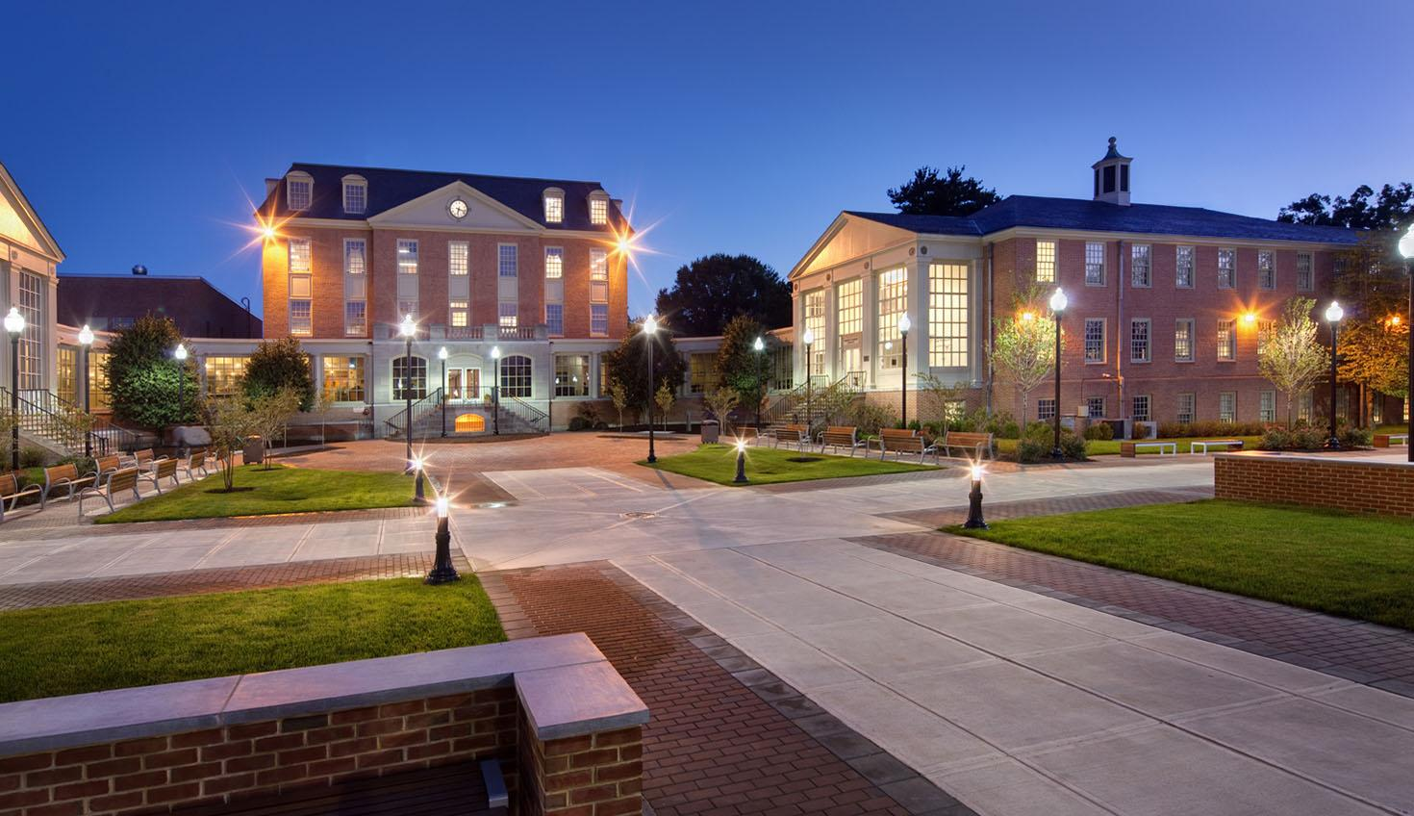
Wesley College
Notes:
-2 to 3 sentence history of the school
-2 to 3 sentence overview of current programs, student body, and near future plans

Slide 22
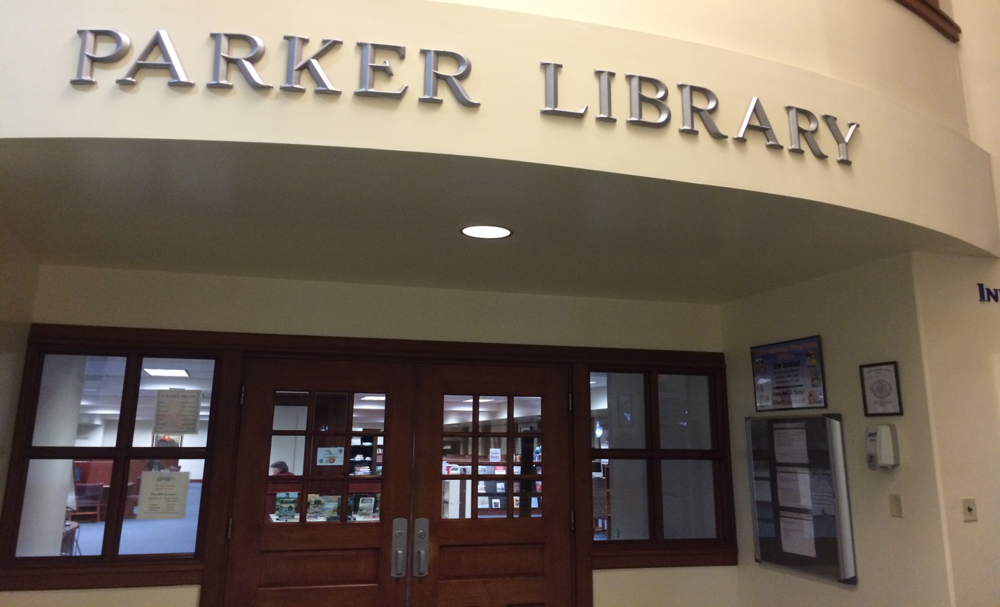
Robert H. Parker Memorial Library
Notes:
-Quick history of the library as a unit on campus;
-Follow up about the renovation history;
-A bit about our services and collections.

Slide 23
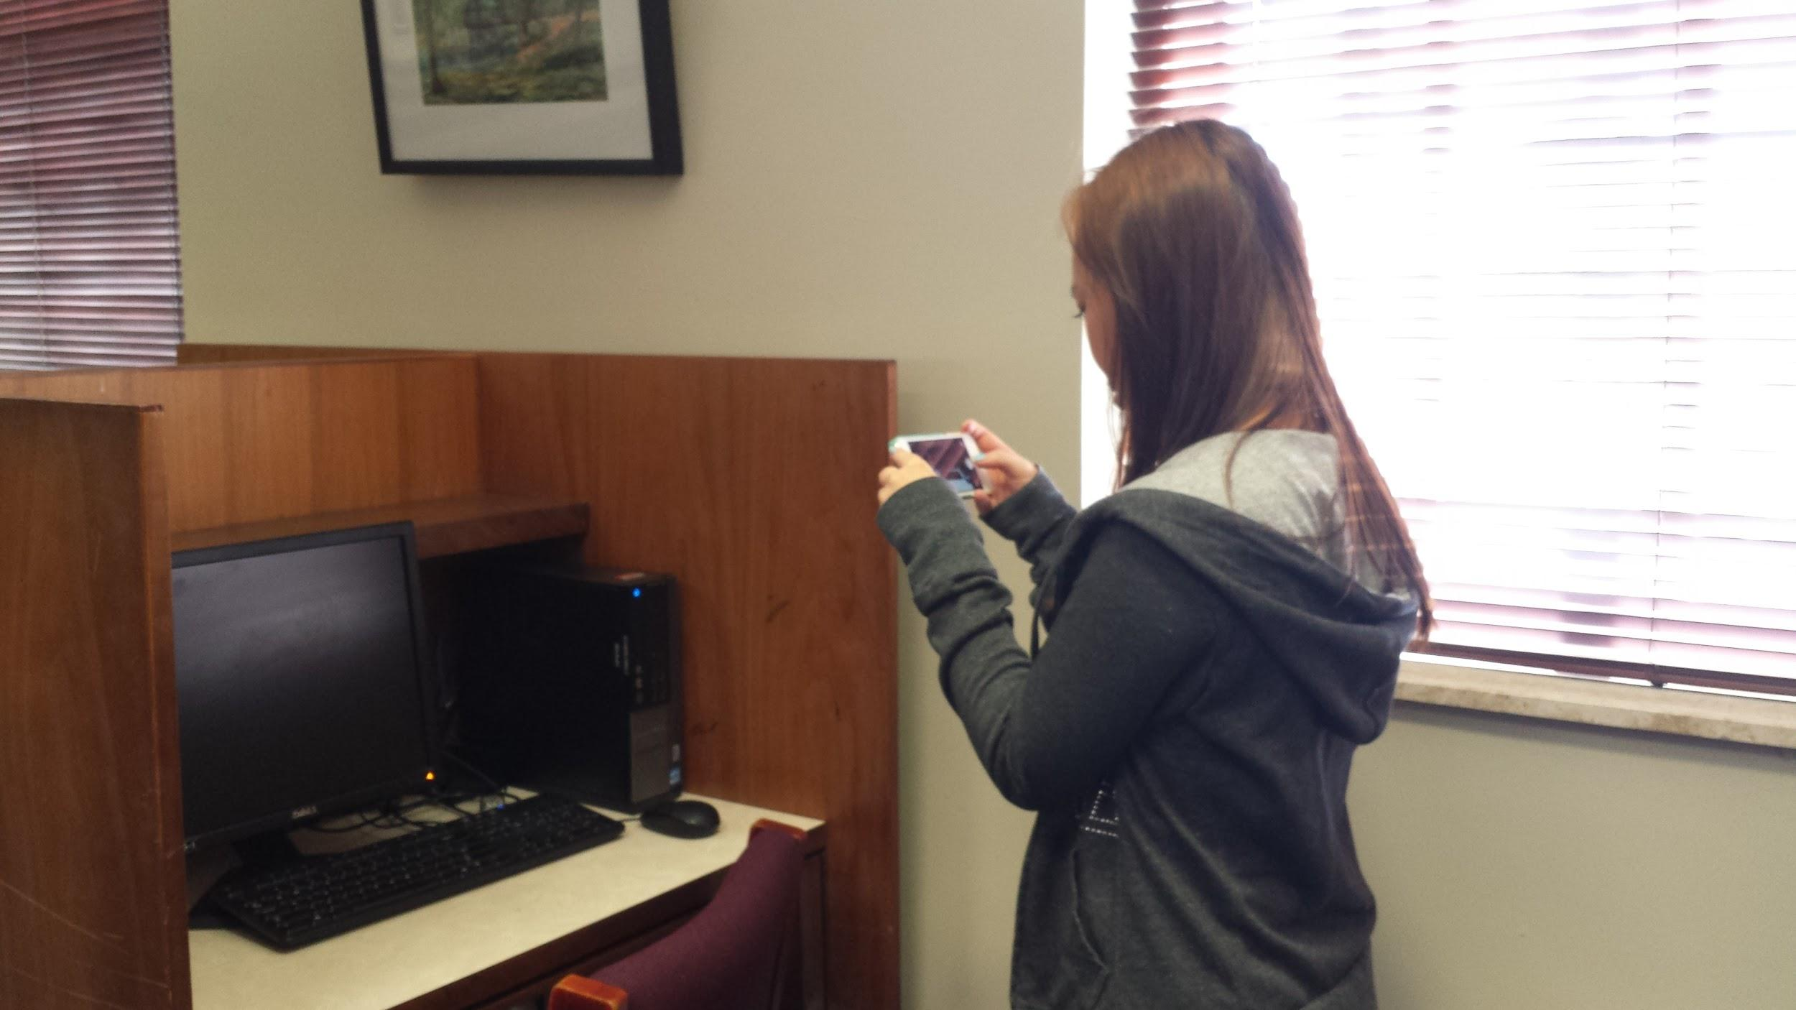
Student Audits

Slide 24
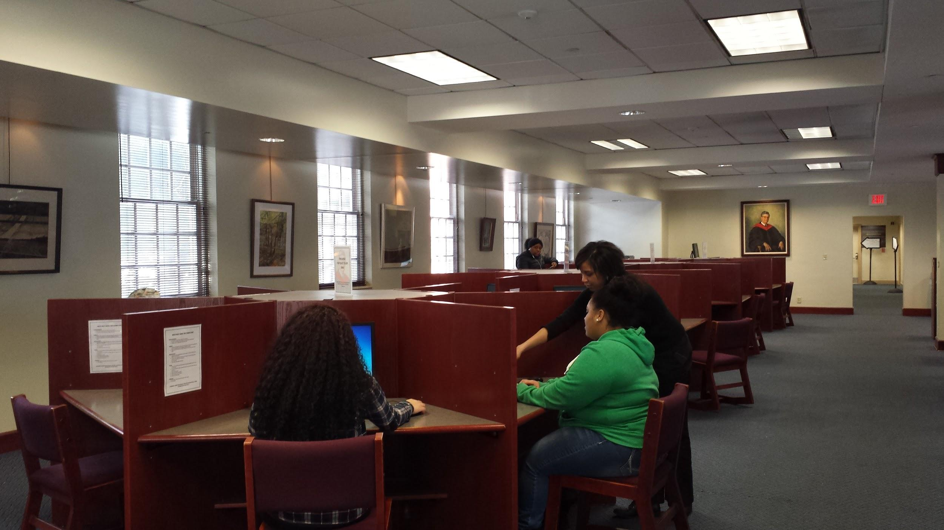
“Things I Like”: Friendly Staff

Slide 25
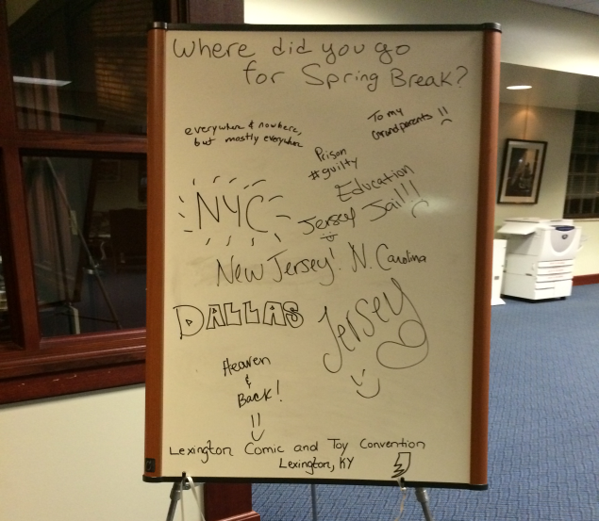
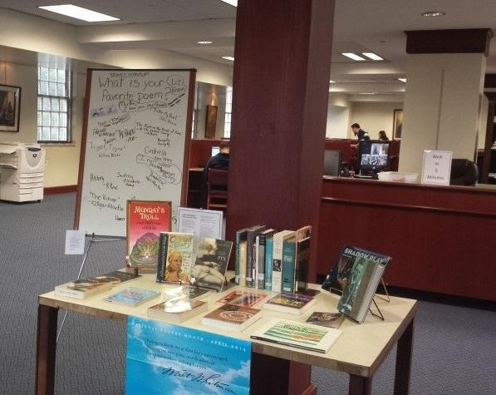
“Things I Like”: Displays & Polls

Slide 26
“Things I Like”: Consortium

Slide 27
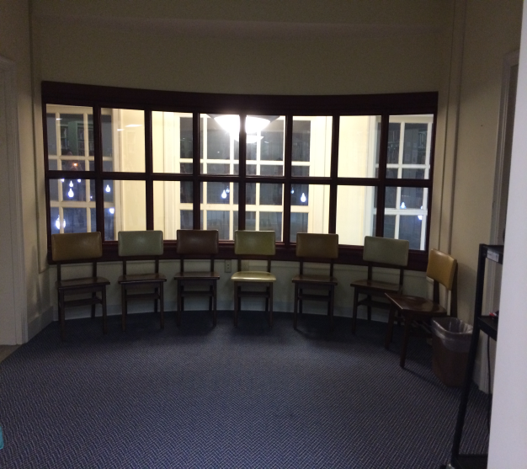
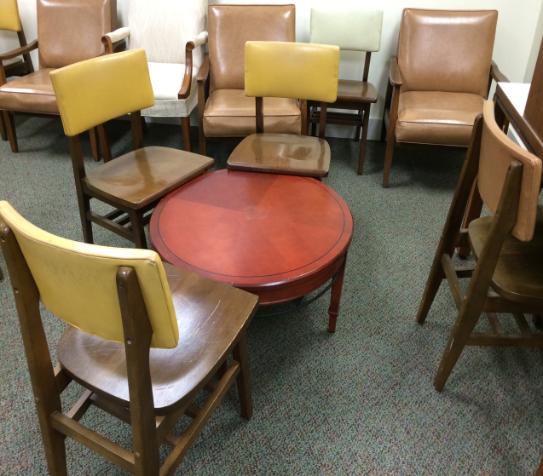
“Things I Don’t Like”: Study Areas

Slide 28
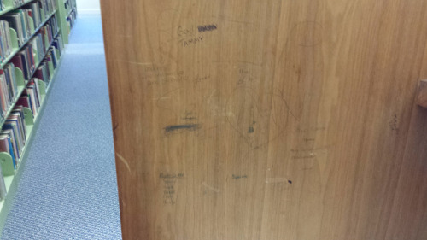
“Things I Don’t Like” Furniture

Slide 29
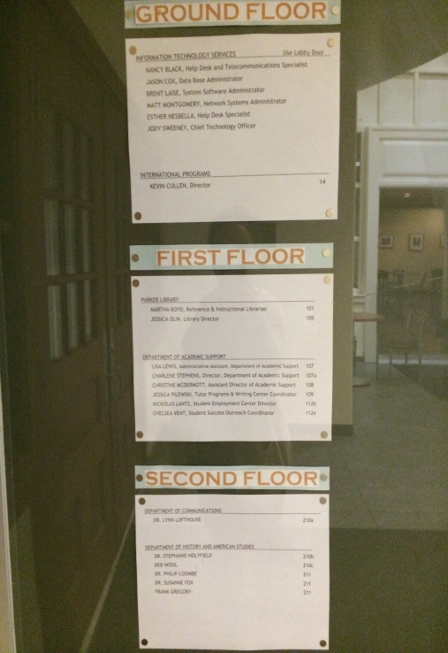
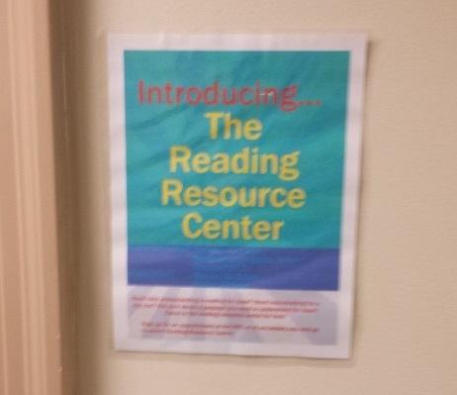
“Things I Don’t Like”: Signs

Slide 30
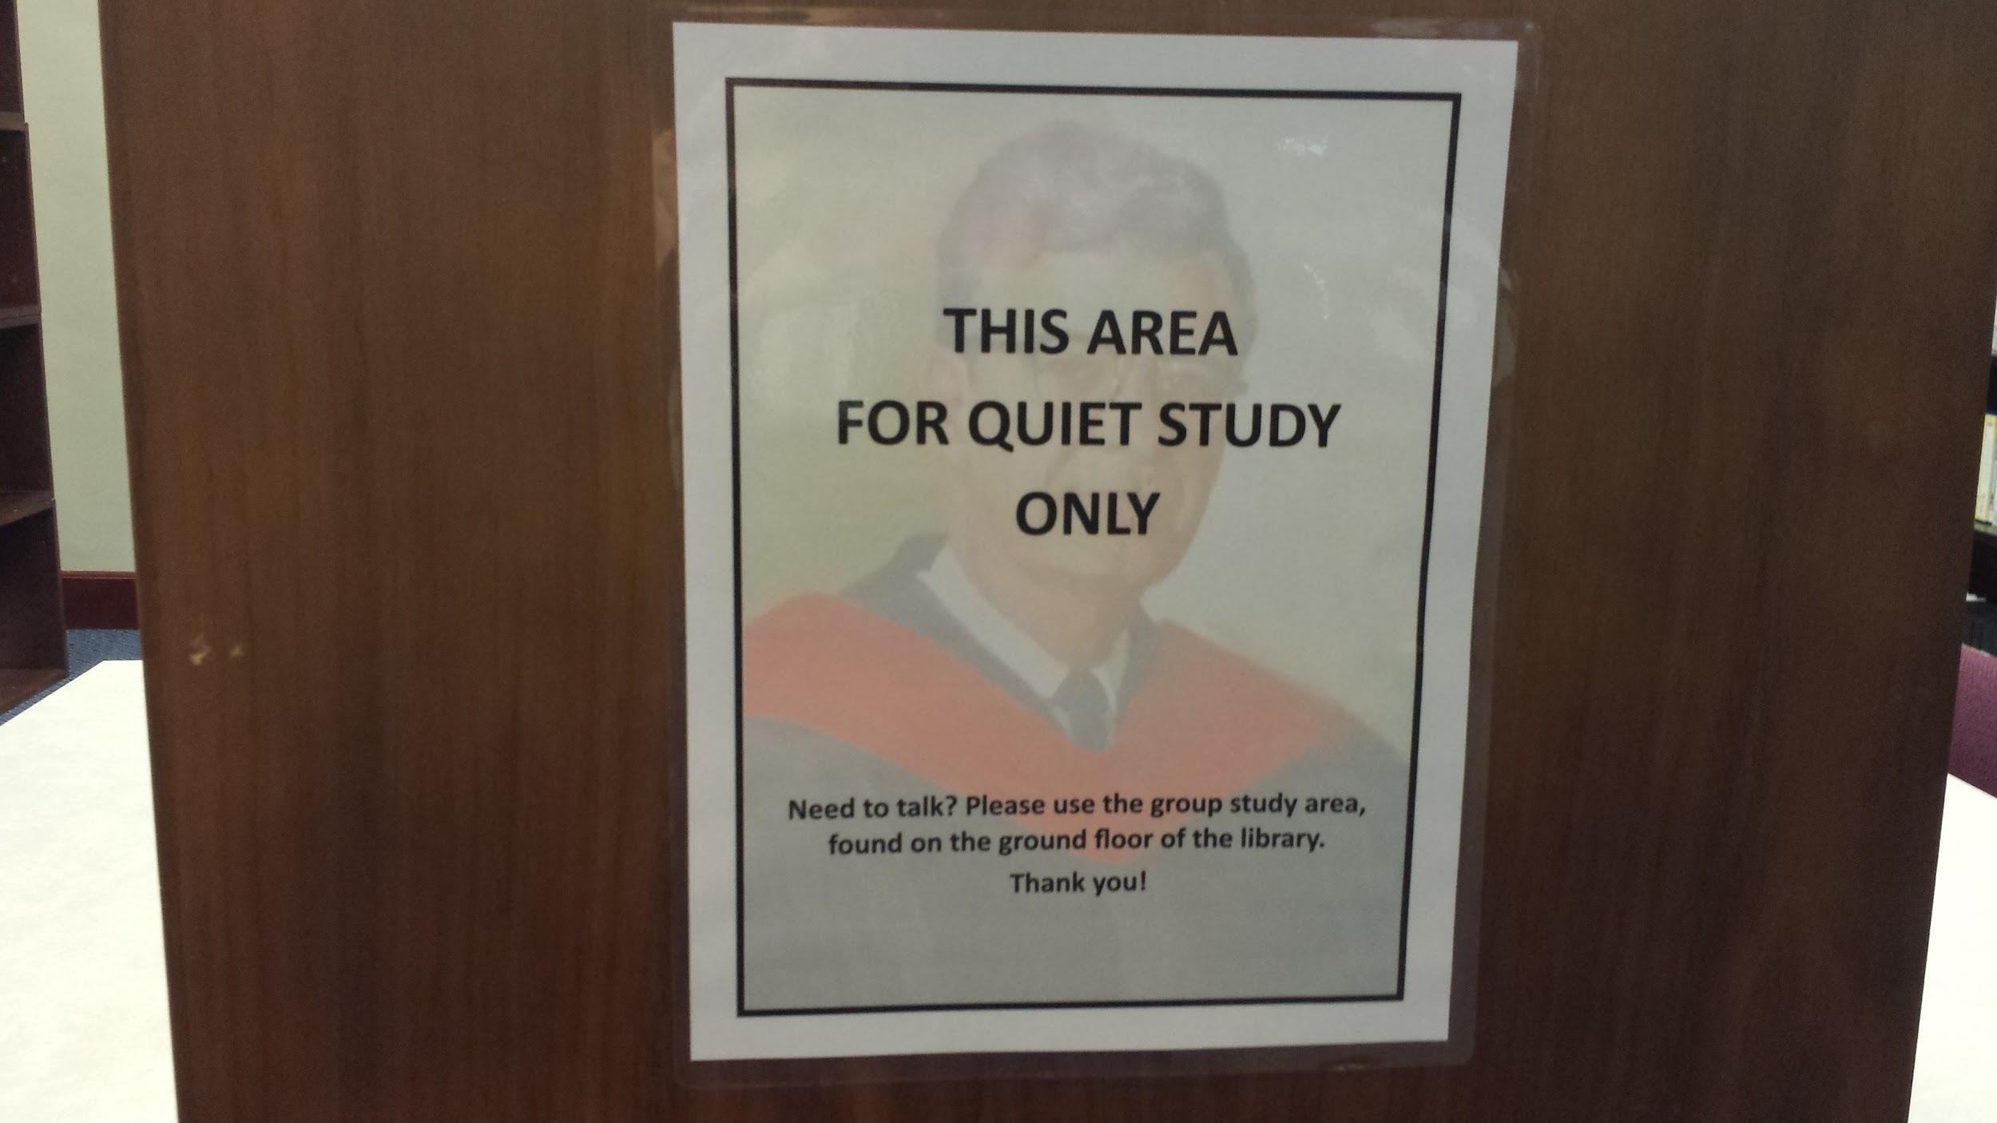
“Things I Don’t Like”: Noise

Slide 31
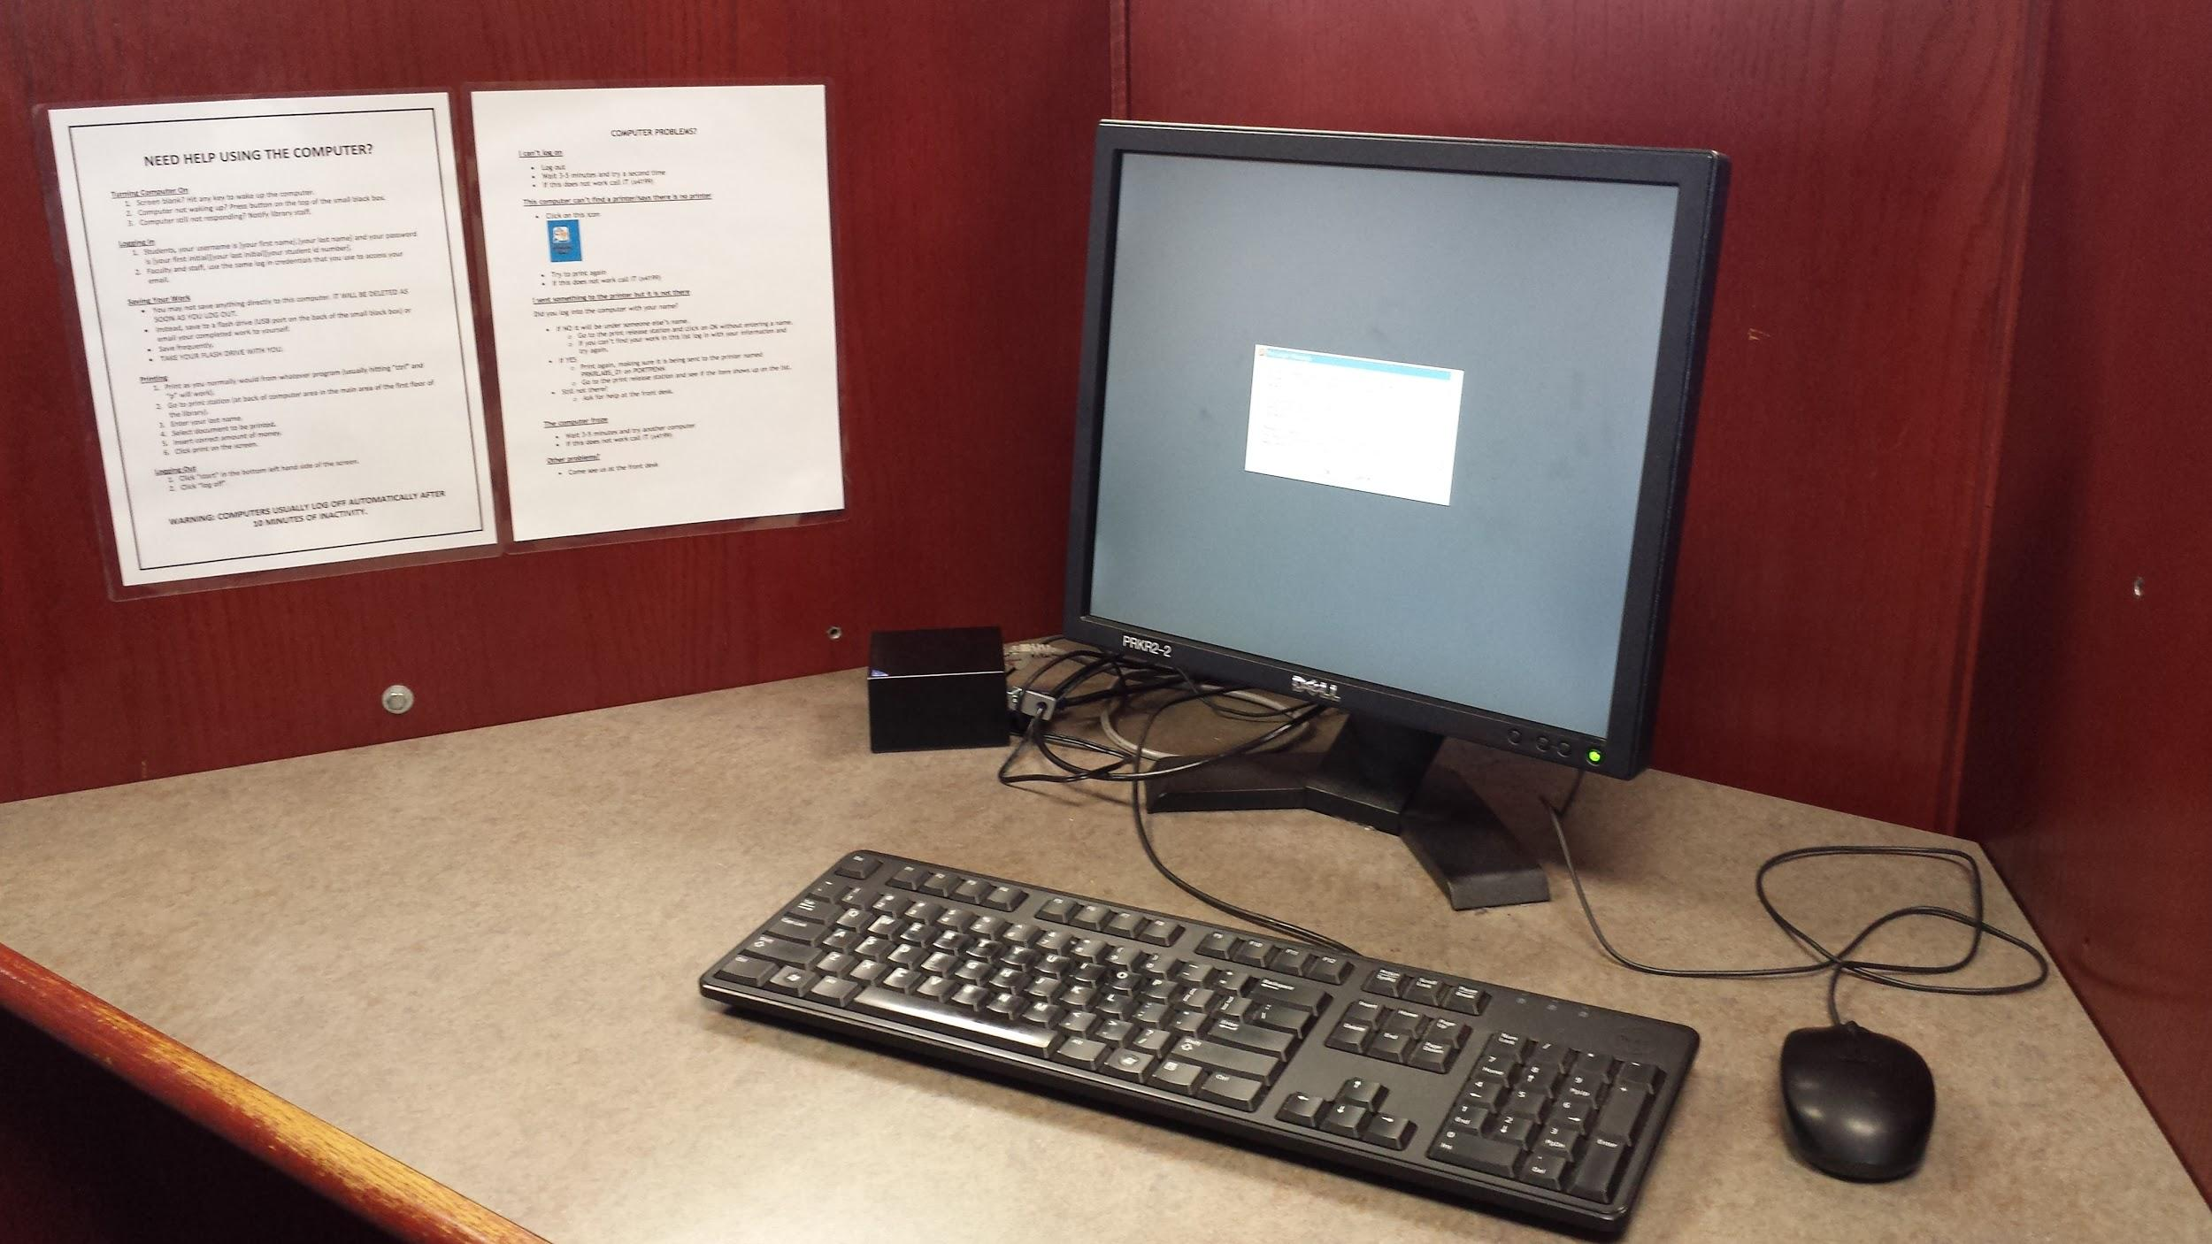
“Things I Don’t Like”: Computers

Slide 32
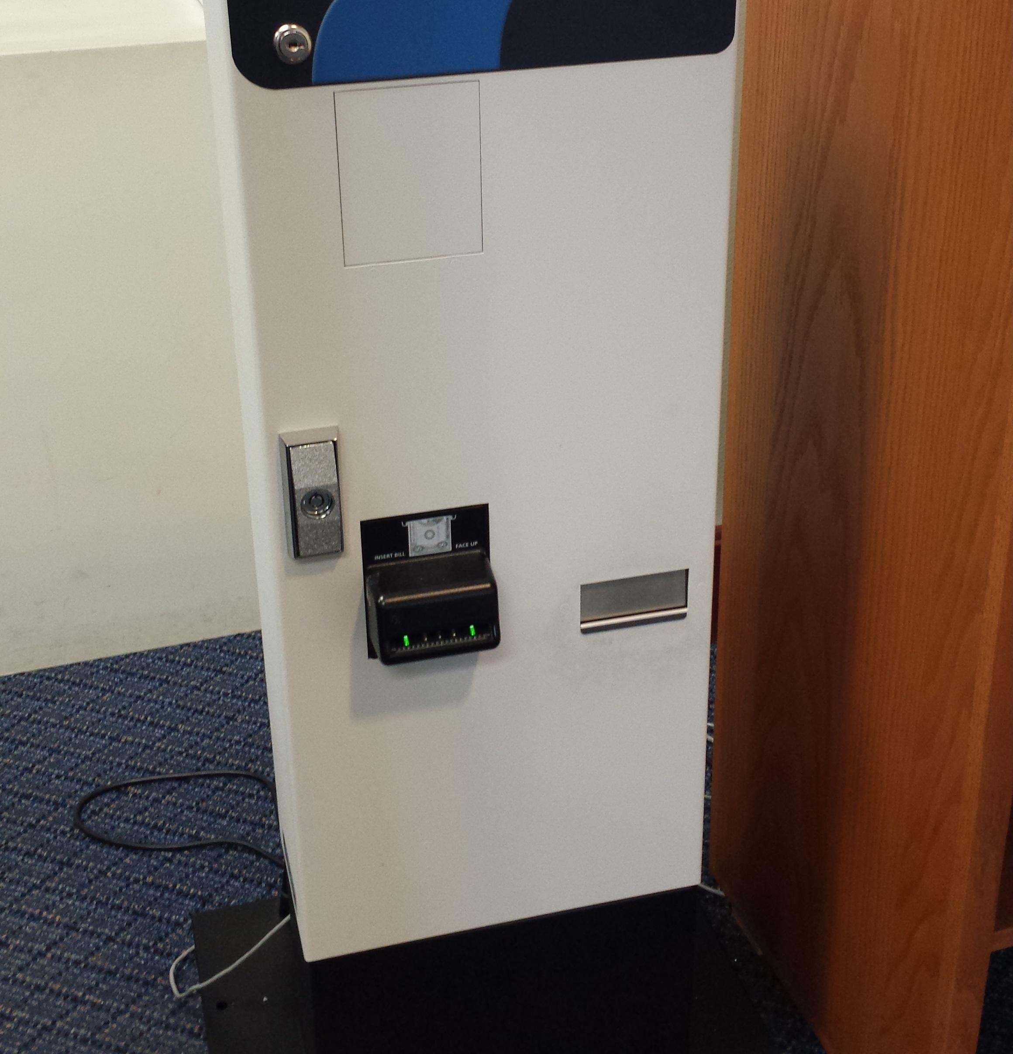
“Things I Don’t Like”: Pay for Print

Slide 33
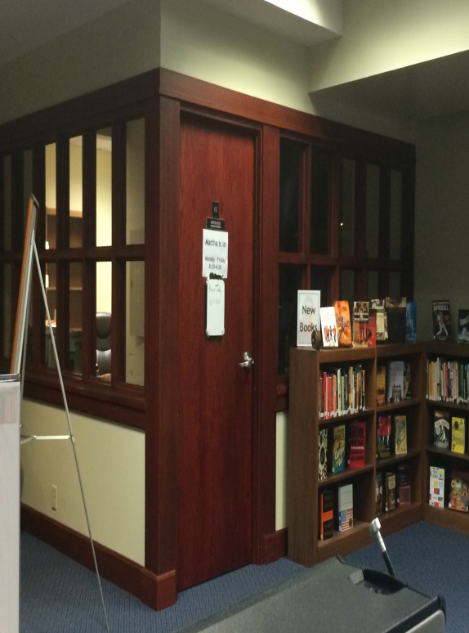
“Things I Don’t Like”: Librarian Offices

Slide 34
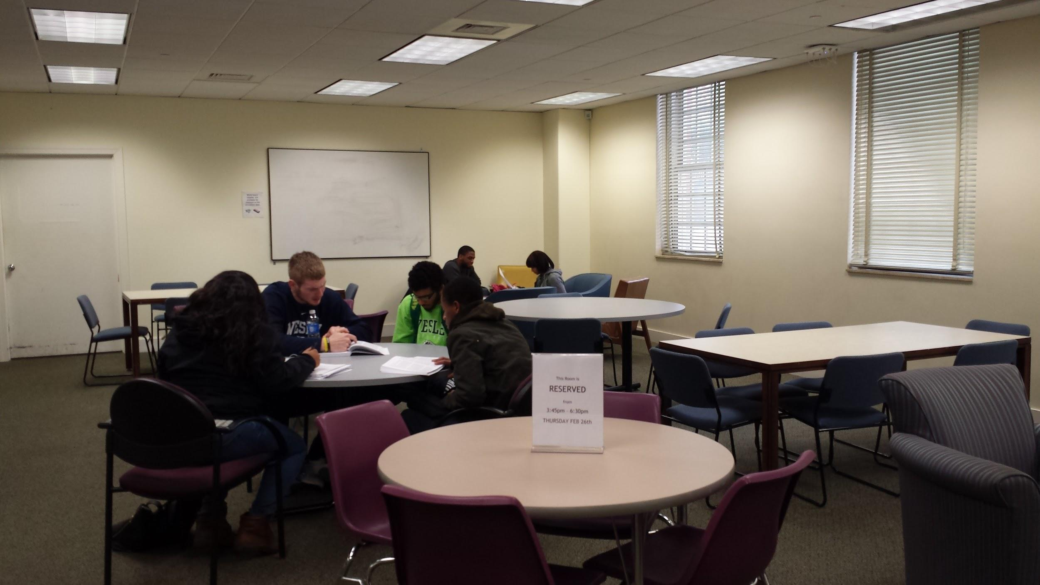
Changes Made: Basement Study Room

Slide 35
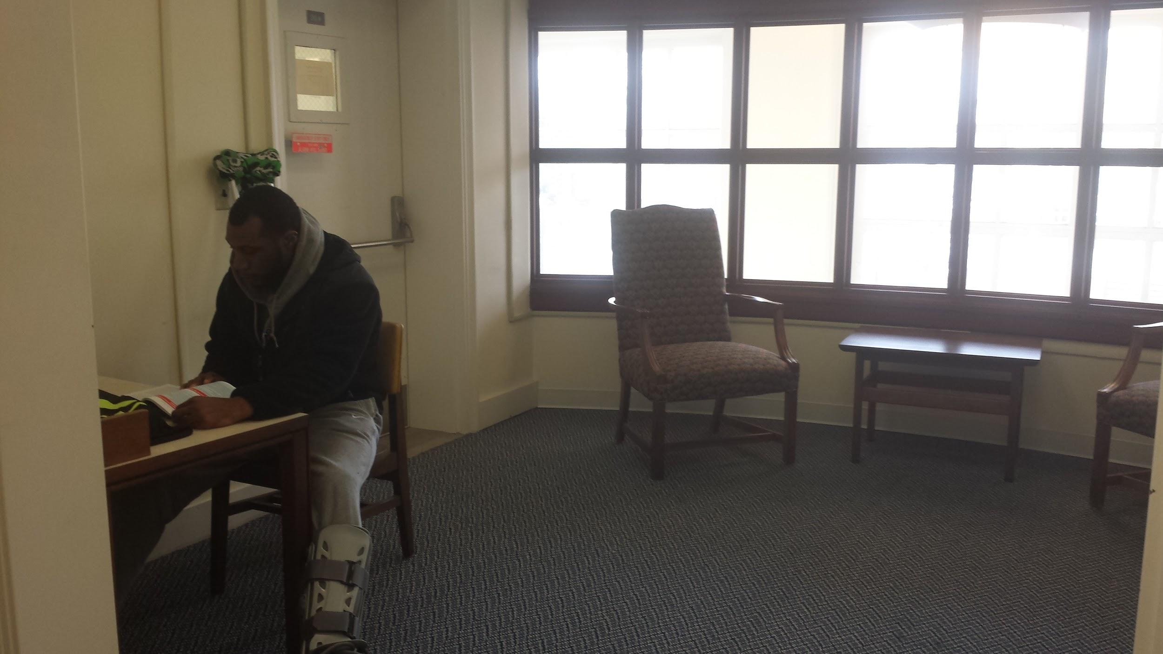
Changes Made: Second Floor Alcove

Slide 36
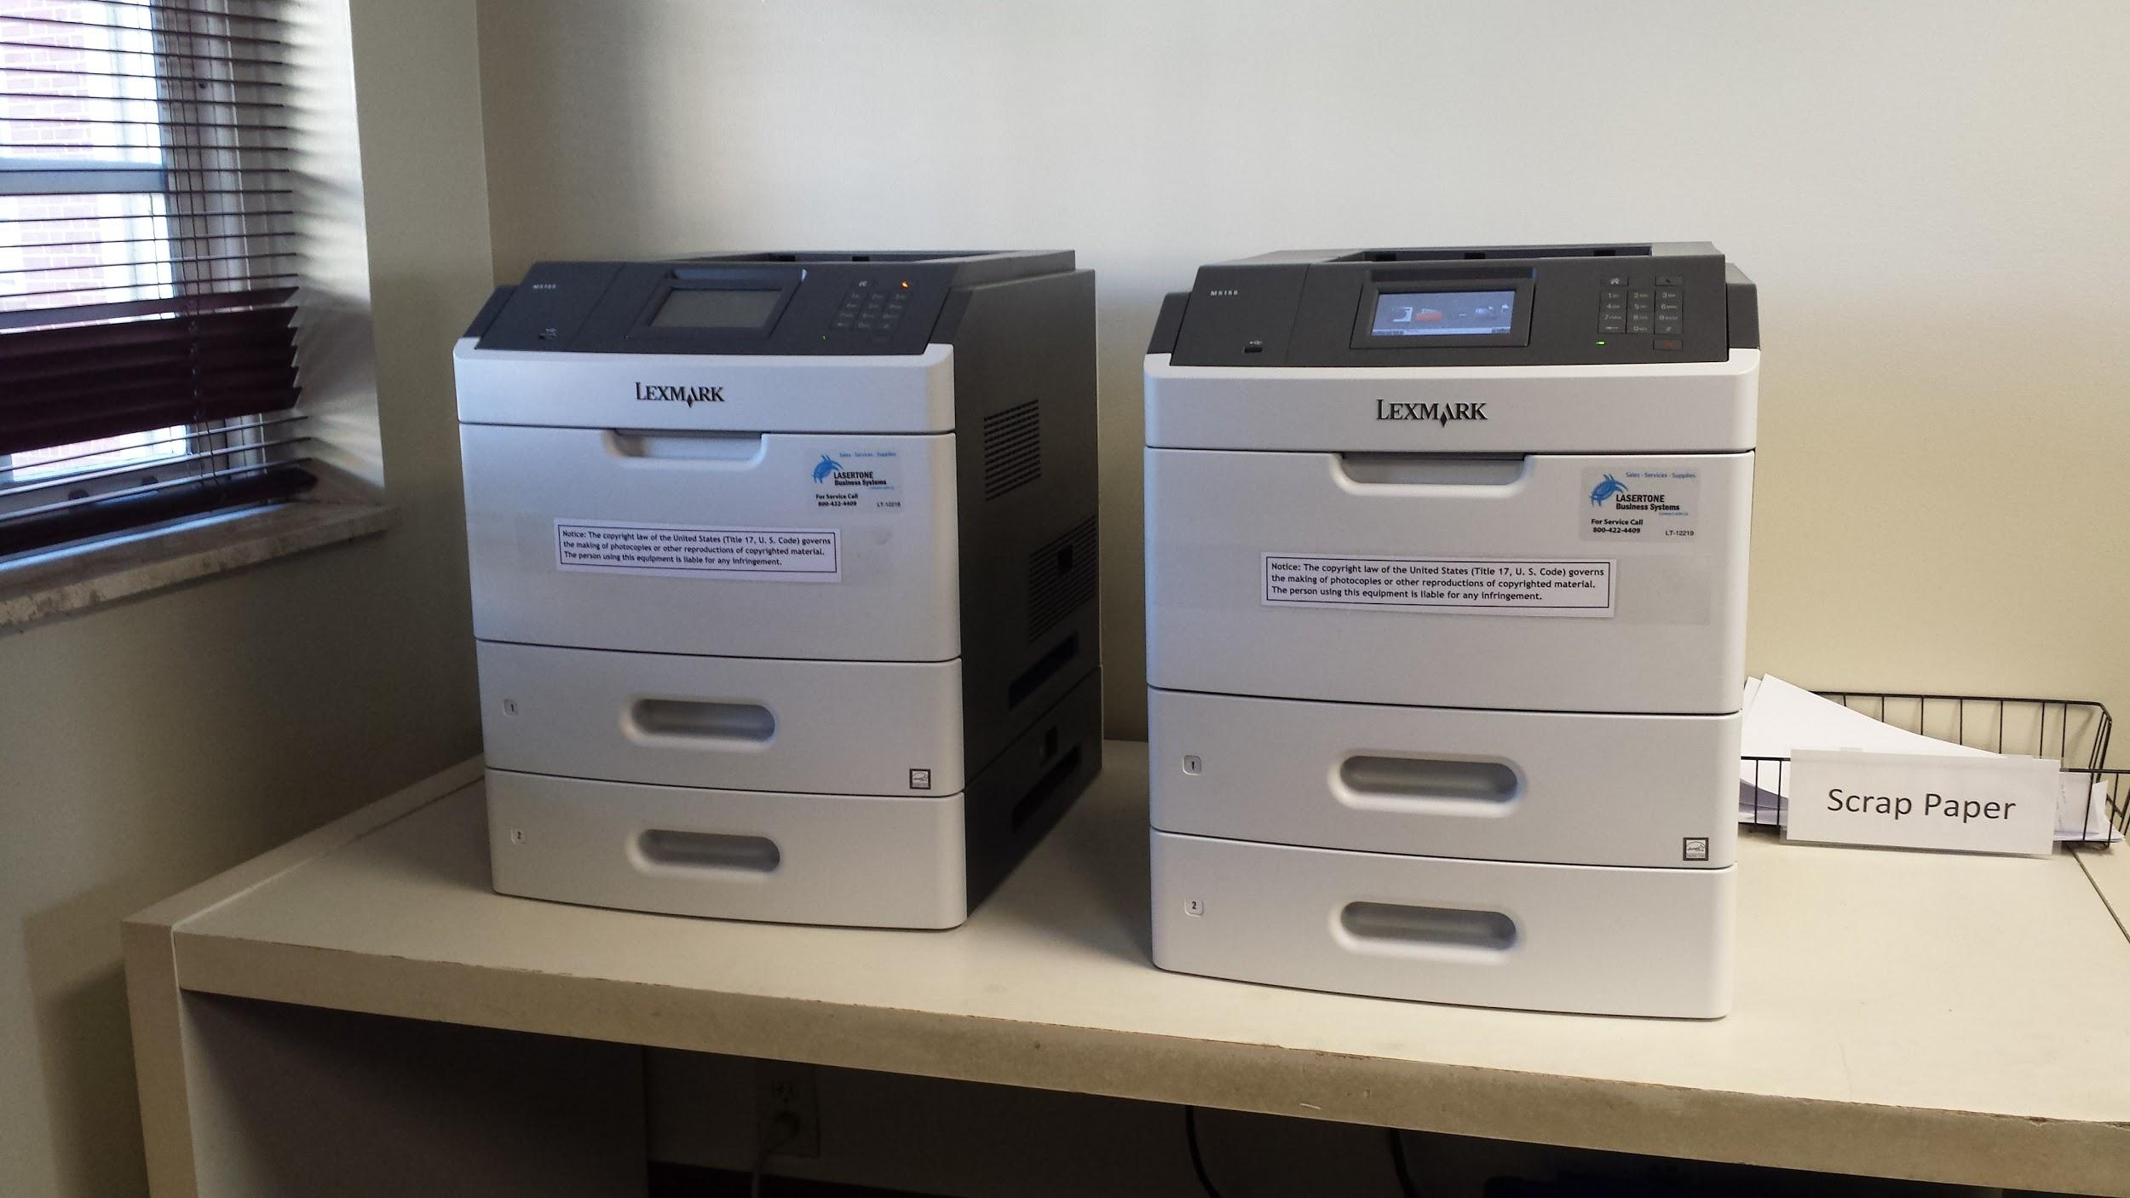
Changes Made: New Printers

Slide 37
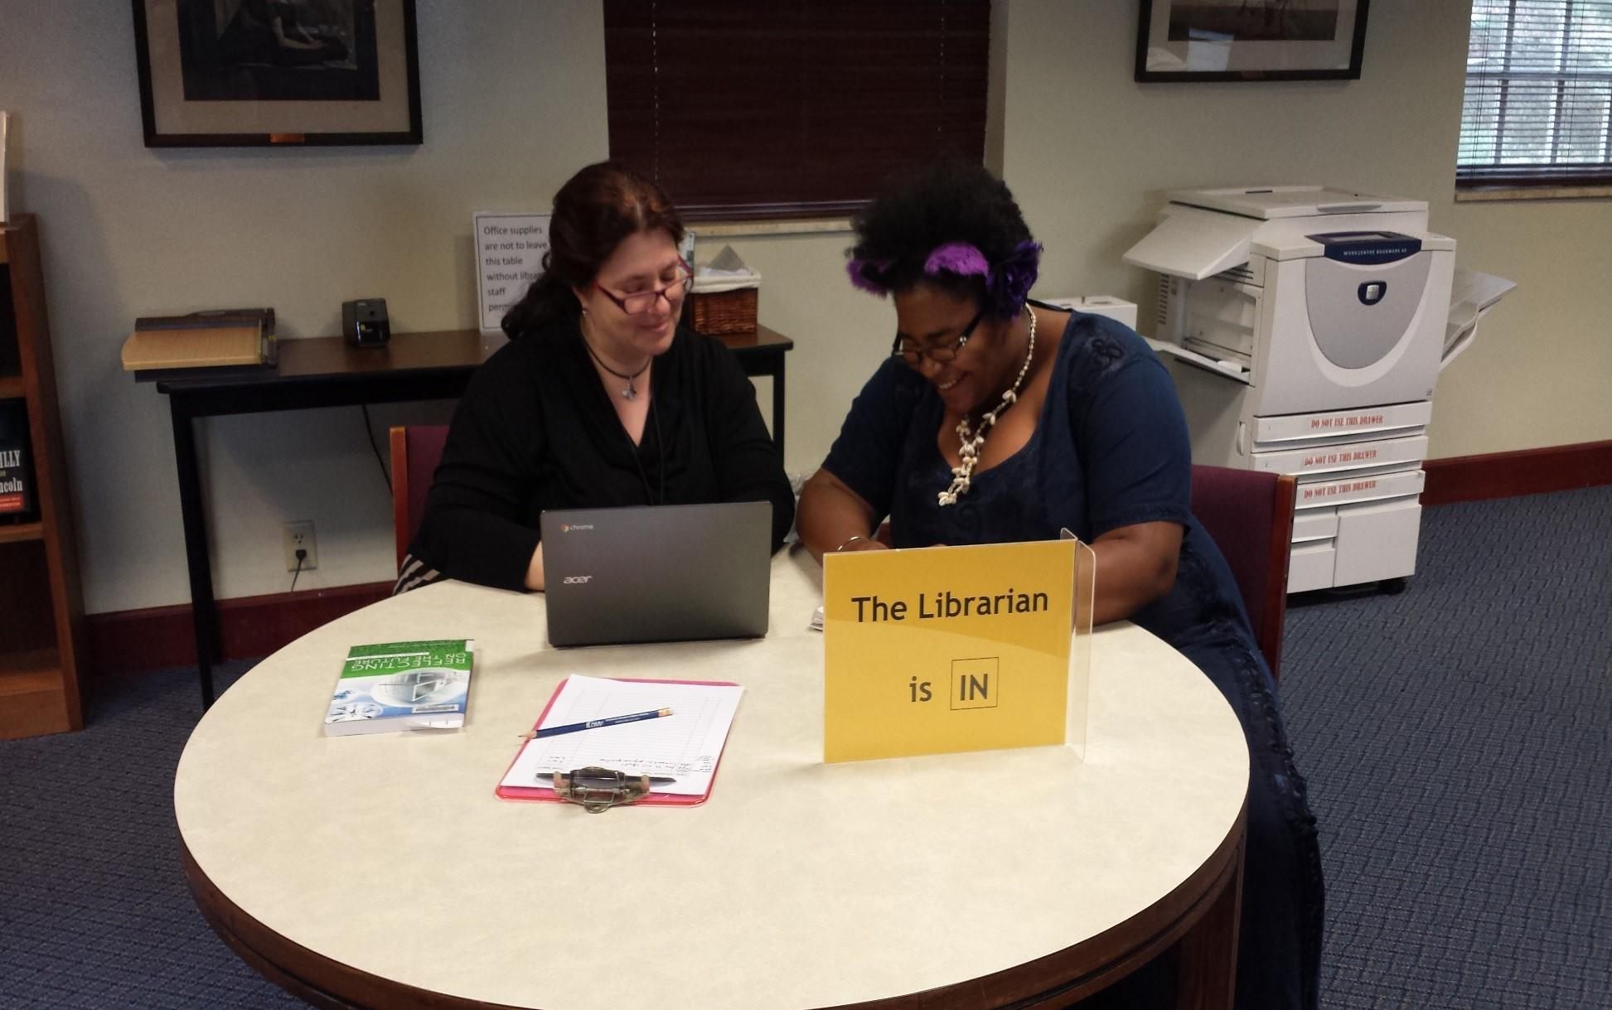
Changes Made: Reference Desk

Slide 38
What surprised us:
Overlap with librarian audits
Consortium
Easy fixes

Slide 39
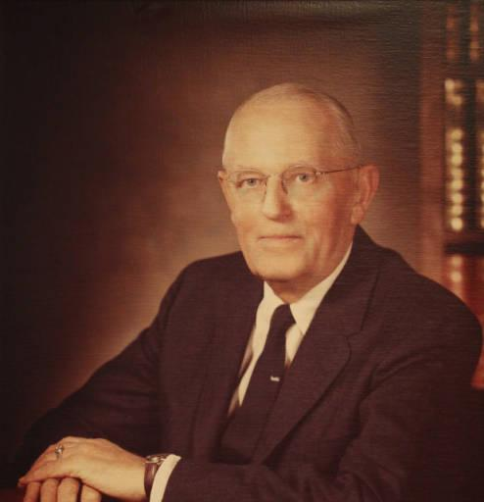
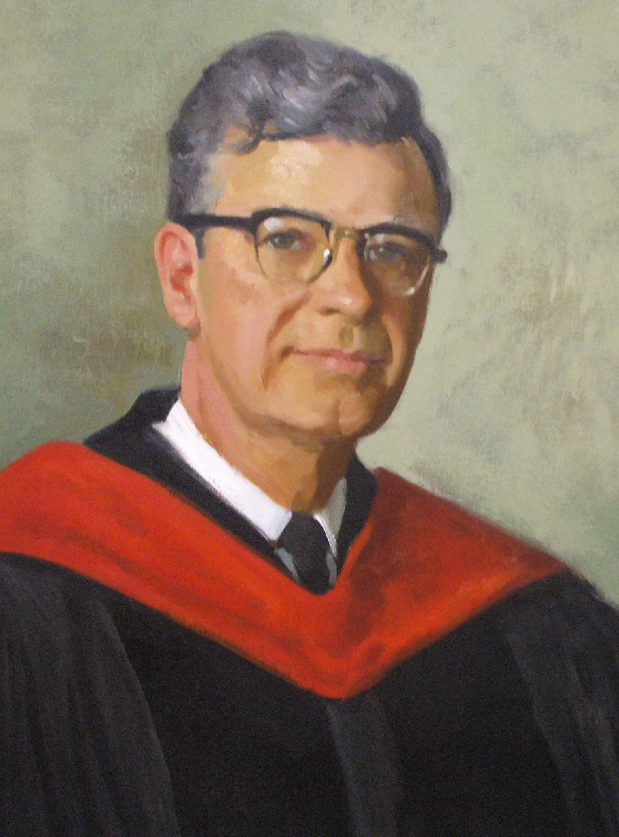
Context Based Differences
Image credit: Medical College of Wisconsin
Notes:
-some joke/comment about these being our libraries’ namesakes
Joe:
New to campus, easier to take off my librarian hat, but needed historical overview from co-workers. Don’t have overall decision-making/budgeting authority.

Slide 40
Your Turn
Notes:
source: https://flic.kr/p/qbvP1a
Joe: kindness audit w/ students, all new first-year students, explicit instructions.

Slide 41
Caveats
ADA
International
Cultural
Shared Spaces
Need States
Campus Regulations
Improvement Cycle

Slide 42
Audience Participation
Ways to connect today:
Chat window;
#acrlkindness or @mrlibrarydude or @olinj;
librarykindnessaudit@gmail.com.
Notes:
Joe

Slide 43
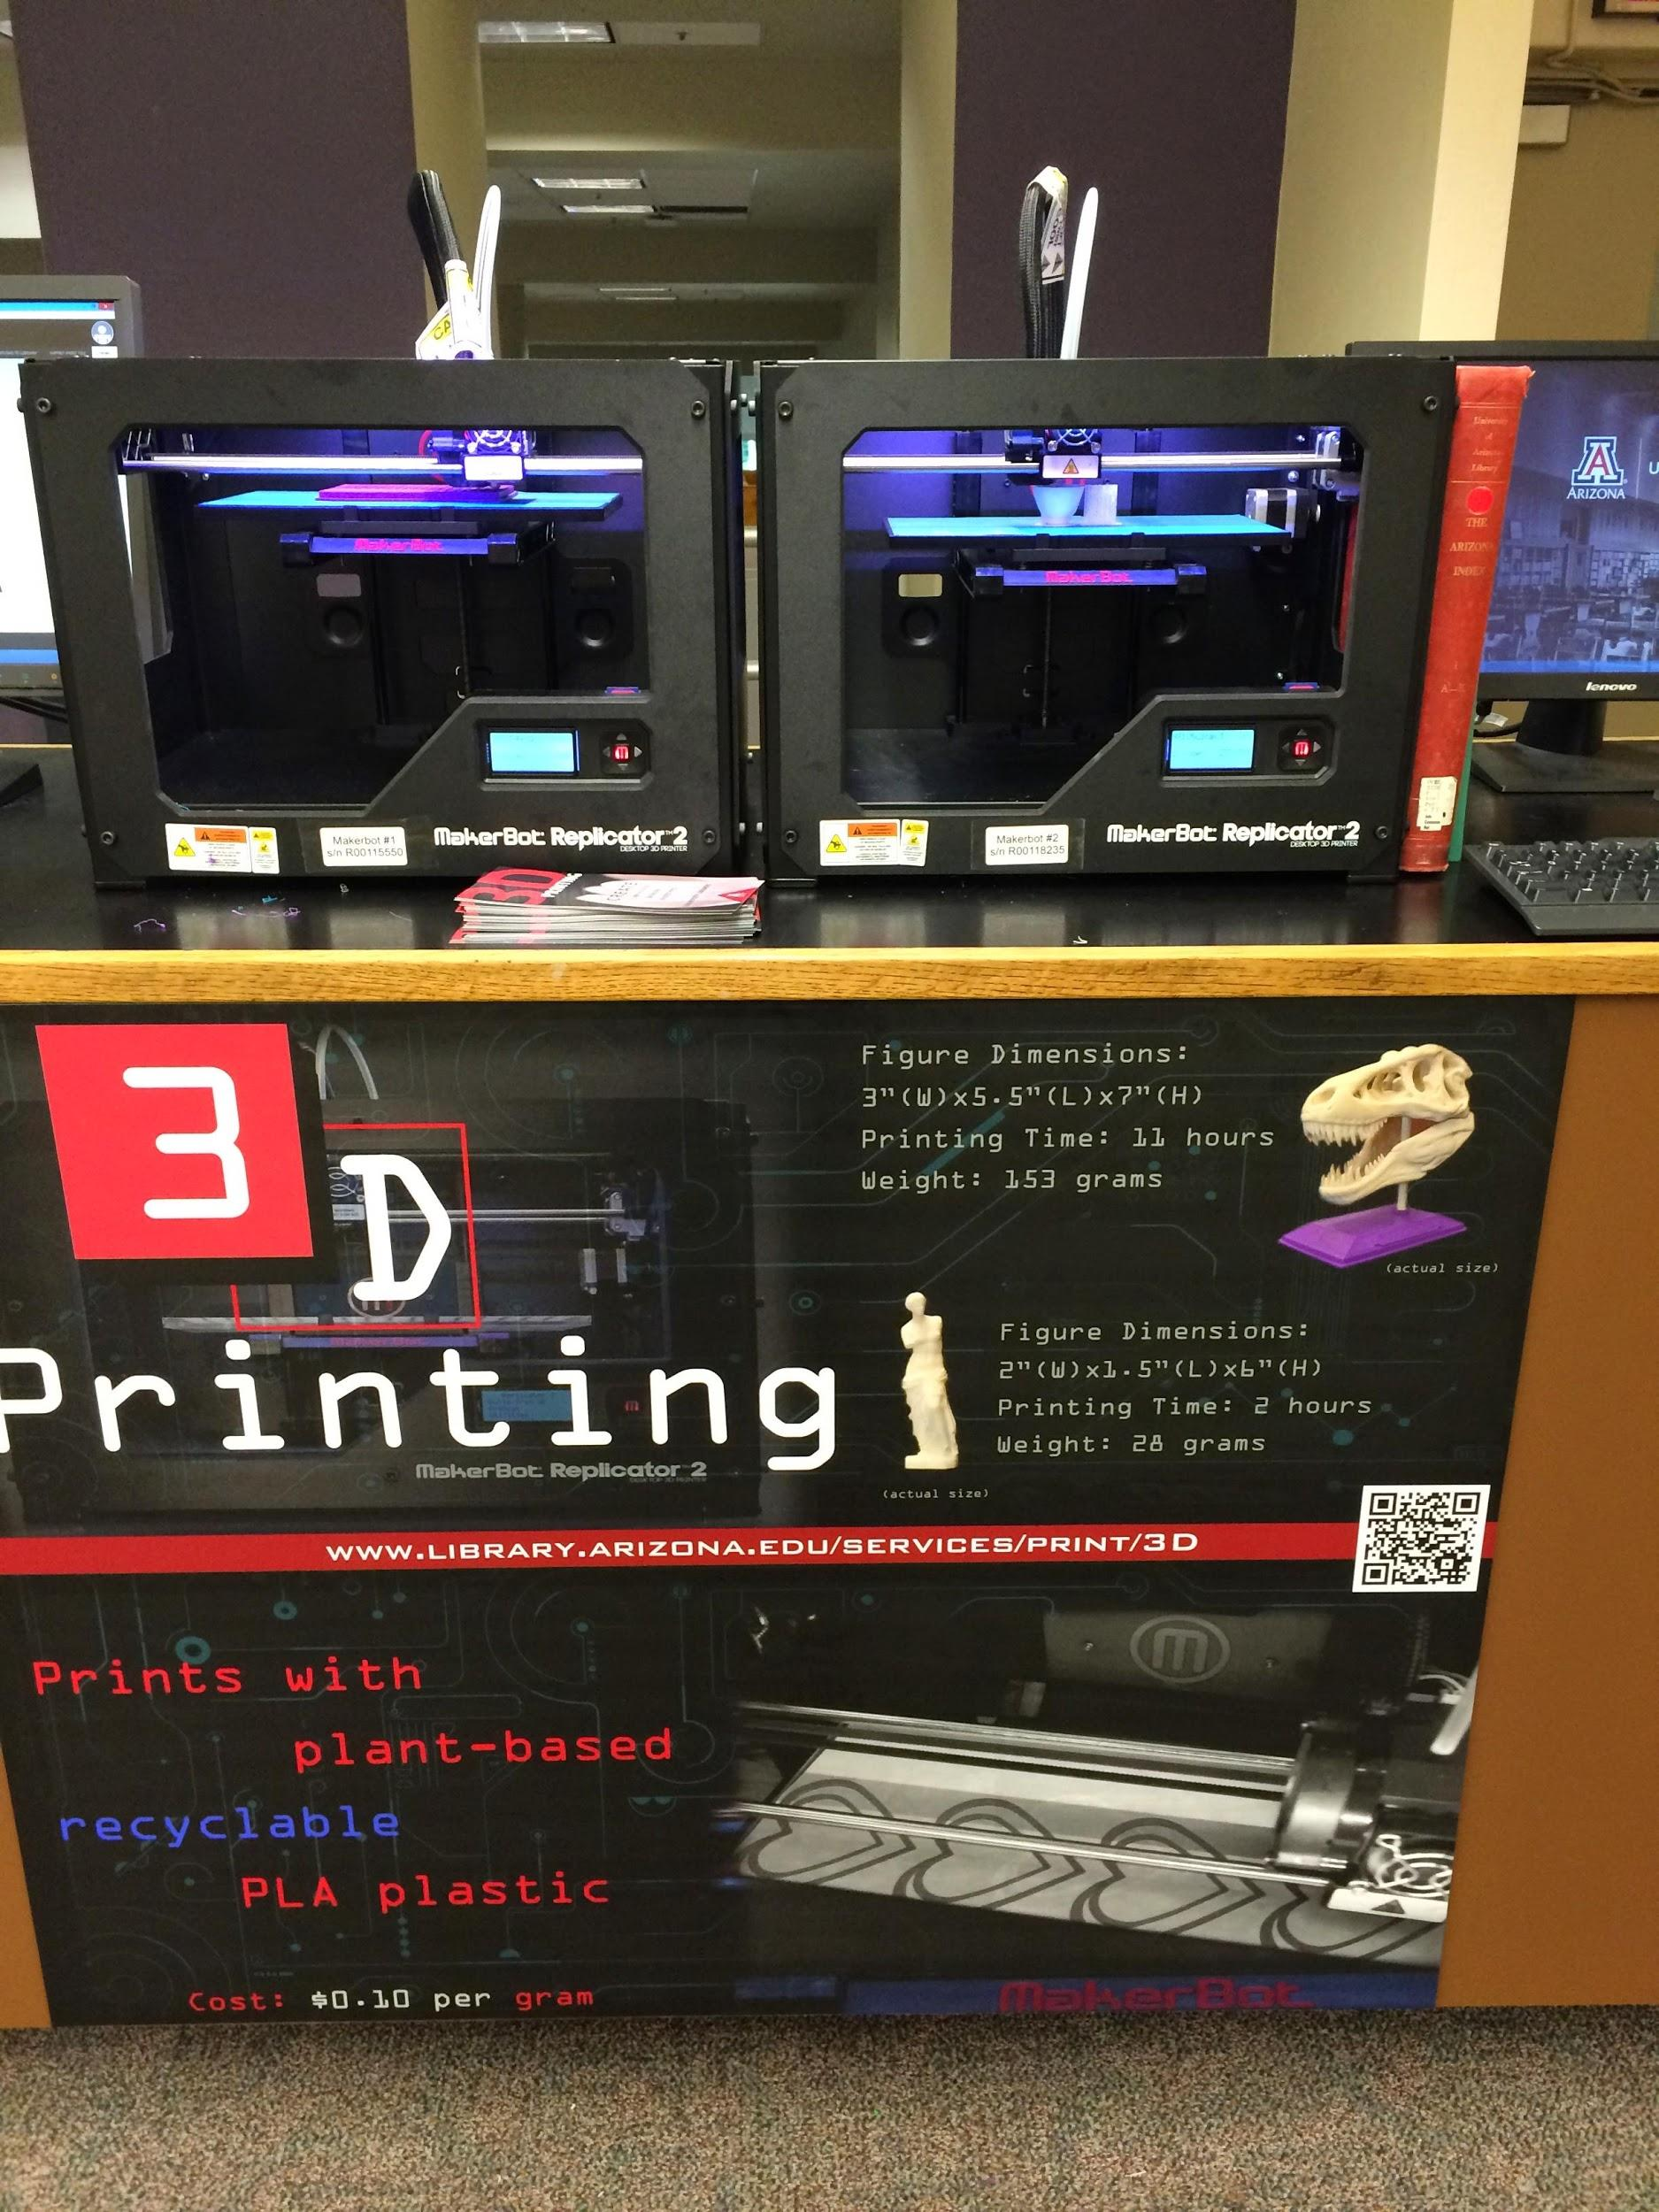
Audience Participation
Picture from Alia Moore at The University of Arizona University Libraries.
Notes:
Joe
Alia Moore, University of Arizona
3D Printing, new service
Open to the community = another way to be “kind”
Be mindful of the lettering on black background.

Slide 44
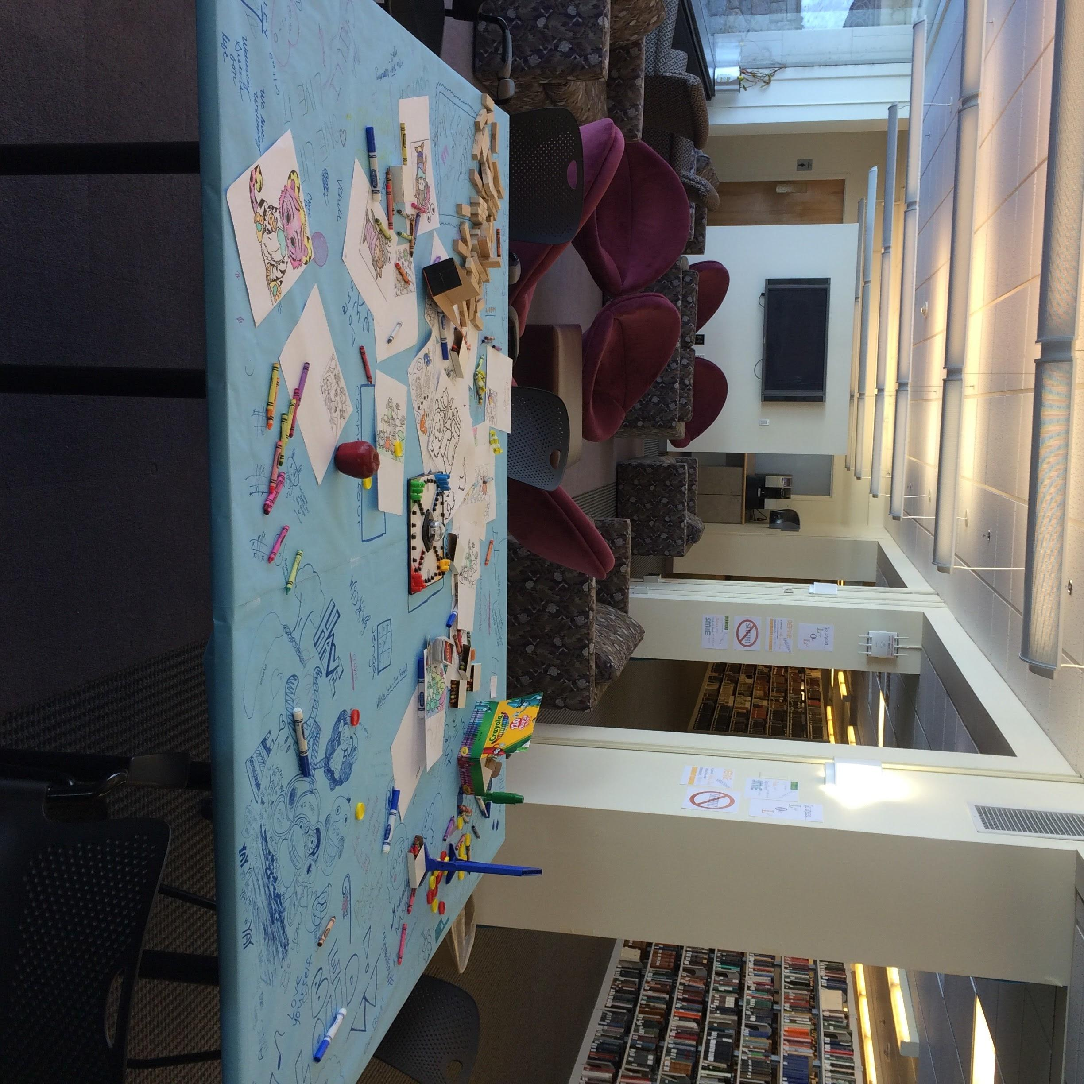
Audience Participation
Picture from Megan Brooks at Wellesley College.

Slide 45
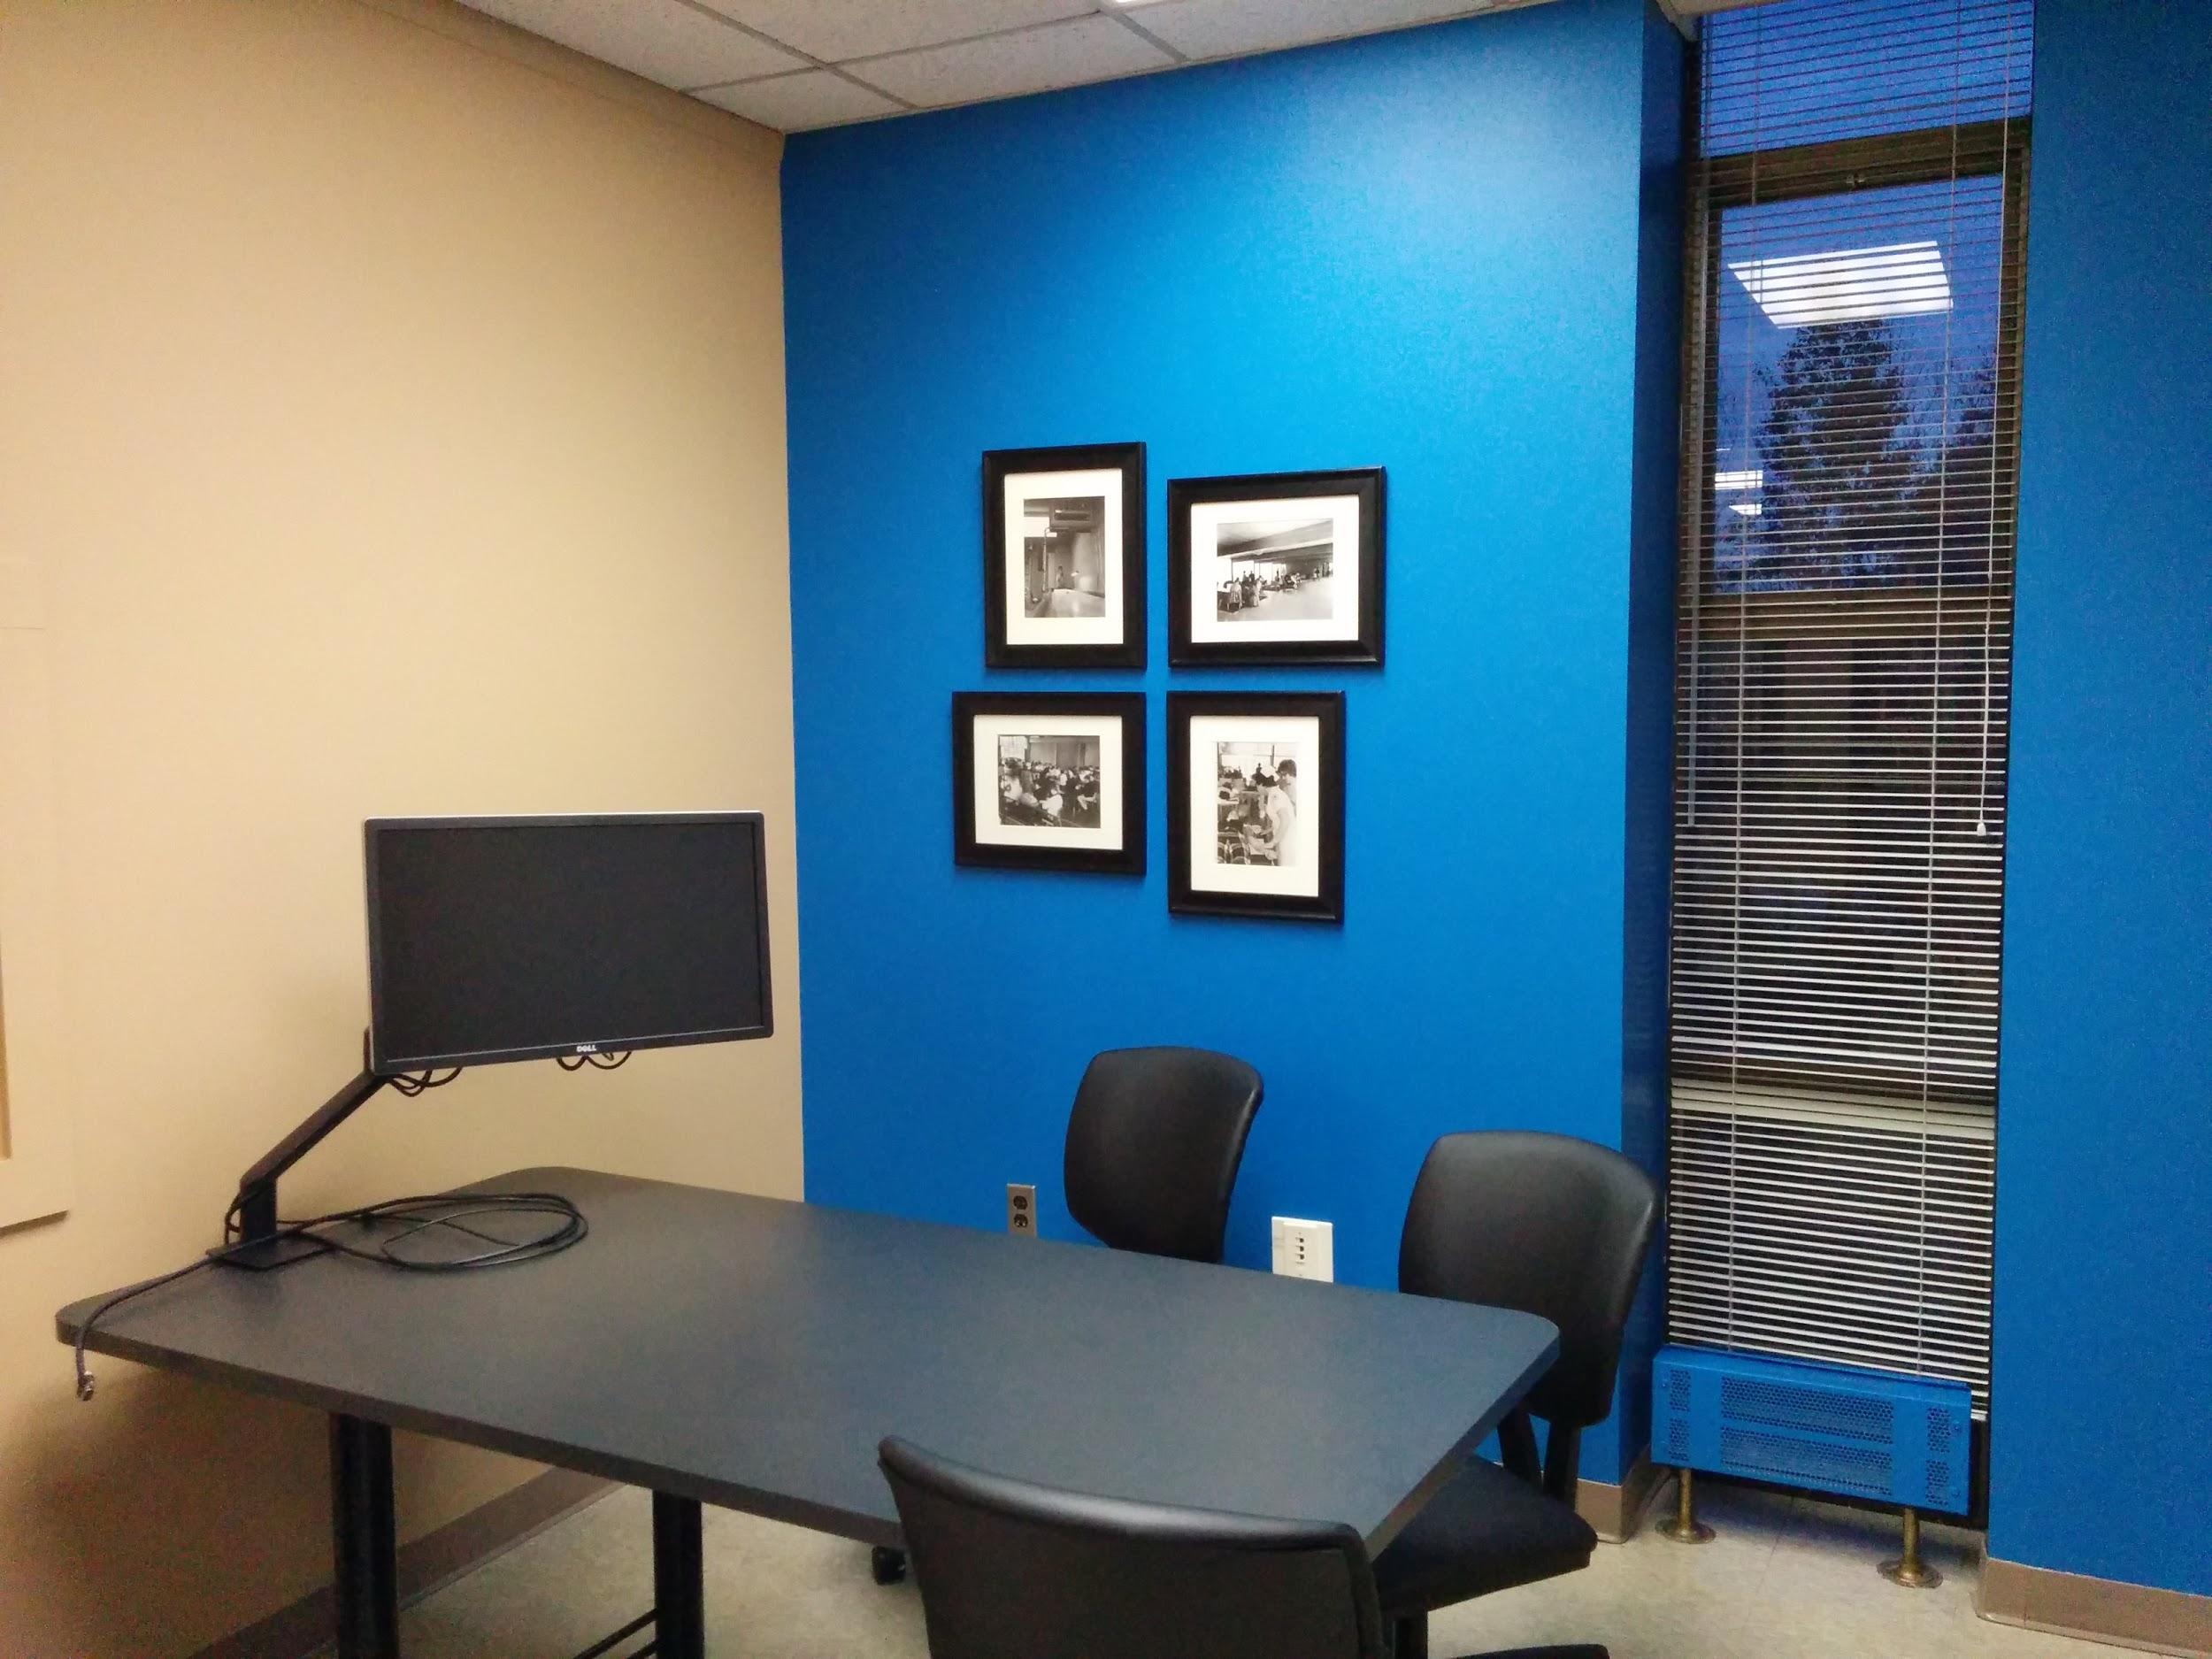
Audience Participation
Picture from Andrew Whitis at University of Findlay.
Notes:
Joe
From Andrew Whitis at the University of Findlay
Study Room, new accent wall

Slide 46
Further Questions:
Jessica: librarianjessica@gmail.com or @olinj
Joe: joehardenbrook@outlook.com or
@mrlibrarydude

