Slide 1
PINS, SMORES AND DOODLES
15 CREATIVE WAYS TO USE FIVE SOCIAL SHARING TOOLS
Association of College & Research Libraries Annual Conference
Portland, Oregon
March 26, 2015
#acrlpins
Abby Stambach
The Sage Colleges
Lauren Puzier
Sotheby’s Institute of Art

Slide 2
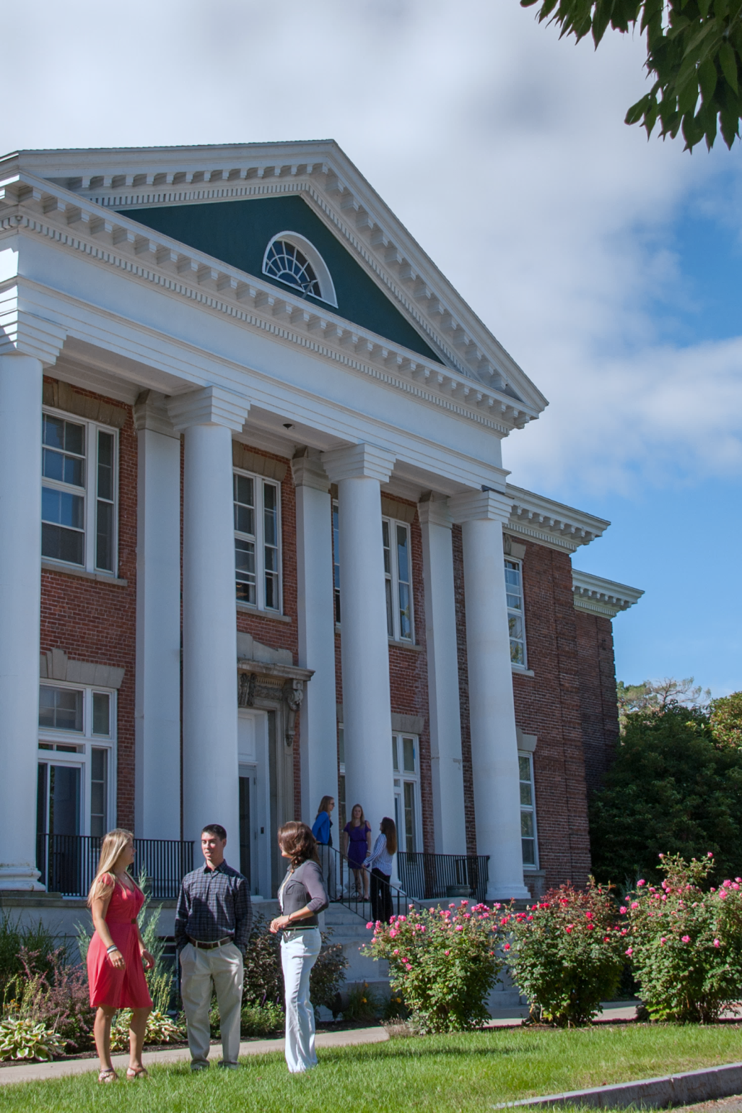
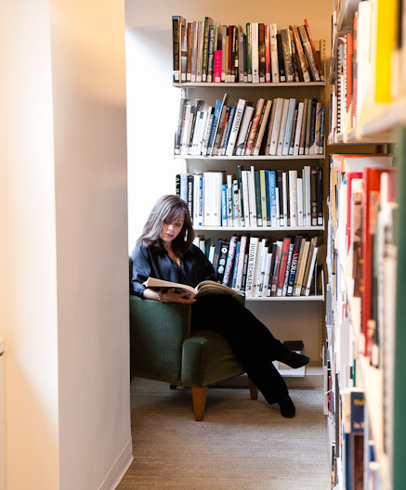
About Us
Notes:
Sage
3,000 students across two campuses in Upstate NY
Offer BA, MA and doctoral degrees
Recently started online programs that grant BA and Master degrees
These online programs has forced to think re-think how we deliver library services especially for online only students
Sotheby’s
Sotheby’s Institute of Art is a graduate school with two campuses, one in New York and one in London.
In NY we have about 125 new FT students each year.
The institute Offers 3 master degrees in art
Our library collection is specialized art collection with just over 10k volumes.

Slide 3
Poll
What type of institution are you from?
University
Four-year college
Two-year college
Graduate school
Other

Slide 4
What is a social sharing tool?

Slide 5
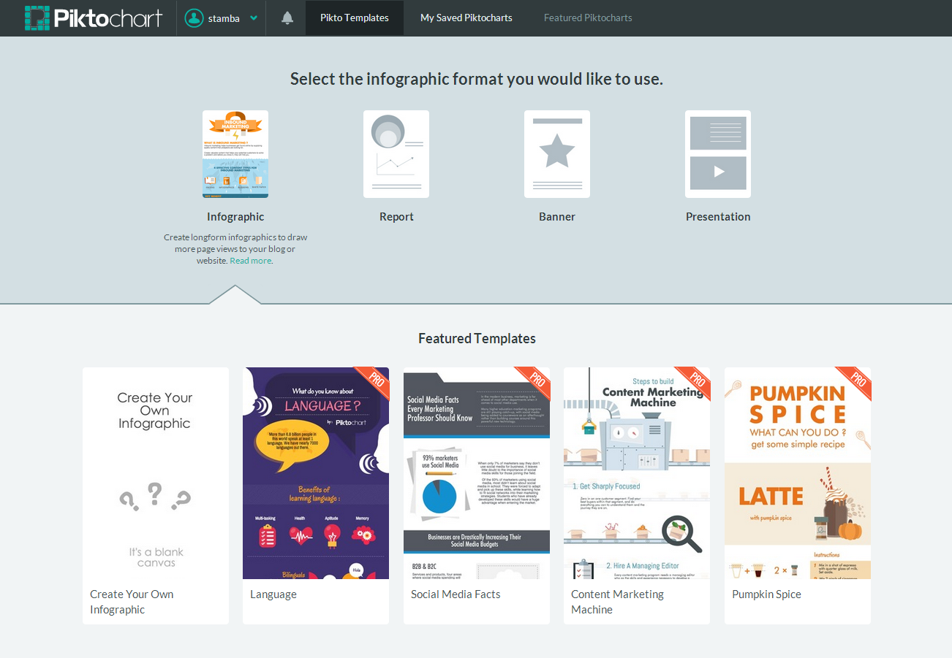
Piktochart
Notes:
Infographic design app for the non-graphic designer
It’s easy to use and even novice users are able to create professional infographics with little effort
Users are able to produce high quality infographics with very little efforts
Has many templates that are easily customized. Also offers several publish options including different file types and paper sizes as well as option to publish directly to a website or various social media
In addition to being used to make infographics, can also be used to make reports, banners and presentations
How it work?
Offers free accounts as well as accounts for educational and non-profit institutions

Slide 6
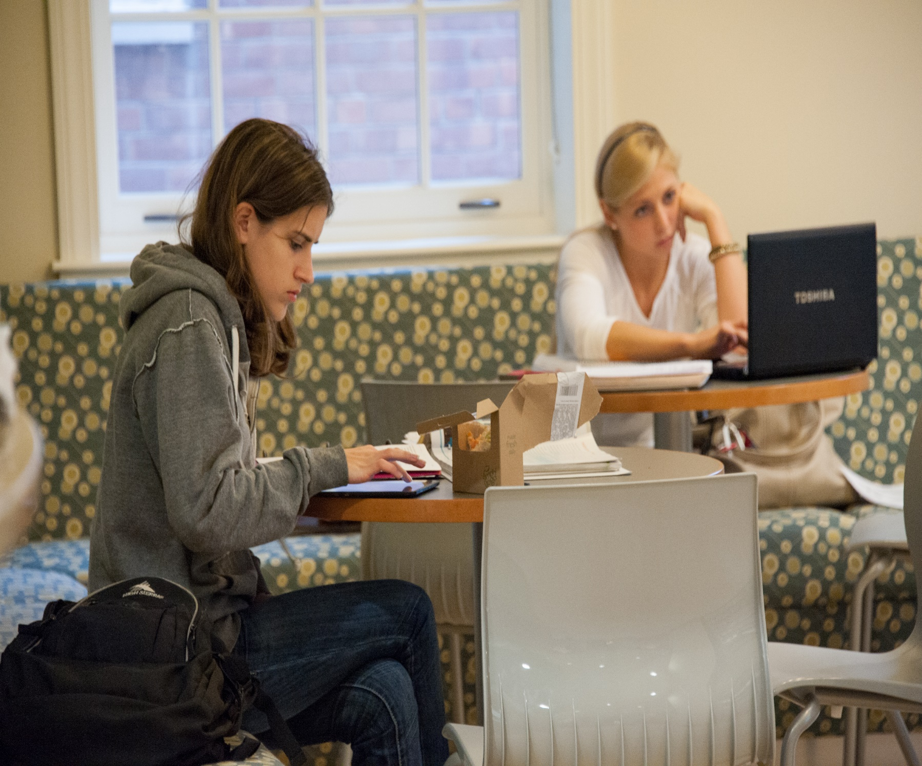
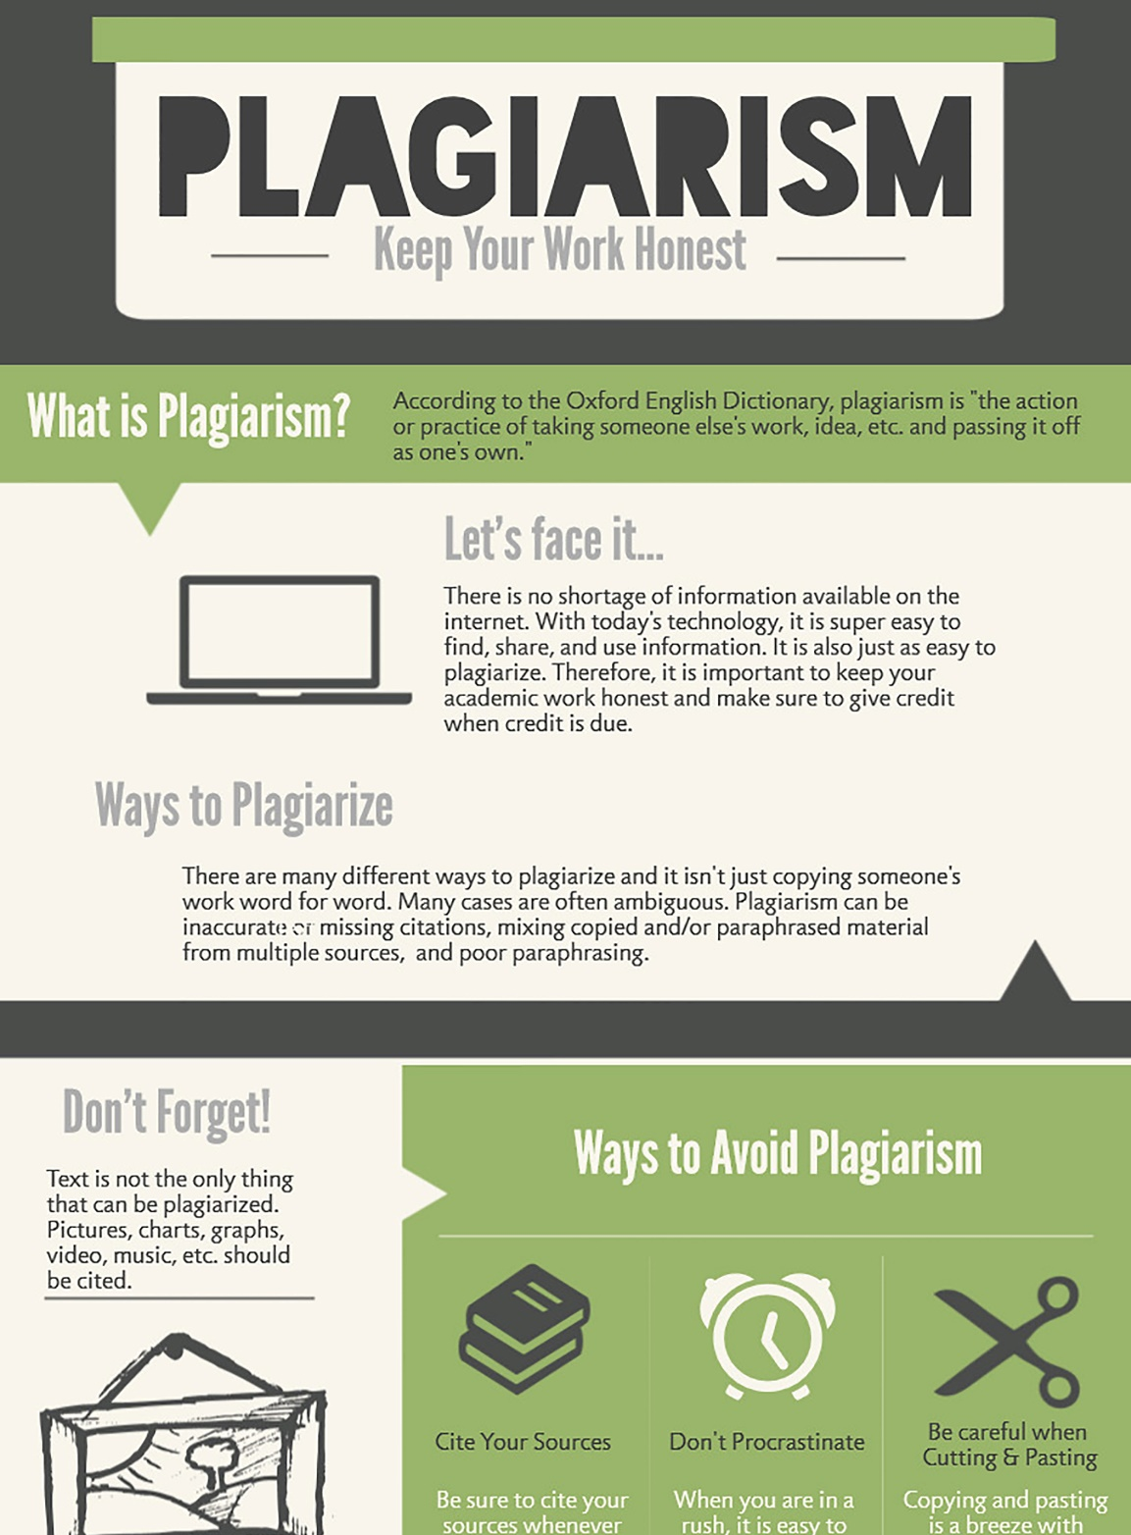
Library tutorials for the DIY student
Notes:
Decline in Reference desk statistics has been highly discussed but in at least Sage’s case, students still need us to help them navigate library resources
Could make argument we are in the DIY generation
Piktochart can be used to be library tutorials for students who rather not make use of in person reference assistance
Sage has previously created library tutorials using Word and have turned these tutorials into infographics
More visually appealing/eye catching and not as wordy as the previous tutorials
Breaks the information into smaller bits that is easier to digest
Also can include visual cues in the tutorials that will help students recall the information

Slide 7
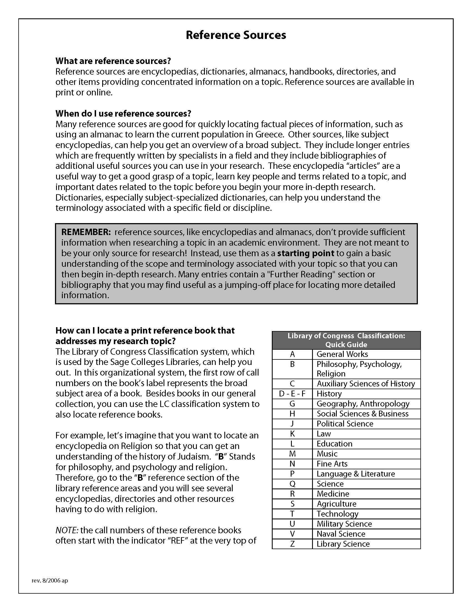
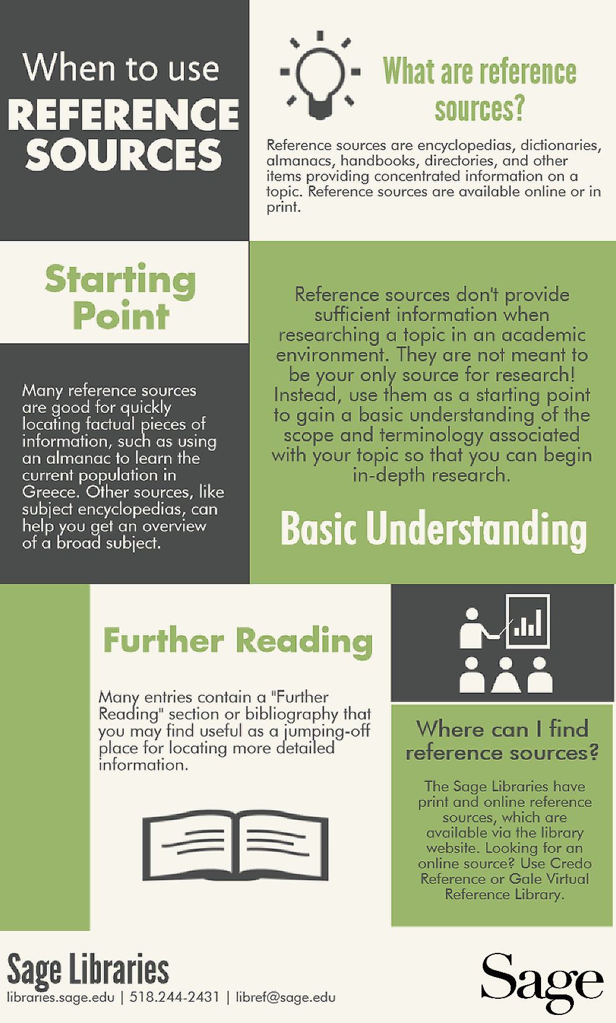

Slide 8
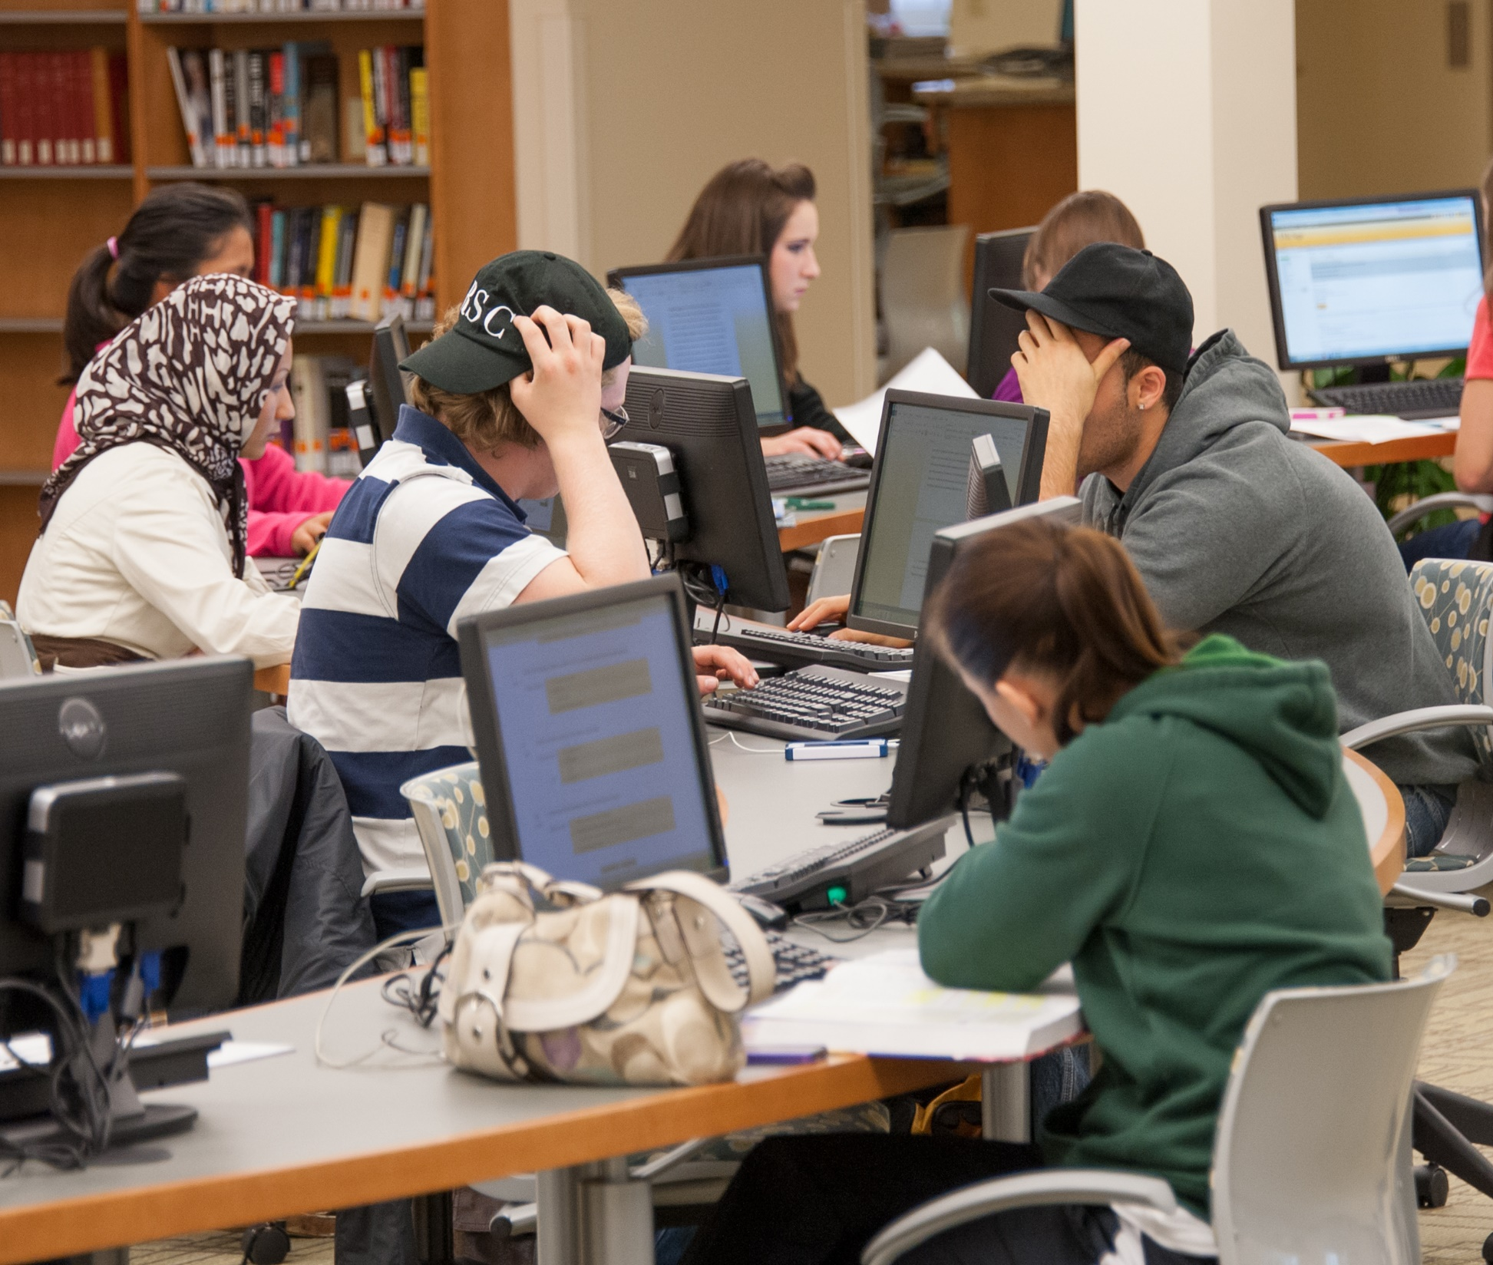
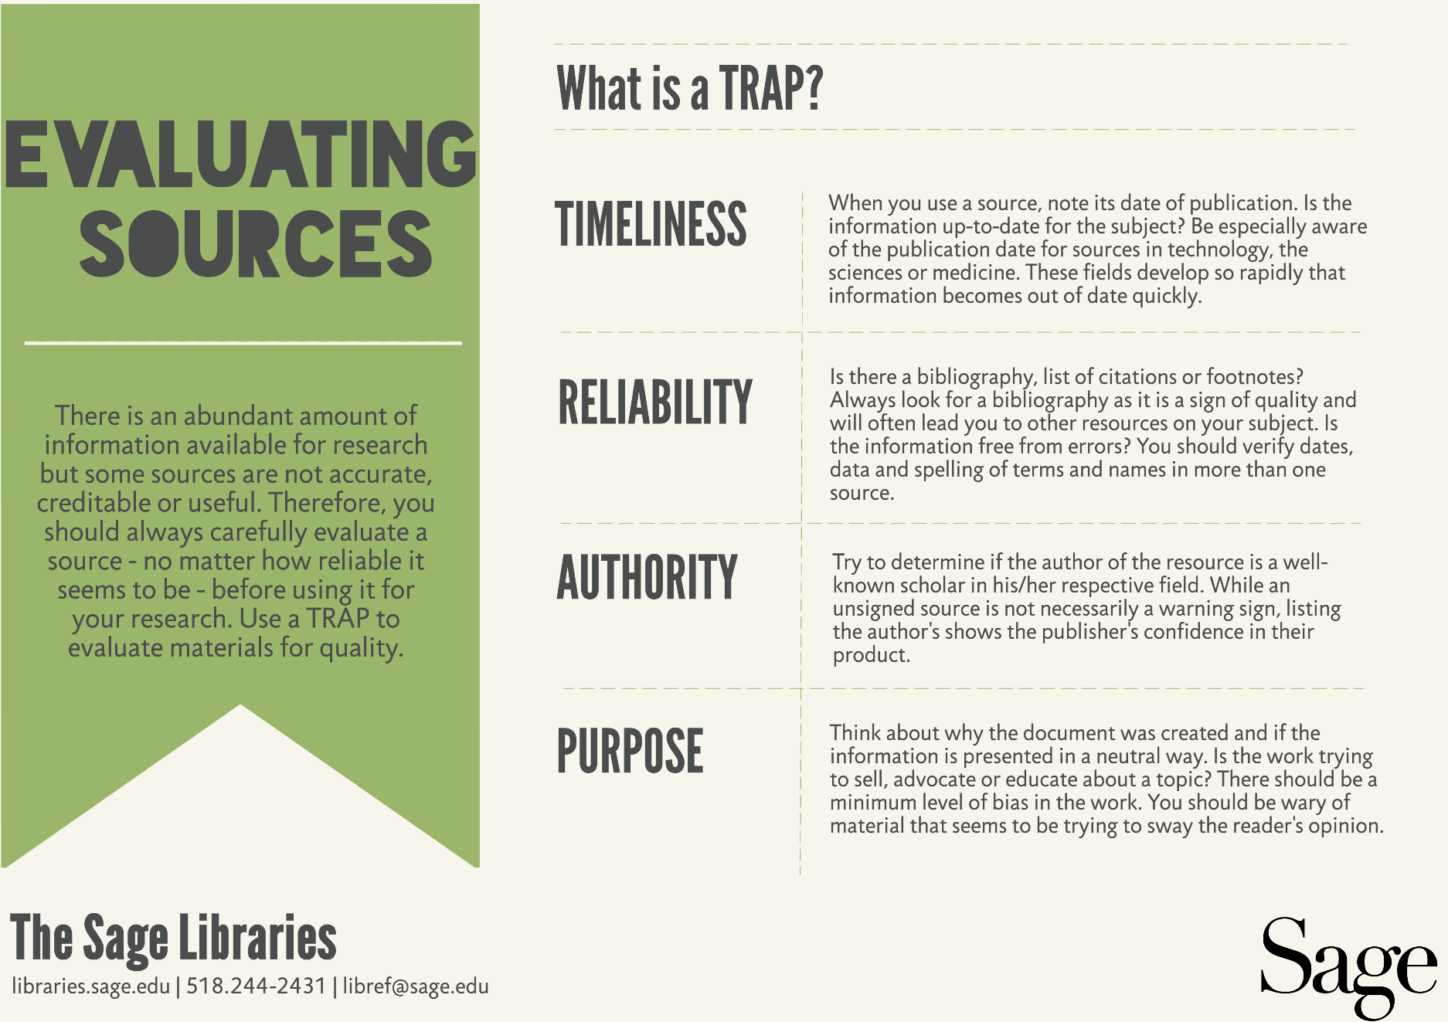
http://bit.ly/1A1SiUm
Notes:
Here’s another example of a Sage library tutorial infograph
As previously mentioned earlier, it is easy to embed piktocharts into websites or share them via social media
This particular infograph has been embedded into Sage’s research guide
Link – here’s one of our guides and in the evaluate your sources box, the piktochart is embedded
This particular box is in all of the guides

Slide 9
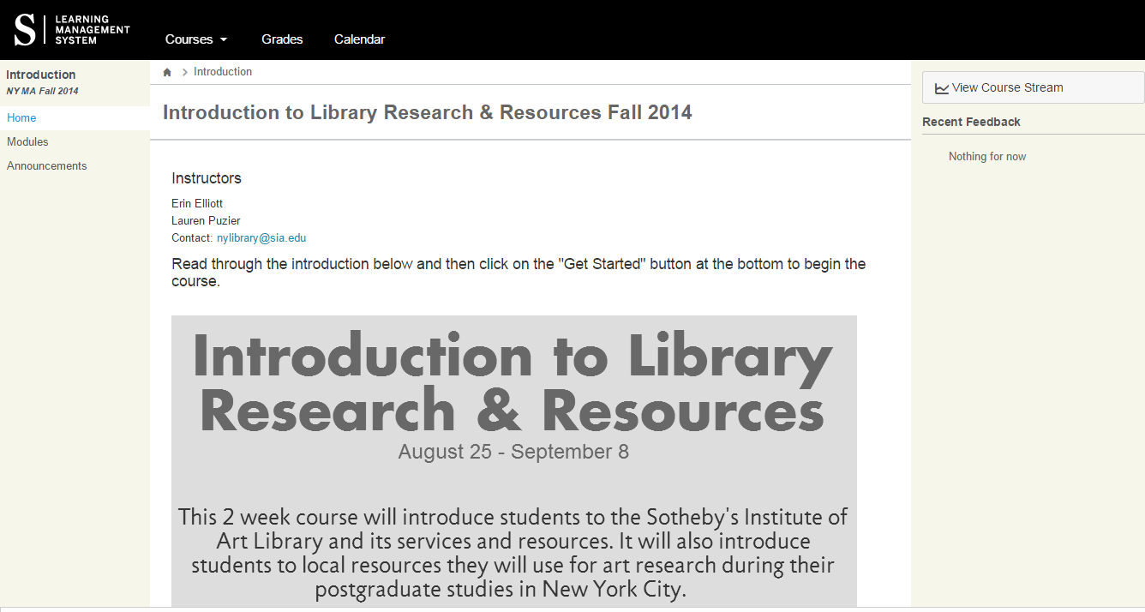
Incorporate into library information literacy courses
Notes:
Create dynamic syllabus for information literacy courses
Could also be turned into an assignment for students to reinforce the concepts of information literacy or visual literacy

Slide 10
Place Holder Slide
Switch to Application Sharing
https://online.sothebysinstitute.com/courses/35
Notes:
https://www.smore.com/mvhzf-library-newsletter

Slide 11
Create attractive posters and presentations
Notes:
Piktochart has a presentation feature
Sections of the piktochart are “turned” into slides and users are able to click through
Like the infographs, it’s easy to share especially across social media and easy to embed
Picture is of a presentation that was created to demonstrate how the Sotheby’s Library supports students that was put on a tv screen to be played on a loop during a student orientation event

Slide 12
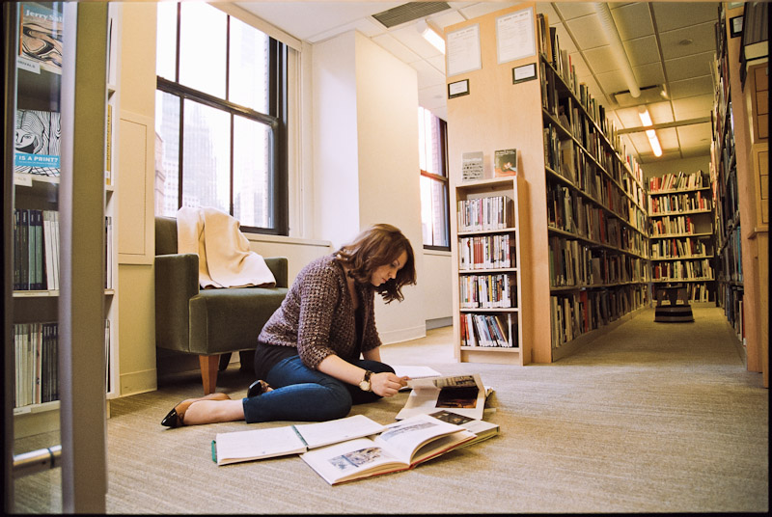
Notes:
Example of a poster made with Piktochart
Able to download high res files either as pdfs or image files
Also able to share directly to social media accounts

Slide 13
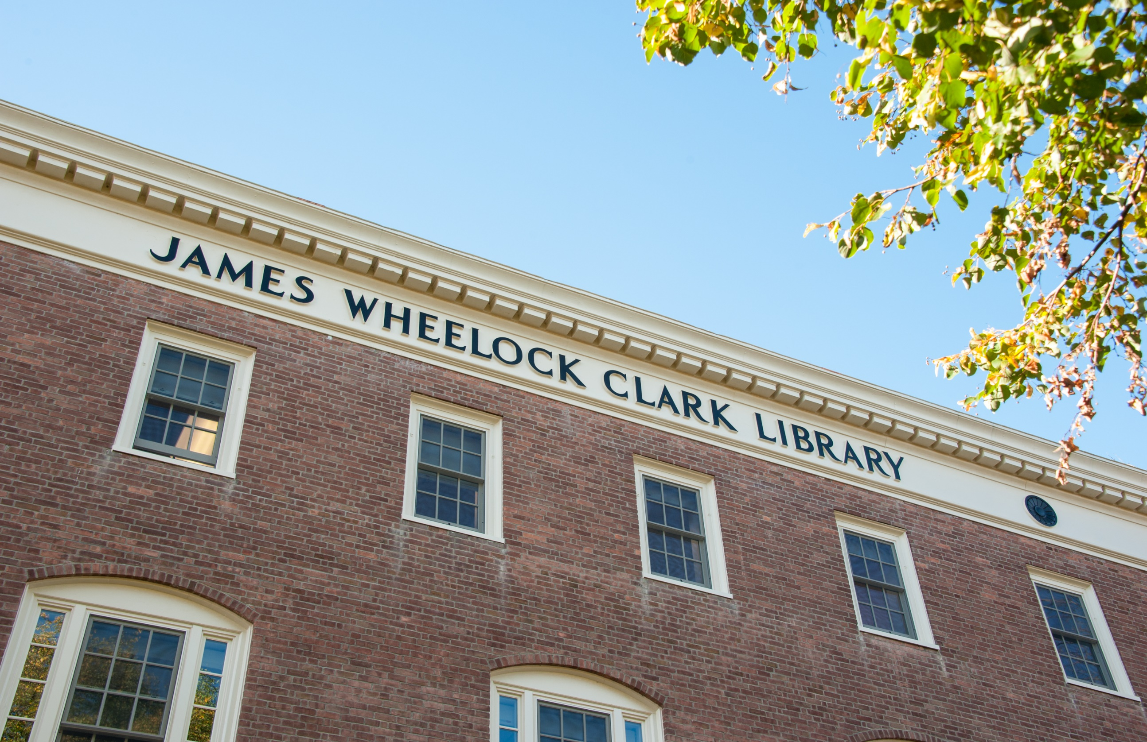
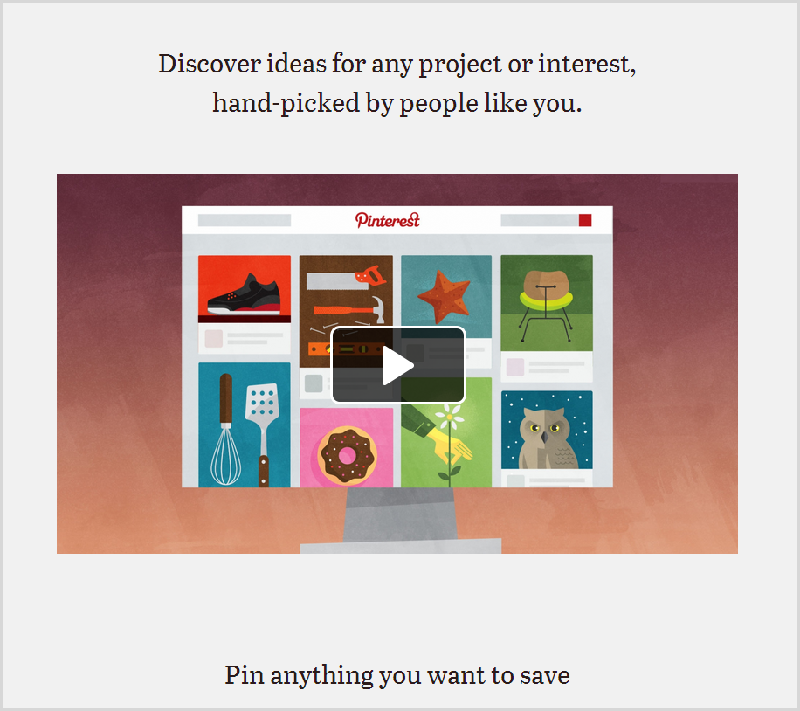
Pinterest
Notes:
The most popular tool/social media highlighted in this presentation
Is a visual discovery tools that allows users to create virtual pin boards. Users pin items to their boards, which can be images or videos
Pins are like bookmarks since they point back to the original source
Pinterest is a great tool for “Do-it-yourself” reference and bibliographic instruction as well as marketing and promotion

Slide 14
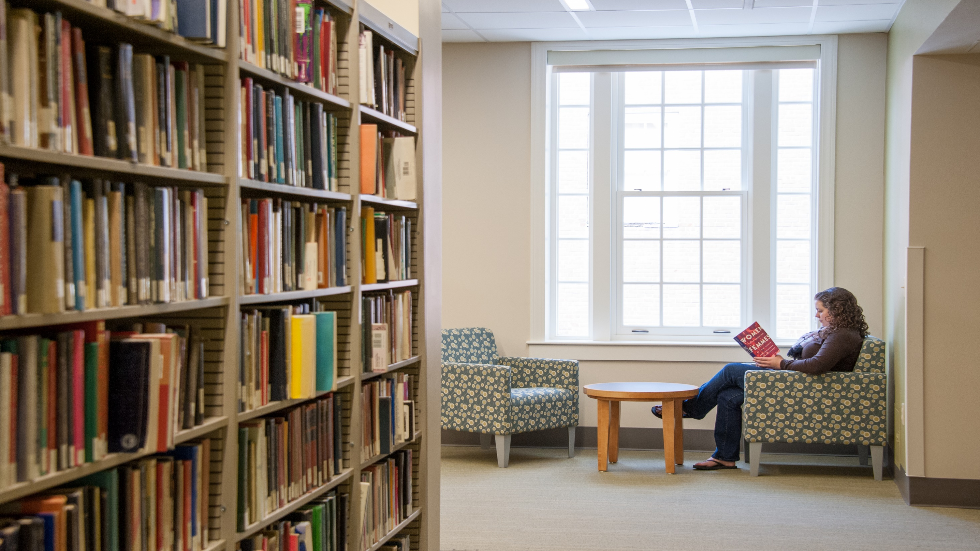
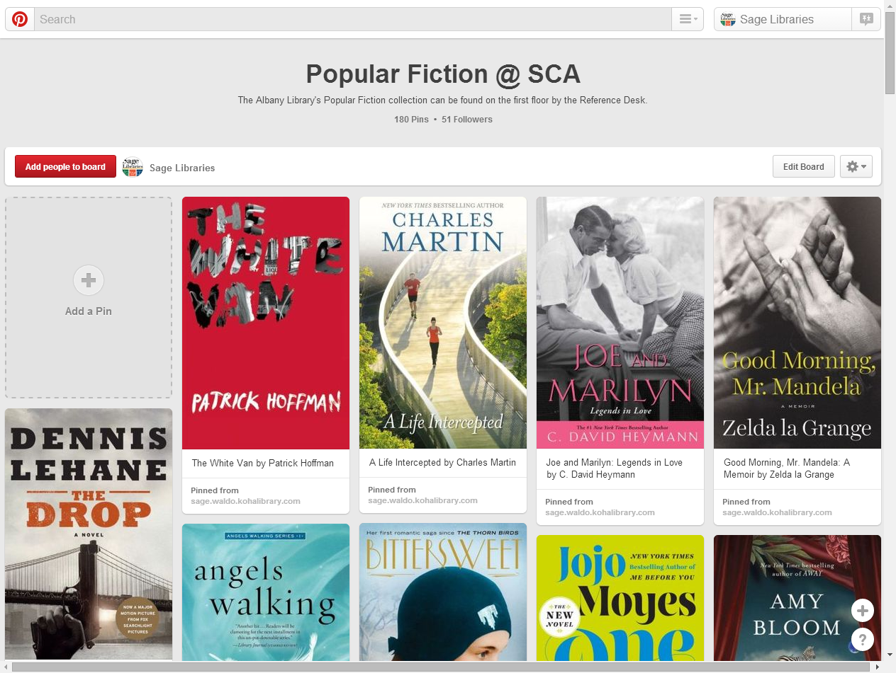
Collection development
Notes:
Pinterest is great for promoting collections
Are able to share pins to other social medias and can also link social media through tools like IFTTT
Also can be used for collection development
Multiple people could be added to a board so if multiple librarians collect for the same area, a pinterest board could be used to share ideas or keep things organize to avoid duplication
Can gauge what’s popular by how many times an item is repinned
Could also create a board for book recommendations. Invite community members to pin wishlist items to one board or have a community current reads board.
Right now, only able to invite people to pin to board, there isn’t an option that allows users to request to pin to a board
Example of large public board: Librarian’s List

Slide 15
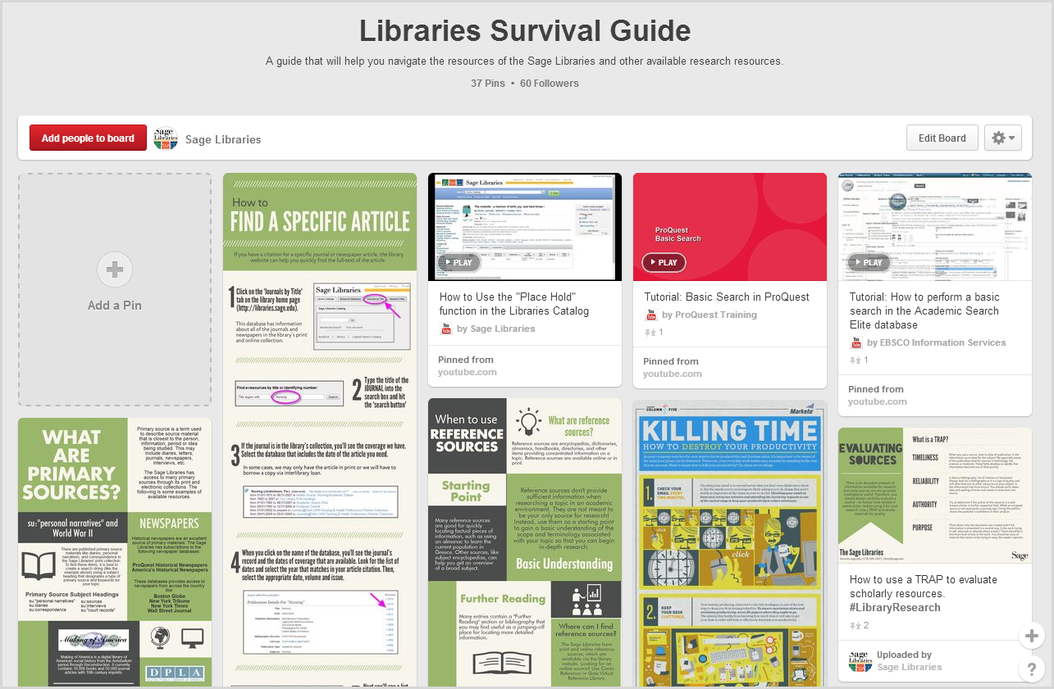
DIY reference

Slide 16
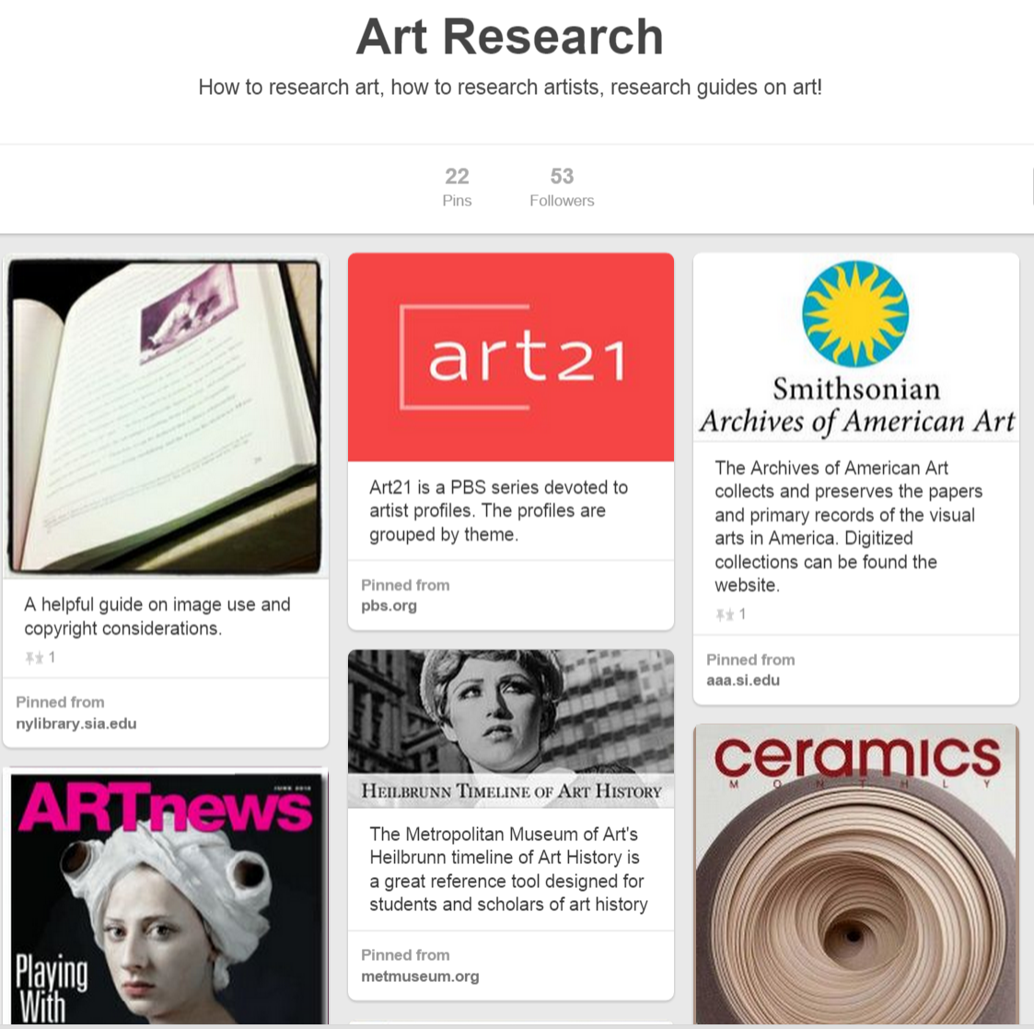
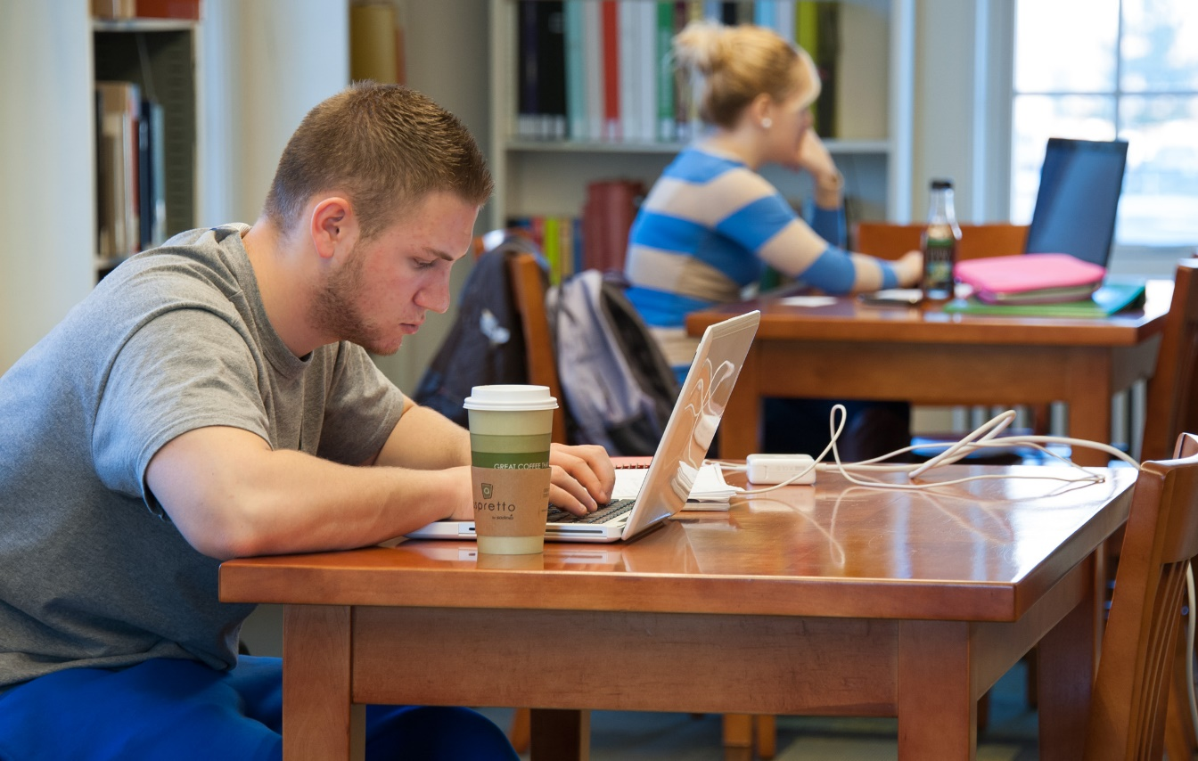
http://bit.ly/1D542rf

Slide 17
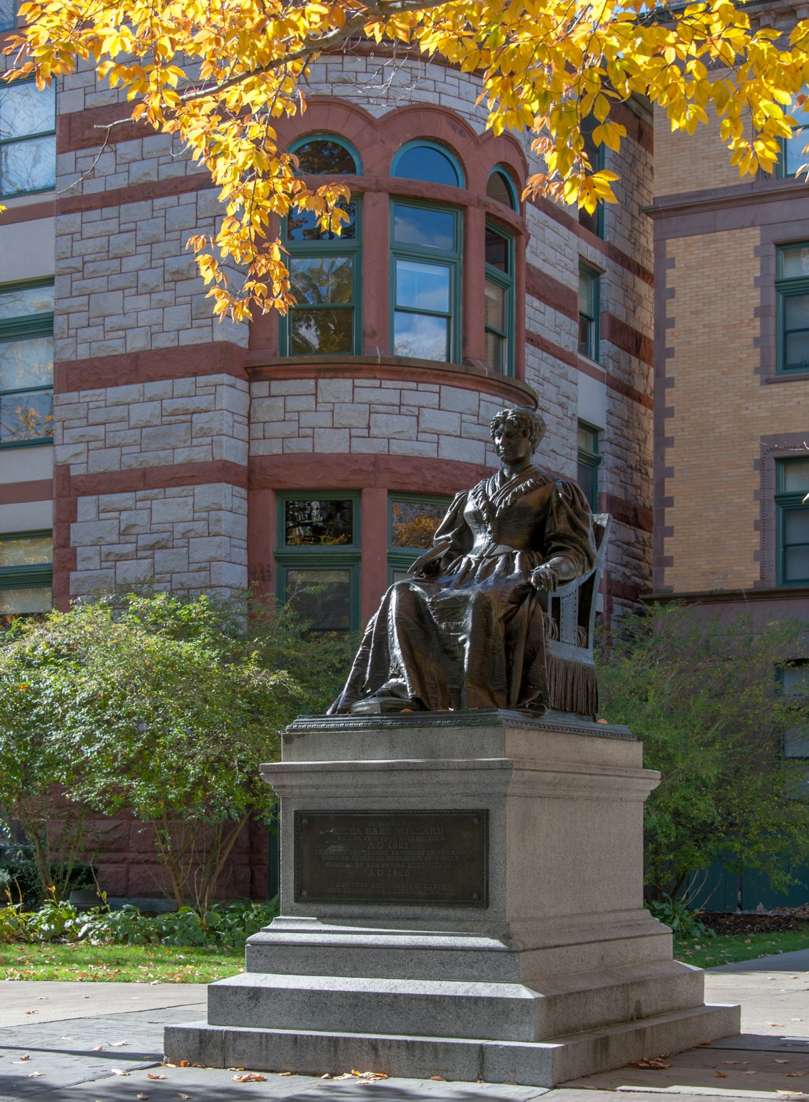
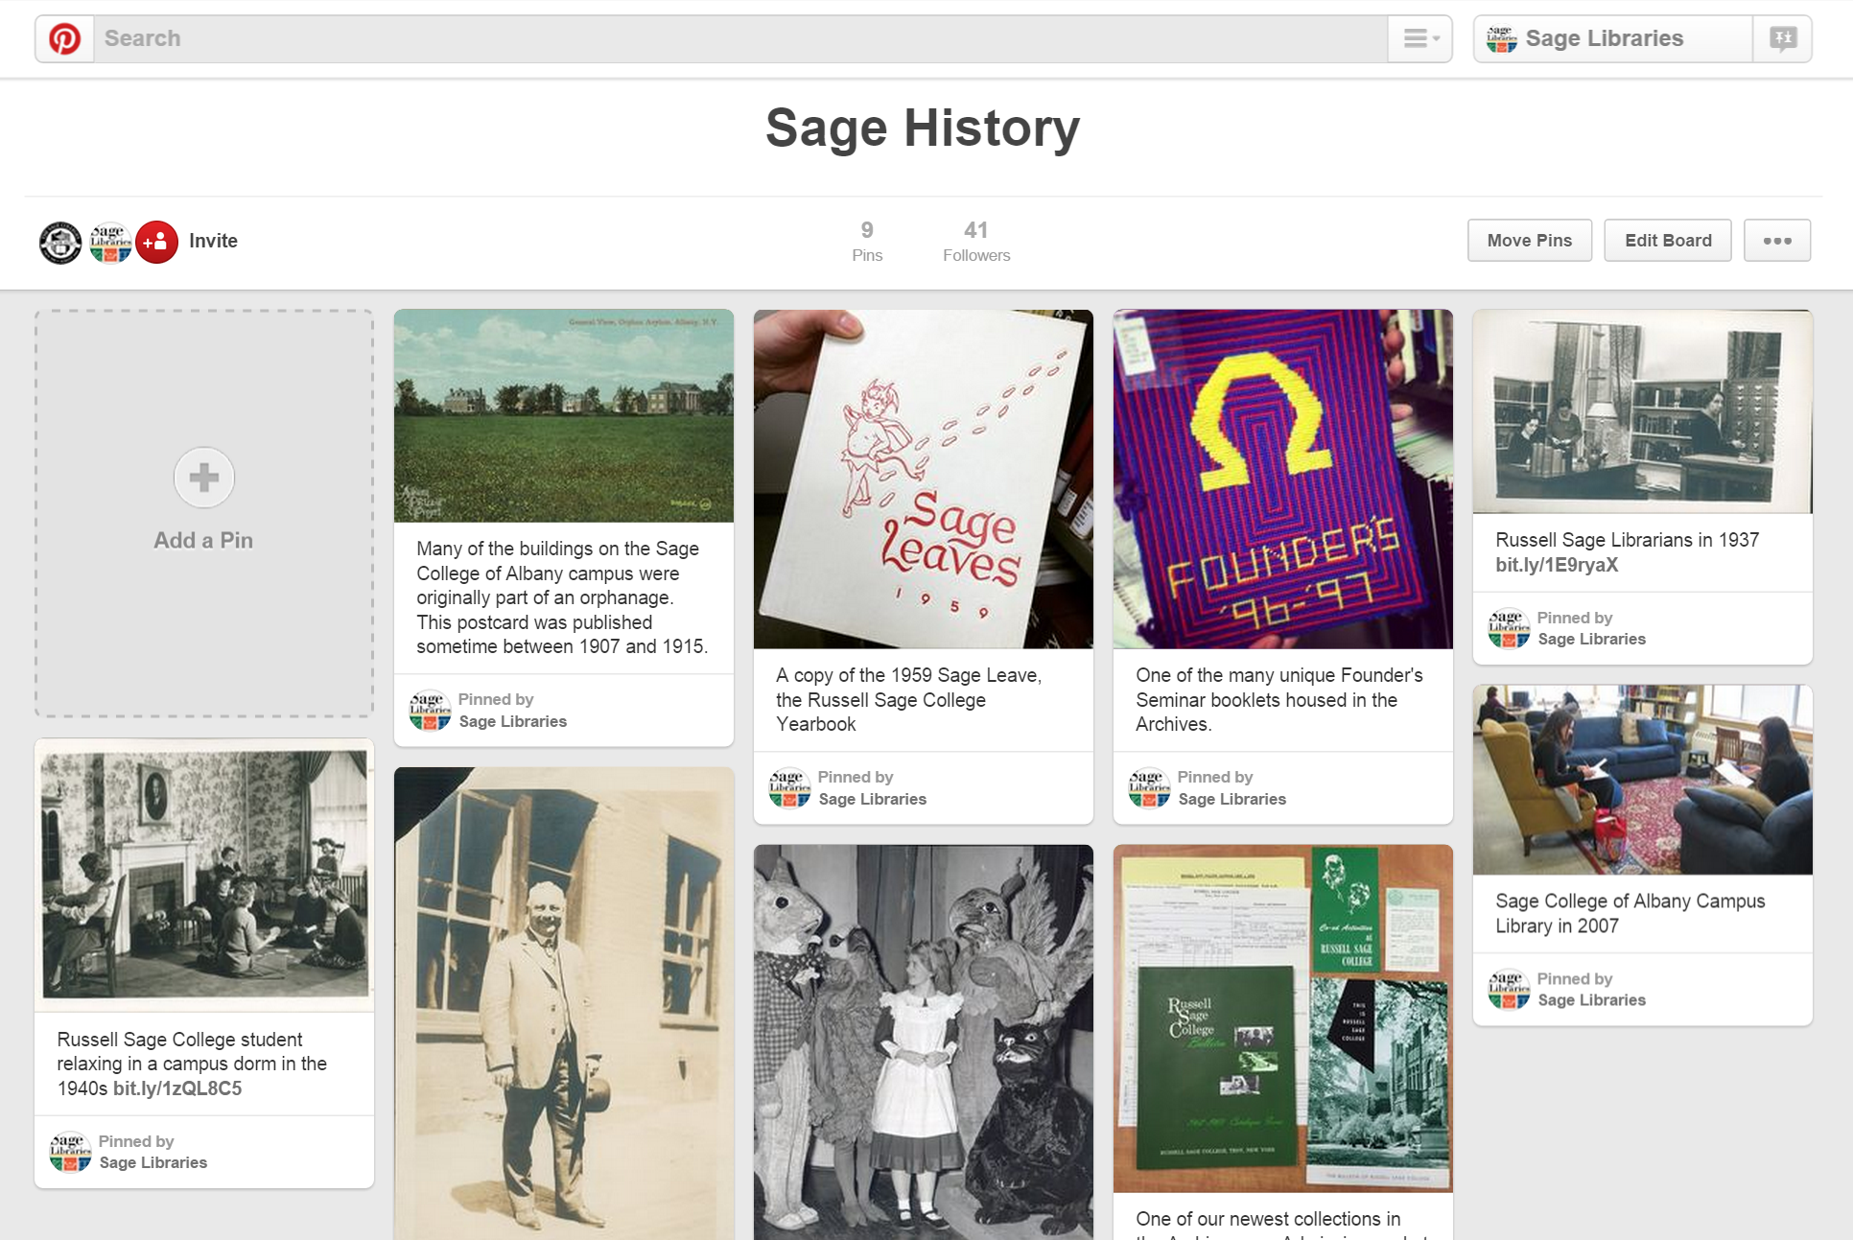
Collaborative boards with other campus departments
Notes:
As mentioned previously, collaborative boards are possible
Another use is to create collaborative boards with other campus departments in order to promote the library’s collections and services
This particular example is a Sage History board that is on the main Sage College’s pinterest page
Library followers and college followers are able to see this board – broadens the reach
Great way to work with departments outside of the library and get beyond the library’s bubble

Slide 18
POLL
Does your library have a newsletter or send out informational emails?
Yes
No

Slide 19
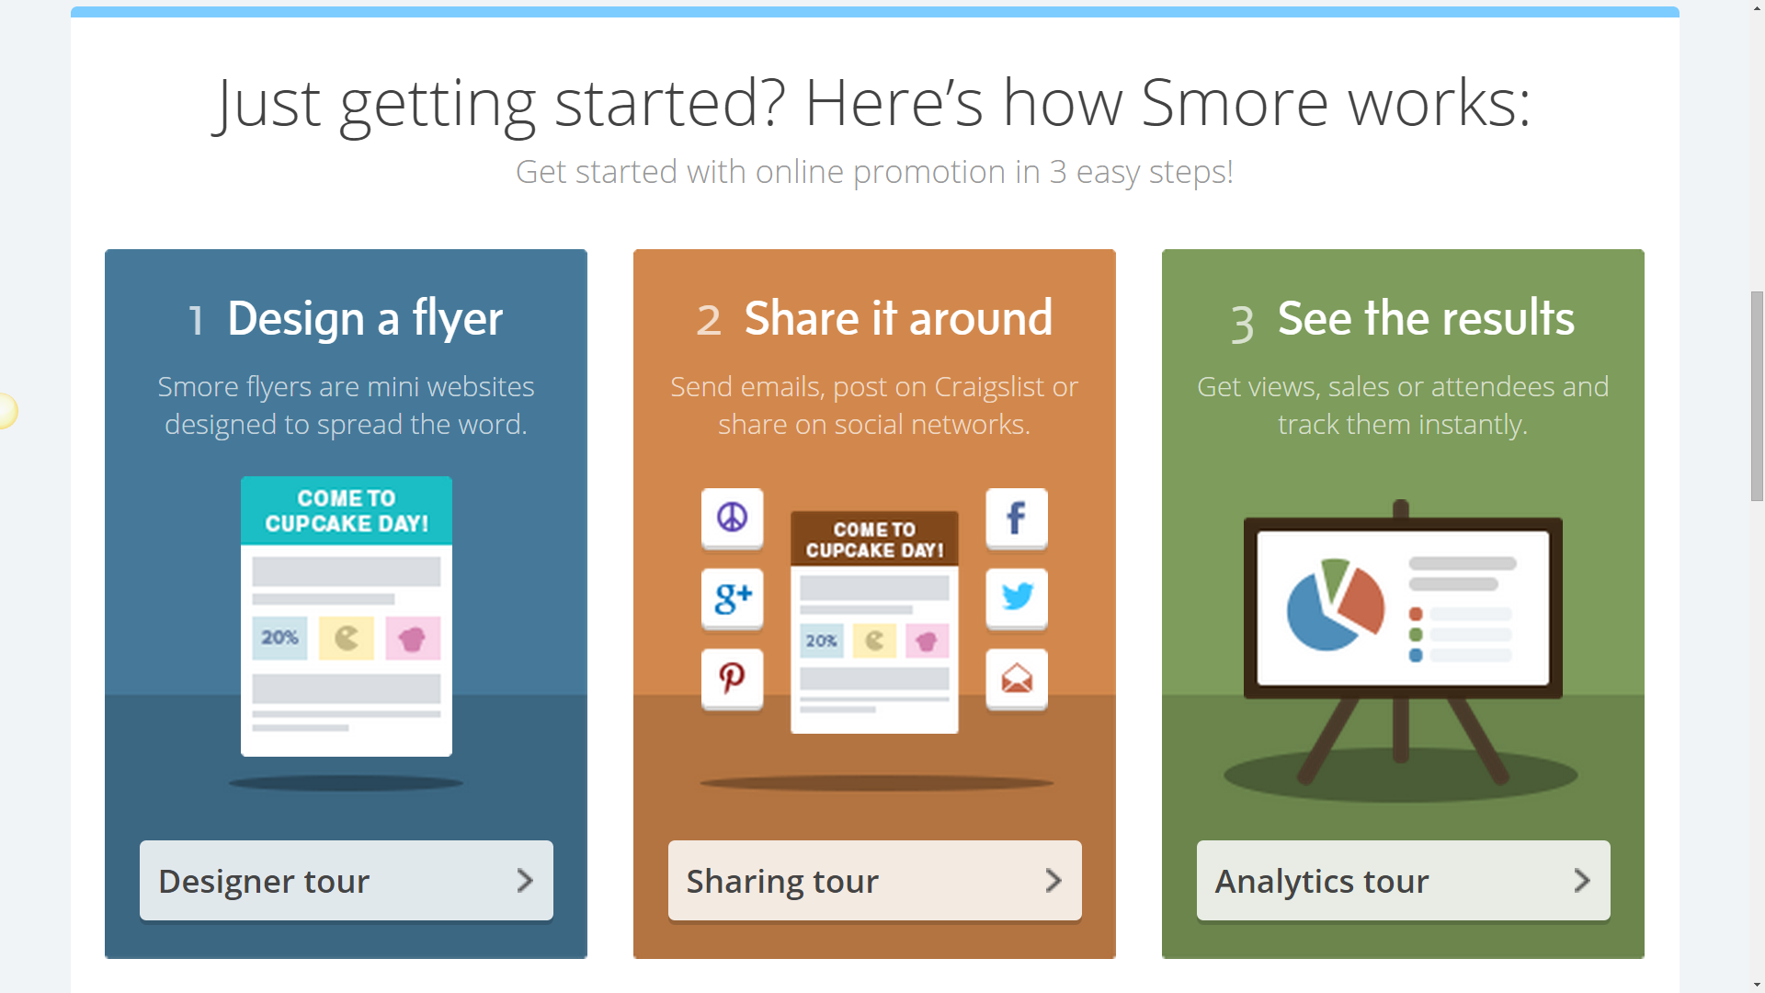
Smore
Notes:
SMORE – A tool to create flyers. You can add different types of sections to the flyer such as text, image galleries, embedded videos from youtube, vimeo etc., event boxes with dates, times maps,
Share flyers a variety of ways – make them easily accessible to your patrons
See results – analytics of views and interactions with flyers – how many ppl viewed them, what links were most clicked, how long people had the flyer open, geographic analytics….
How are we using them in the library???

Slide 20
Online flyers for faculty, staff and student monthly updates
Online monthly newsletters
Notes:
Online flyers for faculty, staff and student monthly updates

Slide 21
Place Holder Slide
Switch to Application Sharing
https://www.smore.com/670d1
Notes:
https://www.smore.com/mvhzf-library-newsletter

Slide 22
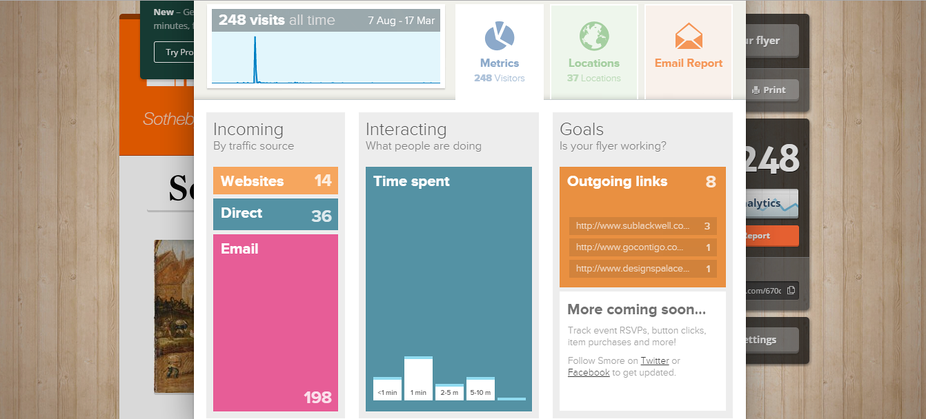
View Flyer Analytics

Slide 23
Print library flyers for folders given out at Orientation Week
Notes:
Paper flyers for inserts in packets given out to new students during orientation week

Slide 24
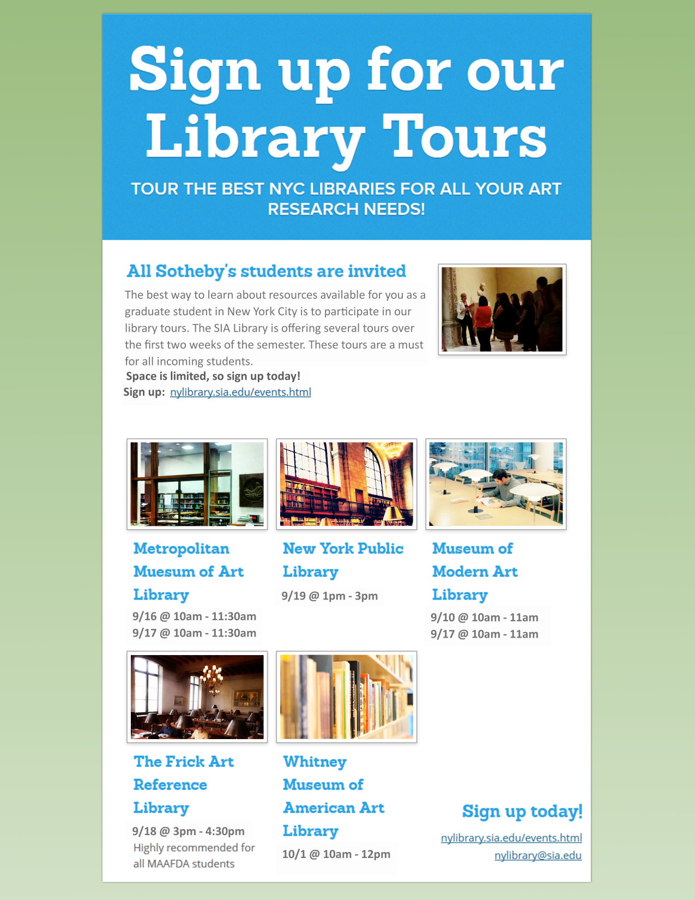
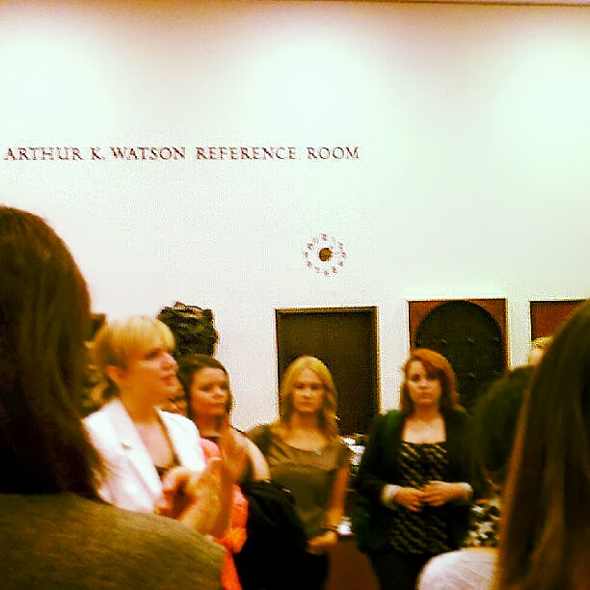
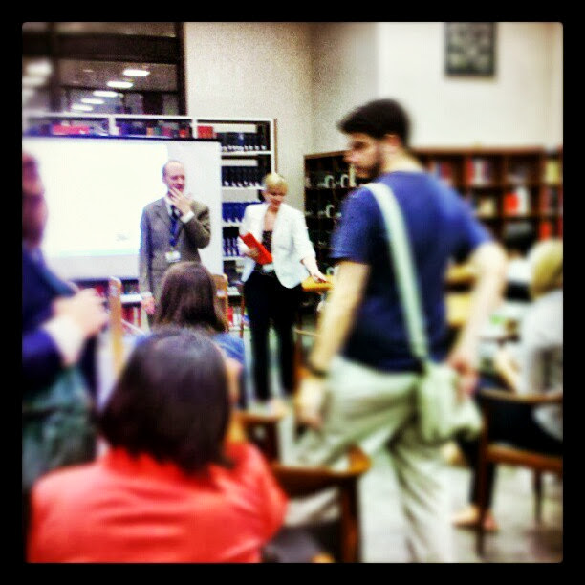
Flyers to promote library events and classes
Notes:
Flyers for promoting library sessions and events

Slide 25
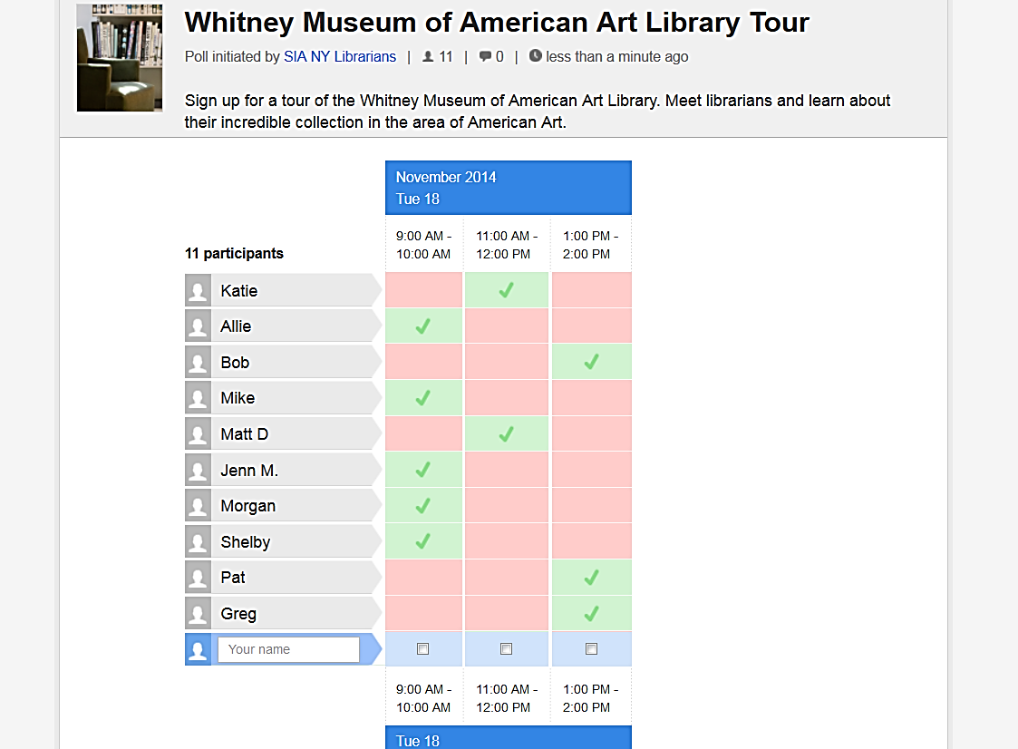
Doodle
Students add their name and select
a time
Schedule library events online
Notes:
They are taken to a Doodle Poll to select the tour time that works for them.
This is our 4th social sharing tool of the day: Doodle.
Doodle is an online scheduling tool that allows you to create polls and distribute through a link.
In this case we created a poll to function as an online sign up sheet for library tours. Students accessed the poll through our Smore flyer and can fill in their name and the tour time that they want to attend. There is an option to require an email address on-submit which we took advantage of. Once we received their email and the tour time, we could send out further instructions – confirmations of dates, directions to the library, rules at each library and so on.
I have included links on the slide pages but all of these links and more are available on our blog so you can check them out later.

Slide 26
Schedule one-on-one reference sessions
Notes:
Doodle also allows you to create an ‘appointment scheduler’ where students can Schedule one on one reference consultations
http://doodle.com/nylibrary with the librarians. You simply select what hours and dates librarians are available on Doodles Meet Me Page and share the link to your calendar on the website. Students can access this page and request appointments when they are free.

Slide 27
Research Library Visit Poll
Survey patrons for the best times for future events
Notes:
The third way that we are using doodle at the library is to create surveys. Surveys are another function Doodle offers. We Survey patrons to find the best times for future meetings or events.
One example is after students received their schedules in the fall we sent out surveys to see when they would be most able to attend library events. I was organizing some sessions on image research and legal research and created a survey with some dates and time options. As students clicked our survey link and filled out the dates and times that worke dbest for them we reiceved the resutls from doodle telling us what the best times were. It made scheduling so easy and we were able to offer our sessiosn at times when most students could make it.
We ended up calling them library early bird sessions because the best time was around 8am during the week.
http://doodle.com/7upzu3xthmr86w96

Slide 28
Bunkr
BUNKR
Create on-the-go presentations
Notes:
Our 5th social sharing tool is BUNKR
Bunkr is a web-based presentation tool. It is a lightweight application that creates eye-catching slides. You can also download and export your presentations. Once you publish your presentation it will be accessible by a U-R-L. Take this with you and you can access your presentation on any device that has internet or wifi enabled. We love Bunkr because it is easy, has a nice UI and of course great for on-the-go slideshows and presentations. It is a great tool for Pecha Kucha presentations and, of course, for sharing with students. How we are using it:
Bunkr’s sleek user-interface makes it ideal for Interactive presentations. An example is an informational presentation you have created (or slide show) that accompanies a library exhibition or a library display. They can be displayed on iPads, tablets or a large touch screen display. You can also share a QR code to the presentations so that when students scan the code the Bunkr is brought up on their phone.
These could be on iPads (that accompany library displays) or a large touch-screen display
How do I tutorials for quick sharing during Virtual Reference
Interactive presentations and on the go presentations
http://bunkrapp.com/dashboard/

Slide 29
Place Holder Slide
Switch to Application Sharing
http://bunkrapp.com/present/i3aoxu/?utm_medium=share

Slide 30
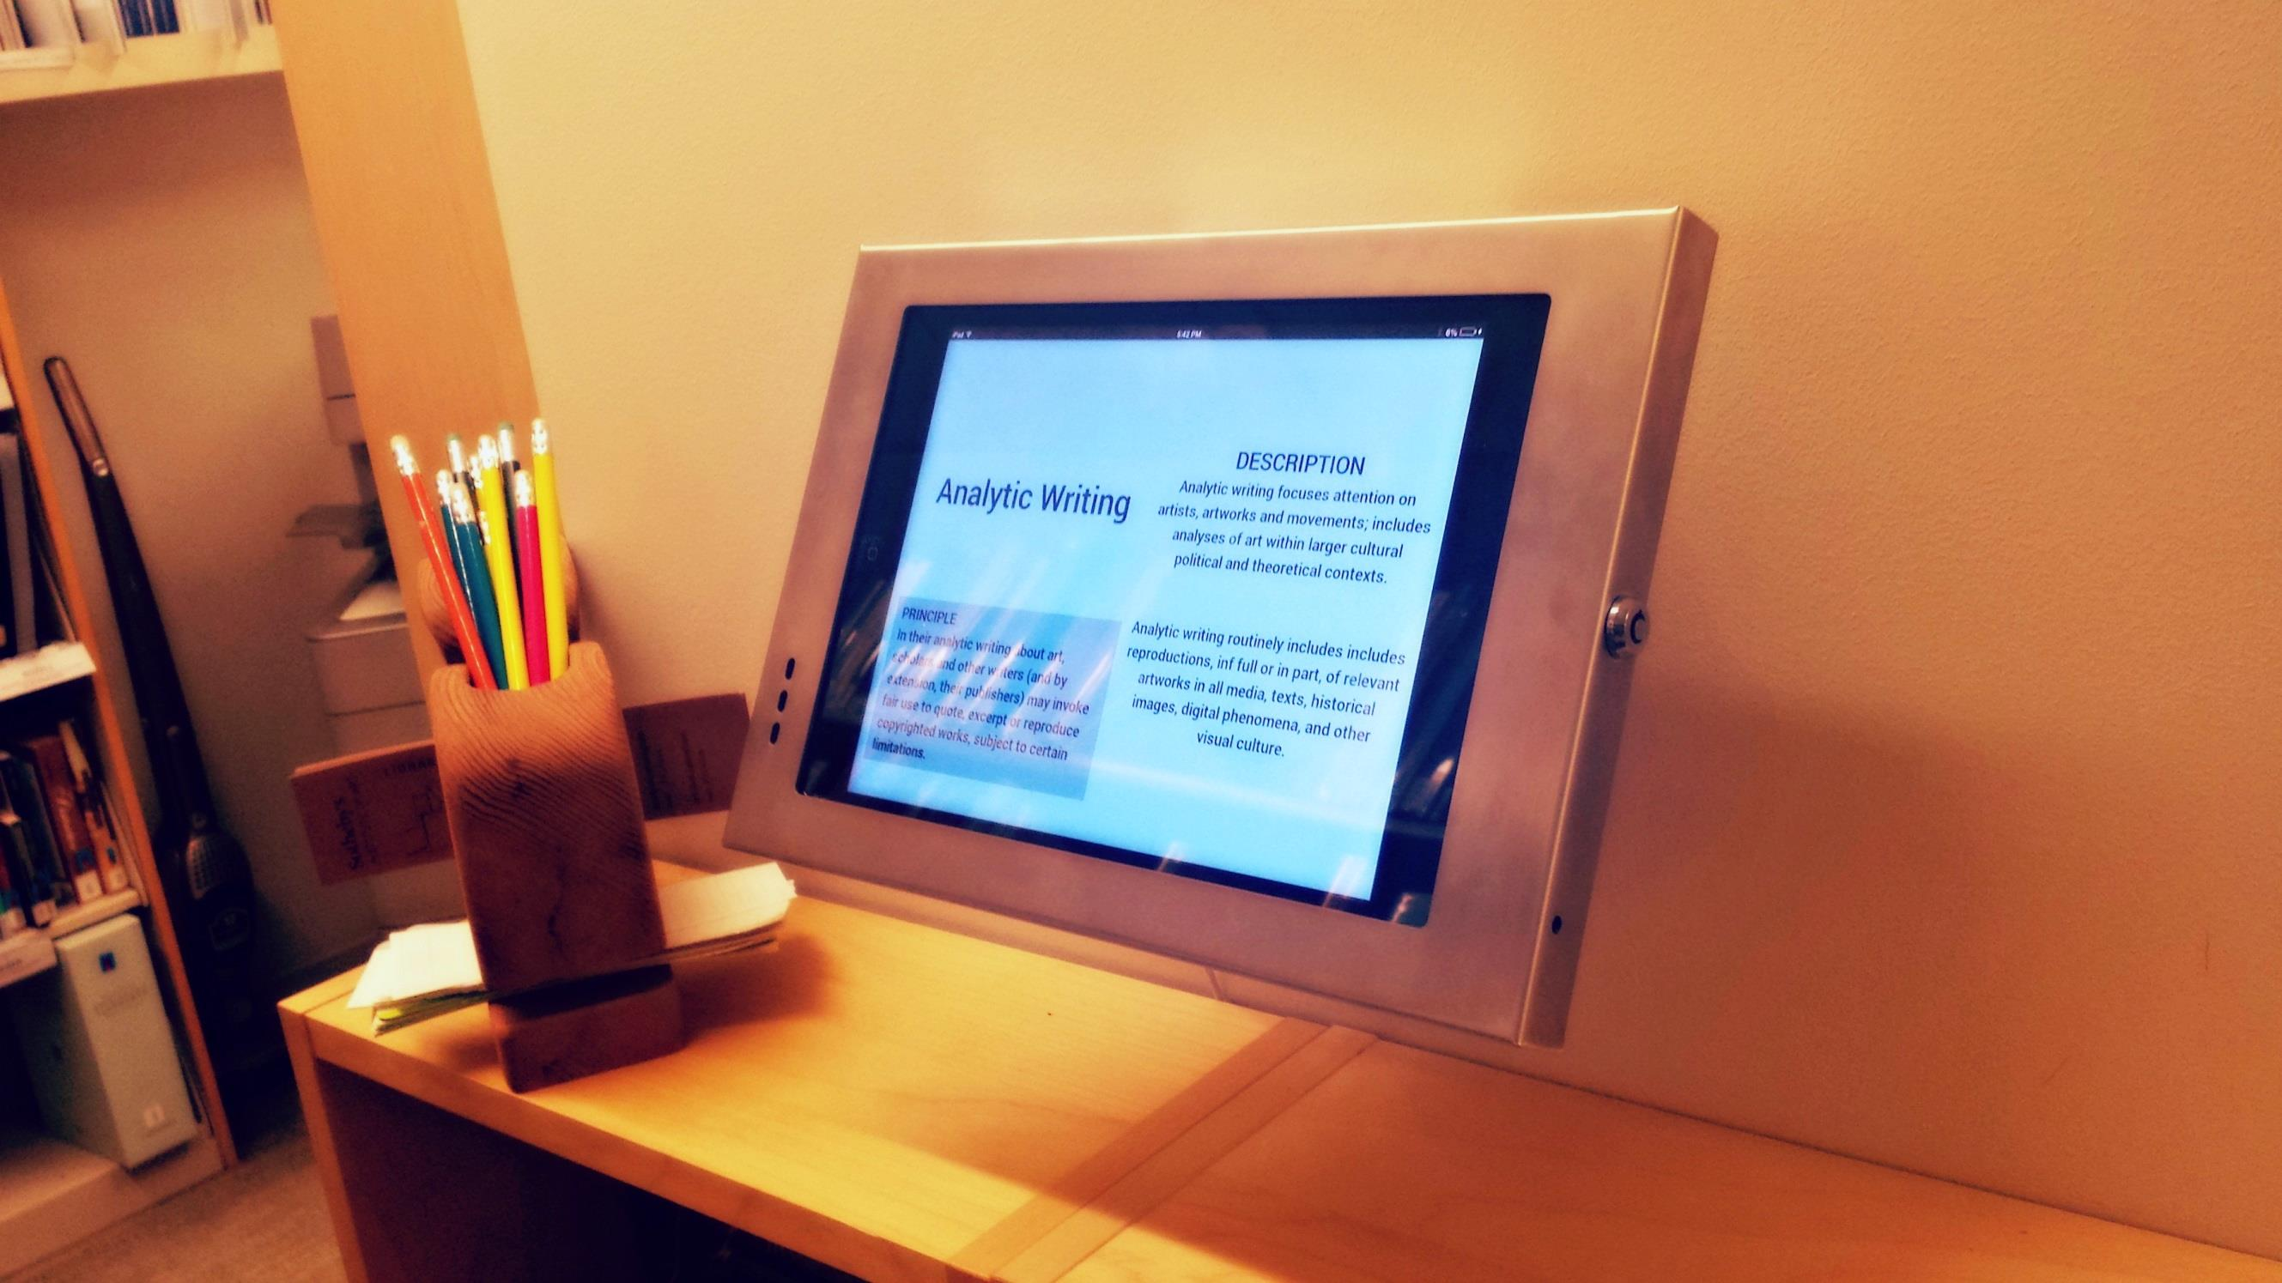
Students can
advance this presentation by swiping
Display interactive presentations
Notes:
Bunkr’s sleek user-interface makes it ideal for Interactive presentations. An example is an informational presentation you have created (or slide show) that accompanies a library exhibition or a library display. They can be displayed on iPads, tablets or a large touch screen display. You can also share a QR code to the presentations so that when students scan the code the Bunkr is brought up on their phone.
These could be on iPads (that accompany library displays) or a large touch-screen display

Slide 31
How-Do-I tutorials for Virtual Reference + for the DIY patron
Notes:
How do I tutorials for Virtual Reference chat and for the DIY patron. Bunkr presentations that are short, visual and to the point are great for the do it yourself student and for students looking to get information when staff are not available. They can be embedded on the library website or Learning Management System, they can be added as a link in a subject guide or even posted on facebook. Students can bookmark them or share them.
Having these tutorials premade is also very handy when doing Virtual Reference. You can send the bunkr link through your chat application or SMS message and students can access it from where ever they may be.

Slide 32
Easy-to-share presentations for Information Literacy sessions
Notes:
The third way we are using Bunkr is as a Presentation platform for library events and information literacy sessions. Earlier I mentioned we held Early Bird sessions on a variety of topics. I was able to create my presentations for these sessions in Bunkr and use Bunkr during the session. After the session concluded I could email the students who attended the link to the presentation so they could have it for their notes or to revisit at a later time.

Slide 33
Visit our blog:
http://pinssmoresanddoodles.blogspot.com/
Abby Lauren
stamba@sage.edu l.Puzier@sia.edu
Notes:
You can check out live examples of how we are putting these tools to work at our libraries by visiting our blog: Pins Smores And Doodles.blogspot.com

